Slide 1
Unit 7:
Quantum Theory, Electron Configuration, and Periodicity
Pre-AP Chemistry

Slide 2
Electromagnetic Radiation
Electromagnetic radiation consists of energy created by means of electric and magnetic fields that alternately increase and decrease in intensity as they move through space.
Visible light, x-rays, microwaves, and radio waves are familiar types of electromagnetic radiation.
Visible light is the only electromagnetic radiation humans can see.
The different types of electromagnetic radiation can be characterized by wavelength and frequency and shown on a scale.

Slide 3
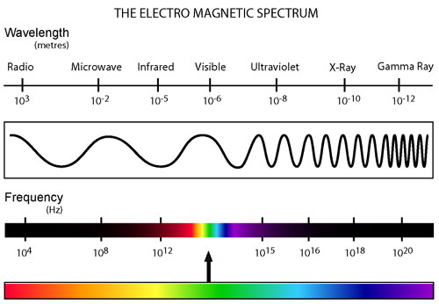
Electromagnetic Spectrum

Slide 4
Wavelength and Frequency
Electromagnetic radiation can be described by wavelength and frequency.
  Wavelength (λ) is the distance between any point on a wave and the corresponding point on the next wave.
    Expressed in meters (or nm, pm, or Ǻ)
  Frequency (ν) is the number of cycles the wave undergoes per second.
    Expressed in s⁻¹, also called hertz (Hz)
Wavelength and frequency are inversely related (as wavelength increases, frequency decreases and vice versa)
The product of wavelength and frequency for all types of electromagnetic radiation is a constant called the speed of light (c).
  c has a value of 3.00 x 10⁸ m/s

Slide 5
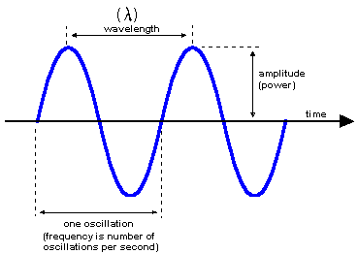
Frequency vs. Wavelength

Slide 6
Wavelength/Frequency Examples
Find the frequency of blue light that has a wavelength of 400 nm.
Find the wavelength of light that has a frequency of 1.50 x 10¹⁵ s⁻¹.
Find the frequency of television waves that have a wavelength of 37 mm.

Slide 7
The Particle Nature of Light
Max Planck discovered that when an object emits or absorbs energy, it does so only in certain quantities of energy.
  Each energy packet is called a quantum and has an energy equal to hν.
    h (Planck’s constant) = 6.626x10⁻³⁴ J·s
  When the quanta of energy are visible light, they are called photons.

Slide 8
Calculating Energy Quantities
Determine the energy of red light that has a frequency of 0.85 x10¹⁵ Hz.
Determine the energy of x rays that have a wavelength of 10. nm.
Determine the wavelength of light that has a energy of 6.2 x10⁻¹⁹ J

Slide 9

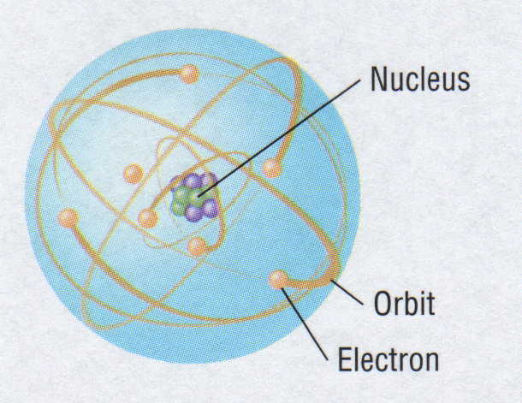
Bohr Model
After Rutherford discovered the nucleus, Bohr proposed that electrons travel in definite orbits around the nucleus.
Neils Bohr
Planetary Model

Slide 10
Bohr Model of Atom
Increasing energy
of orbits
n = 3
n = 2
n = 1
e⁻
A photon is emitted
with energy E = hf
The Bohr model of the atom, like many ideas in
the history of science, was at first prompted by
and later partially disproved by experimentation.
Notes:
10
In 1913, Niels Bohr proposed a theoretical model for the hydrogen atom that explained its emission spectrum.
– His model required only one assumption: The electron moves around the nucleus in circular orbits that can have only certain allowed radii.
– Bohr proposed that the electron could occupy only certain regions of space
– Bohr showed that the energy of an electron in a particular orbit is
E_{n} = – ℜhc
n²
where ℜ is the Rydberg constant, h is the Planck’s constant, c is the speed of light, and n is a positive integer corresponding to the number assigned to the orbit.
n = 1 corresponds to the orbit closest to the nucleus and is the lowest in energy.
A hydrogen atom in this orbit is called the ground state, the most stable arrangement for a hydrogen atom.
As n increases, the radii of the orbit increases and the energy of that orbit becomes less negative.
A hydrogen atom with an electron in an orbit with n >1 is in an excited state — energy is higher than the energy of the ground state.
Decay is when an atom in an excited state undergoes a transition to the ground state — loses energy by emitting a photon whose energy corresponds to the difference in energy between the two states.

Slide 11
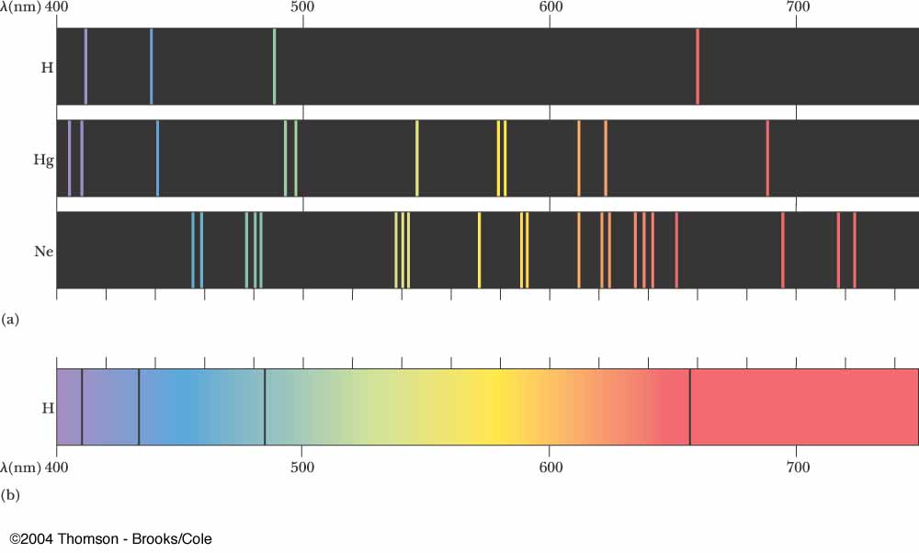
Atomic Spectra
Scientists found that when a gaseous element is heated, it will emit light in discrete, unique patterns of wavelengths.
Each element has its own unique atomic spectra.

Slide 12
Energy of an Orbit
The energy of an orbit with a number n (energy level) and nuclear charge (Z) is
Calculate the energy of the light associated with an electron moving from the second to the fourth energy level in a hydrogen atom.

Slide 13
Rydberg Equation
The mathematical equation used to predict the position and wavelength of any line in a given series is called the Rydberg equation:
n₁ and n₂ refer to the energy levels of the electrons and n₁<n₂.
R is the Rydberg constant equal to 1.096776x10⁷ m⁻¹)
Line spectra result from the emission of light by atoms and therefore represent electrons in excited atoms dropping from high orbits to lower ones.

Slide 14
Using the Rydberg Equation
Calculate the wavelength of an electron in a hydrogen atom transitioning from the level n = 4 to n = 2.
Calculate the frequency of electromagnetic radiation emitted by a hydrogen atom in the electron transition from n = 3 to n = 2.

Slide 15
Understanding Bohr
Bohr’s contributions to the understanding of atomic structure:
    Electrons can occupy only certain regions of space, called orbits.
    Orbits closer to the nucleus are more stable — they are at lower energy levels.
    Electrons can move from one orbit to another by absorbing or emitting energy, giving rise to characteristic spectra.
Bohr’s model could not explain the spectra of atoms heavier than hydrogen.
Bohr was able to use his model hydrogen to:
  Account for the observed spectral lines.
  Calculate the radius for hydrogen atoms.
His model did not account for:
  Atoms other than hydrogen.
  Why energy was quantized.

Slide 16
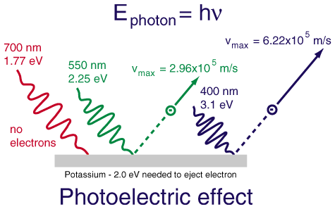
Photoelectric Effect
The photoelectric effect refers to electrons being emitted from substances when they absorb energy from light.
The electrons emitted are referred to as “photoelectrons”.
The energy of the photons is used to eject the electron from an atom (ionization). Any remaining energy from the photon contributes to the speed of the electron.

Slide 17
Waves and Particles
Experiments proved that energy behaved in a particle like manner (quanta of energy).
Louis de Broglie hypothesized that matter could behave as a wave as well as a particle. He applied this hypothesis to the electron.
Energy of a wave is given by E = hv.
Energy of a particle is given by E = mc².
Since electron’s can have only one energy, both energy equations must be equal
Dual character of matter and energy is known as the wave-particle duality.

Slide 18
de Broglie Wavelength
de Broglie derived an equation for the wavelength of any particle of mass m moving at speed u:
According to this equation, matter behaves as though it moves in a wave.
An object’s wavelength is inversely proportional to its mass.
  Heavy objects such as planets have wavelengths that are many orders of magnitude smaller than the object itself

Slide 19
Heisenberg Uncertainty Principle
Werner Heisenberg postulated the uncertainty principle, which states that it is impossible to know simultaneously the exact position and momentum of a particle.
This principle means that fixed paths for electrons cannot be assigned.

Slide 20
Quantum Mechanical Model
Modern atomic theory describes the electronic structure of the atom as the probability of finding electrons within certain regions of space (orbitals).
  Complex wave equations are used to describe the orbitals (Schrodinger).
The atom is mostly empty space.
Two regions
  Nucleus
    protons and neutrons
  Electron cloud
    region where you might find an electron

Slide 21

Schrodinger’s Cat

Slide 22
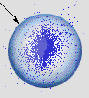
Quantum Mechanics
Orbital (“electron cloud”)
  Region in space where there is 90% probability of finding an electron
90% probability of
finding the electron
Electron Probability vs. Distance
40
30
20
Electron Probability (%)
10
0
0
50
100
150
200
250
Distance from the Nucleus (pm)
Orbital
Notes:
22

Slide 23
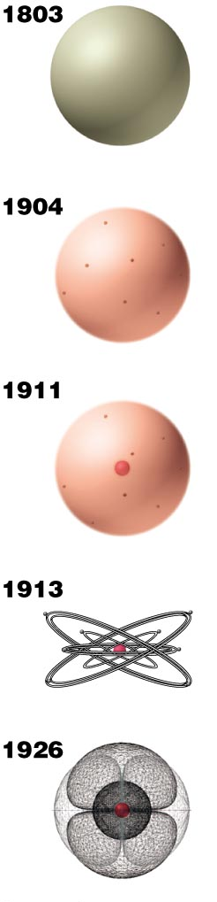
Review Models of the Atom
Dalton proposes the
indivisible unit of an
element is the atom.
Thomson discovers
electrons, believed to
reside within a sphere of
uniform positive charge
(the “plum-pudding model).
Rutherford demonstrates
the existence of a positively
charged nucleus that
contains nearly all the
mass of an atom.
Bohr proposes fixed
circular orbits around
the nucleus for electrons.
In the current model of the atom,
electrons occupy regions of space
(orbitals) around the nucleus
determined by their energies.
Notes:
Atomic Theory I
The Early Days
by Anthony Carpi, Ph.D. http://www.visionlearning.com/library/modulo_espanol.php?c3=&mid=50&ut=&l=e
Until the final years of the nineteenth century, the accepted model of the atom resembled that of a billiard ball - a small, solid sphere. In 1897, J. J. Thomson dramatically changed the modern view of the atom with his discovery of the electron. Thomson's work suggested that the atom was not an "indivisible" particle as John Dalton had suggested but, a jigsaw puzzle made of smaller pieces. Thomson's notion of the electron came from his work with a nineteenth century scientific curiosity: the cathode ray tube. For years scientists had known that if an electric current was passed through a vacuum tube, a stream of glowing material could be seen; however, no one could explain why. Thomson found that the mysterious glowing stream would bend toward a positively charged electric plate. Thomson theorized, and was later proven correct, that the stream was in fact made up of small particles, pieces of atoms that carried a negative charge. These particles were later named electrons. After Eugene Goldstein’s 1886 discovery that atoms had positive charges, Thomson imagined that atoms looked like pieces of raisin bread, a structure in which clumps of small, negatively charged electrons (the "raisins") were scattered inside a smear of positive charges. In 1908, Ernest Rutherford, a former student of Thomson's, proved Thomson's raisin bread structure incorrect. Rutherford performed a series of experiments with radioactive alpha particles. While it was unclear at the time what the alpha particle was, it was known to be very tiny. Rutherford fired tiny alpha particles at solid objects such as gold foil. He found that while most of the alpha particles passed right through the gold foil, a small number of alpha particles passed through at an angle (as if they had bumped up against something) and some bounced straight back like a tennis ball hitting a wall. Rutherford's experiments suggested that gold foil, and matter in general, had holes in it! These holes allowed most of the alpha particles to pass directly through, while a small number ricocheted off or bounced straight back because they hit a solid object. In 1911, Rutherford proposed a revolutionary view of the atom. He suggested that the atom consisted of a small, dense core of positively charged particles in the center (or nucleus) of the atom, surrounded by a swirling ring of electrons. The nucleus was so dense that the alpha particles would bounce off of it, but the electrons were so tiny, and spread out at such great distances, that the alpha particles would pass right through this area of the atom. Rutherford's atom resembled a tiny solar system with the positively charged nucleus always at the center and the electrons revolving around the nucleus.
Interpreting Rutherford's Gold Foil Experiment
The positively charged particles in the nucleus of the atom were called protons. Protons carry an equal, but opposite, charge to electrons, but protons are much larger and heavier than electrons.
In 1932, James Chadwick discovered a third type of subatomic particle, which he named the neutron. Neutrons help stabilize the protons in the atom's nucleus. Because the nucleus is so tightly packed together, the positively charged protons would tend to repel each other normally. Neutrons help to reduce the repulsion between protons and stabilize the atom's nucleus. Neutrons always reside in the nucleus of atoms and they are about the same size as protons. However, neutrons do not have any electrical charge; they are electrically neutral.
Atoms are electrically neutral because the number of protons (+ charges) is equal to the number of electrons (- charges) and thus the two cancel out. As the atom gets larger, the number of protons increases, and so does the number of electrons (in the neutral state of the atom).
Atoms are extremely small. One hydrogen atom (the smallest atom known) is approximately 5 x 10⁻⁸ mm in diameter. To put that in perspective, it would take almost 20 million hydrogen atoms to make a line as long as this dash -. Most of the space taken up by an atom is actually empty because the electron spins at a very far distance from the nucleus. For example, if we were to draw a hydrogen atom to scale and used a 1-cm proton, the atom's electron would spin at a distance of ~0.5 km from the nucleus. In other words, the atom would be larger than a football field!
Atoms of different elements are distinguished from each other by their number of protons (the number of protons is constant for all atoms of a single element; the number of neutrons and electrons can vary under some circumstances). To identify this important characteristic of atoms, the term atomic number (Z) is used to describe the number of protons in an atom. For example, Z = 1 for hydrogen and Z = 2 for helium.
Another important characteristic of an atom is its weight, or atomic mass. The weight of an atom is roughly determined by the total number of protons and neutrons in the atom. While protons and neutrons are about the same size, the electron is more that 1,800 times smaller than the two. Thus the electrons' weight is inconsequential in determining the weight of an atom - it's like comparing the weight of a flea to the weight of an elephant. Refer to the animation above to see how the number of protons plus neutrons in the hydrogen and helium atoms corresponds to the atomic mass.

Slide 24
Quantum Numbers
Four Quantum Numbers:
  Specify the “address” of each electron in an atom
  Principal Quantum Number ( n )
  Angular Momentum Quantum Number ( l )
  Magnetic Quantum Number ( m_{l} )
  Spin Quantum Number ( m_{s} )
Notes:
24

Slide 25
The Principal Quantum Number
The quantum number n is the principal quantum number.
  The principal quantum number tells the average relative distance of the electron from the nucleus
  n = 1, 2, 3, 4 . . .
  As n increases for a given atom, so does the average distance of the electrons from the nucleus.
  Electrons with higher values of n are easier to remove from an atom.
  All wave functions that have the same value of n are said to constitute a principal shell because those electrons have similar average distances from the nucleus.
Notes:
25

Slide 26
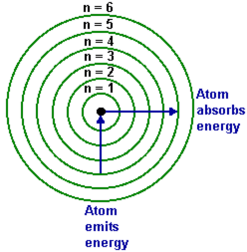
Energy Levels

Slide 27
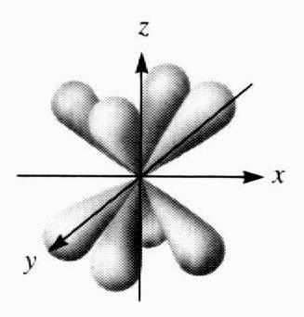



The Angular Momentum Quantum Number
The angular momentum quantum number, l, describes the shape of the orbital.
Values of l can range from 0 to n-1.
All wave functions that have the same value of both n and l form a subshell.
Regions of space occupied by electrons in the same subshell have the same shape but are oriented differently in space.
s
p
d
f
Notes:
27

Slide 28
Angular Momentum Quantum Number
An atom’s subshells have a letter designation:
  l = 0 is an s subshell
  l = 1 is a p subshell
  l = 2 is a d subshell
  l = 3 is an f subshell
  l = 4 is a g subshell

Slide 29
The Magnetic Quantum Number
The magnetic quantum number, m_{l}, describes the orientation of the orbital occupied by the electrons with respect to an applied magnetic field.
Values of m_{l} can range from –l to +l
Each wave function with an allowed combination of n, l, and m_{l} values describes a particular spatial distribution for an electron.
Each principal shell contains a fixed number of subshells, and each subshell contains a fixed number of orbitals.
Notes:
29

Slide 30
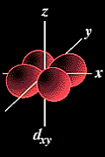
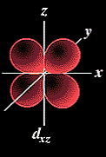
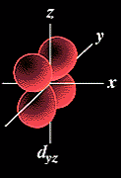
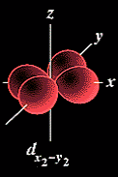
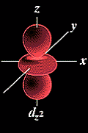
Magnetic Quantum Number
Notes:
30

Slide 31

The Spin Quantum Number
When an electrically charged object spins, it produces a magnetic moment parallel to the axis of rotation and behaves like a magnet.
A magnetic moment is called electron spin.
An electron has two possible orientations in an external magnetic field, which are described by a fourth quantum number m_{s}.
The electron can have a spin of +½ or -½.
An orbital can hold 2 electrons that spin in opposite directions.
Notes:
31

Slide 32
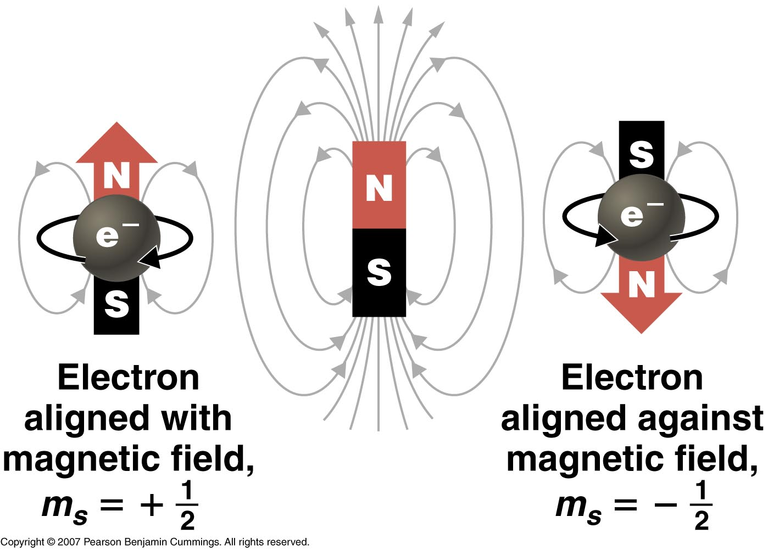
Electron Spin
Notes:
32

Slide 33
Pauli Exclusion Principle
Pauli Exclusion Principle
  Developed by physicist Wolfgang Pauli
  No two electrons in an atom can have the same 4 quantum numbers.
  Each electron has a unique “address”:
    Principal # → energy level
    Angular momentum # → sublevel (s,p,d,f)
    Magnetic # → orbital
    Spin # → electron
Notes:
33
Wolfgang Pauli determined that each orbital can contain no more than two electrons.
Pauli exclusion principle: No two electrons in an atom can have the same value of all four quantum numbers (n, l, m_{l} , m_{s}).
By giving the values of n, l, and m_{l}, we specify a particular orbit.
Because m_{s} has only two values (+½ or -½), two electrons (and only two electrons) can occupy any given orbital, one with spin up and one with spin down.
Pauli's Exclusion Principle.
Put bluntly, this states that "No two electrons in one atom can have the same values for all four quantum numbers". (My interpretation of the Principal and not a direct quote)
This essentially means that a maximum of only two electrons can occupy a single orbital. When two electrons occupy an orbital they must have opposed spin (i.e. different values for the spin quantum number).
We are now beginning to see how the electronic configuration of the elements is built up.

Slide 34
Atomic Orbitals Review
The location of an electron in an atom cannot be known precisely at any time.
Probable location can be predicted based on wave functions arranged into orbitals based on energy levels.
An atom’s energy levels, or shells, indicate how close electrons are to the nucleus of the atom.
Energy levels contain sublevels (subshells) which designate the orbital shape that the electrons belong to.
  Four major sublevel designations: s, p, d, and f
  Two electrons may occupy a single orbital, but must have opposite spins.

Slide 35
Quantum Numbers Review
n → shell 1,2,3,4,….
l → subshell 0,1,2,…n-1
m_{l} → orbital -l … 0 … +l
m_{s} → electron spin +½ and -½
Notes:
35

Slide 36
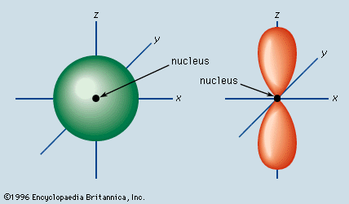
“s” Orbital
Spherical shaped orbital with the nucleus at its center.
Only one “s” orbital per energy level.
Lowest “s” orbital is found in energy level #1.

Slide 37
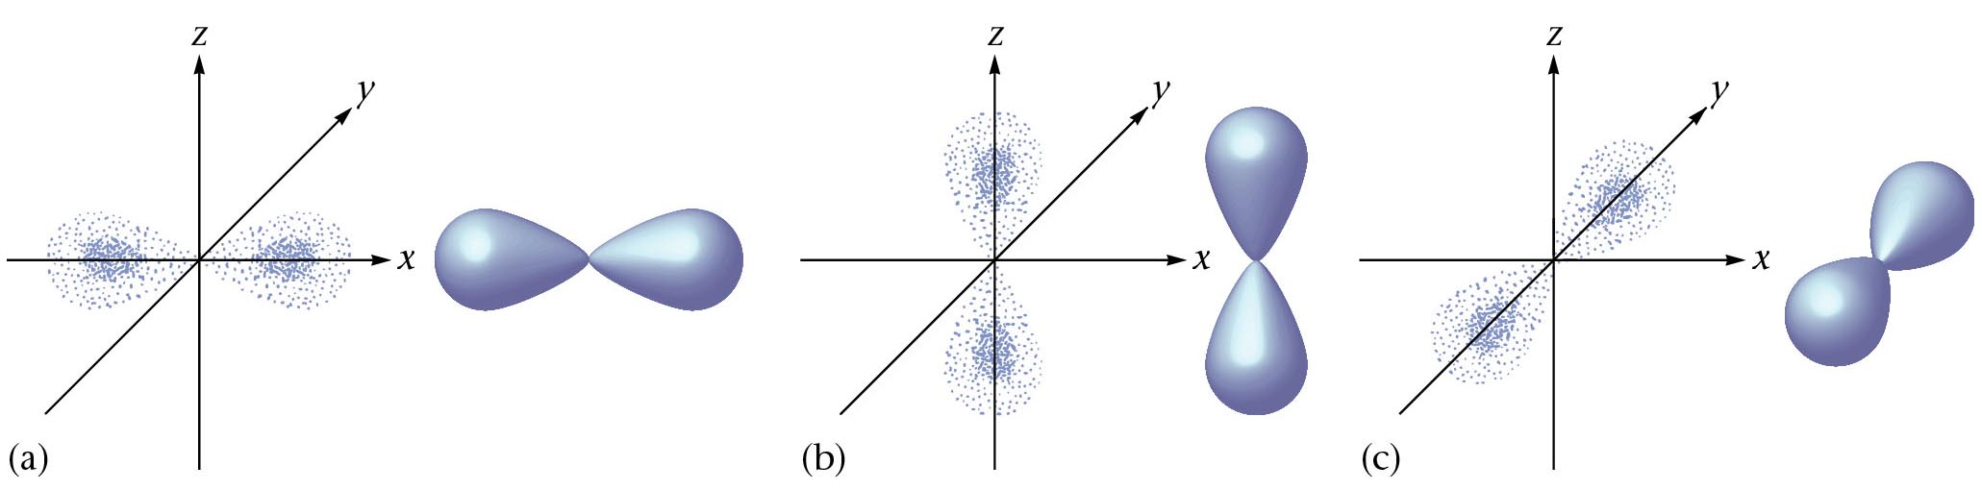
“p” Orbital
Higher in energy than the “s” orbital in the same energy level.
Dumbbell shaped orbital with two regions (lobes), one on either side of the nucleus.
Three “p” orbitals per energy level, each with specific orientation in space: p_{x}, p_{y}, p_{z}
Lowest “p” orbital found in energy level #2.
y
y
y
z
z
z
x
x
x
p_{x}
p_{z}
p_{y}

Slide 38
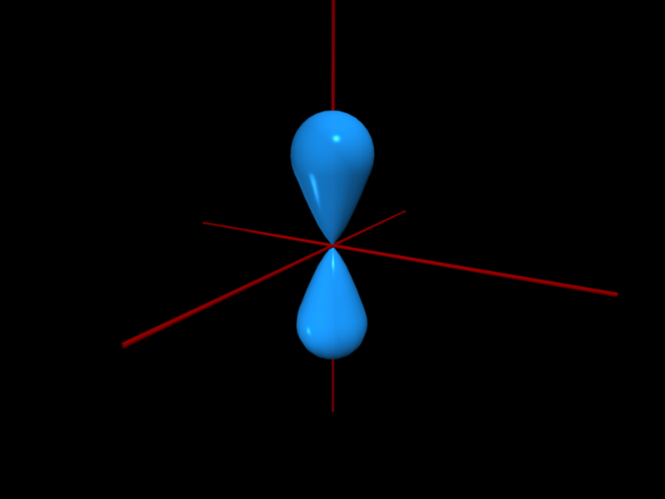
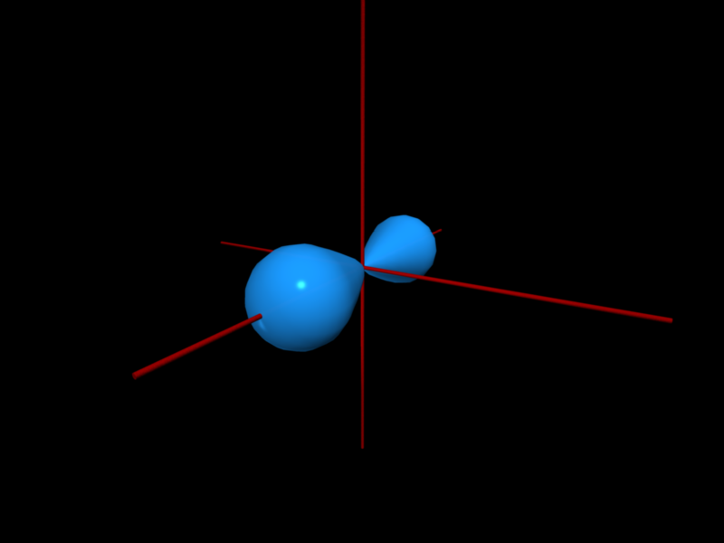
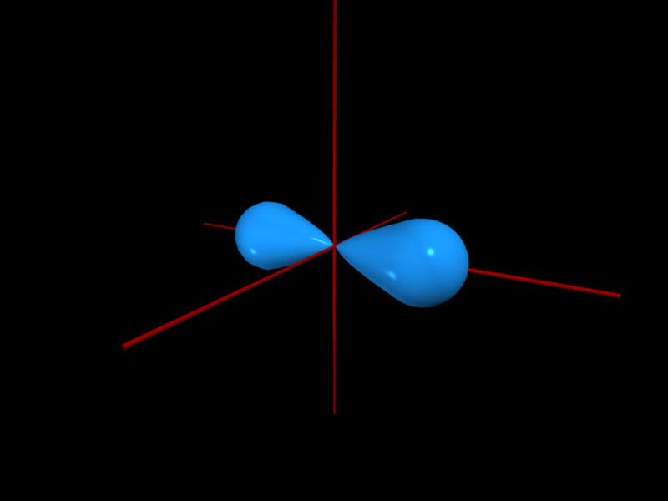

Slide 39
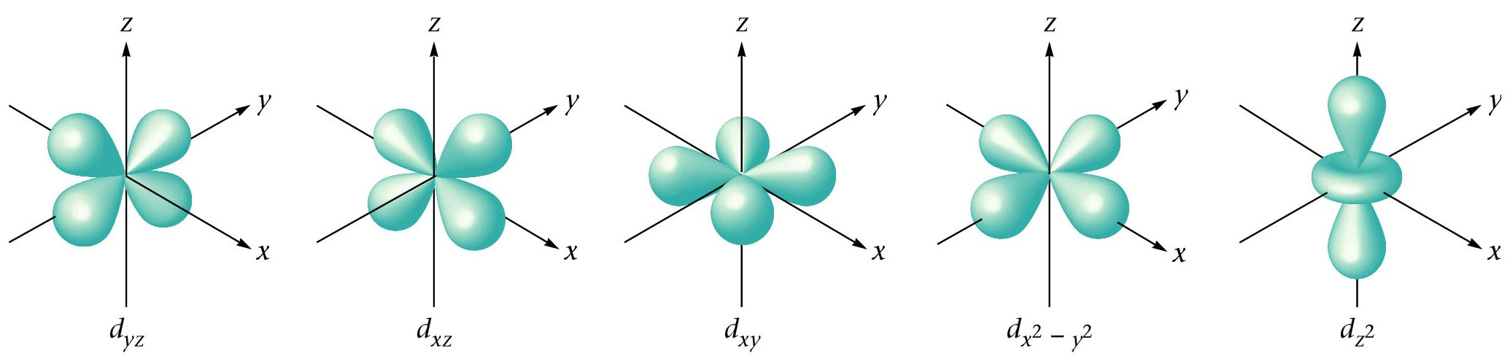
“d” Orbital
Higher in energy than the “p” orbitals in the same energy level.
Five “d” orbitals per energy levels.
  Four of the orbitals are “cloverleaf” shaped, each with four lobes that are centered around the nucleus.
  Fifth lobe is dumbbell shaped with a “donut-shaped” region around the center.
Lowest “d” orbital found in energy level #3.

Slide 40
“f” Orbital
Higher in energy than the “d” orbitals in the same energy level.
Seven “f” orbitals per energy level.
Each “f” orbital has a complex, multi-lobed shape.
Lowest “f” orbital found in energy level #4.

Slide 41
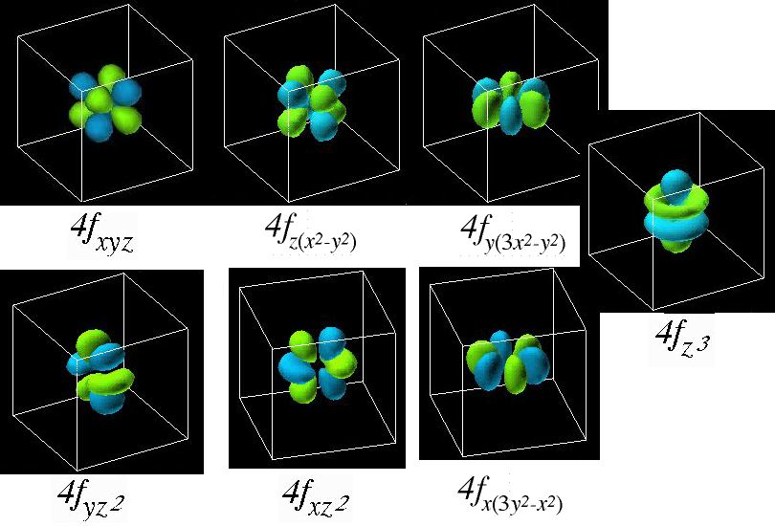
“f” Orbitals

Slide 42
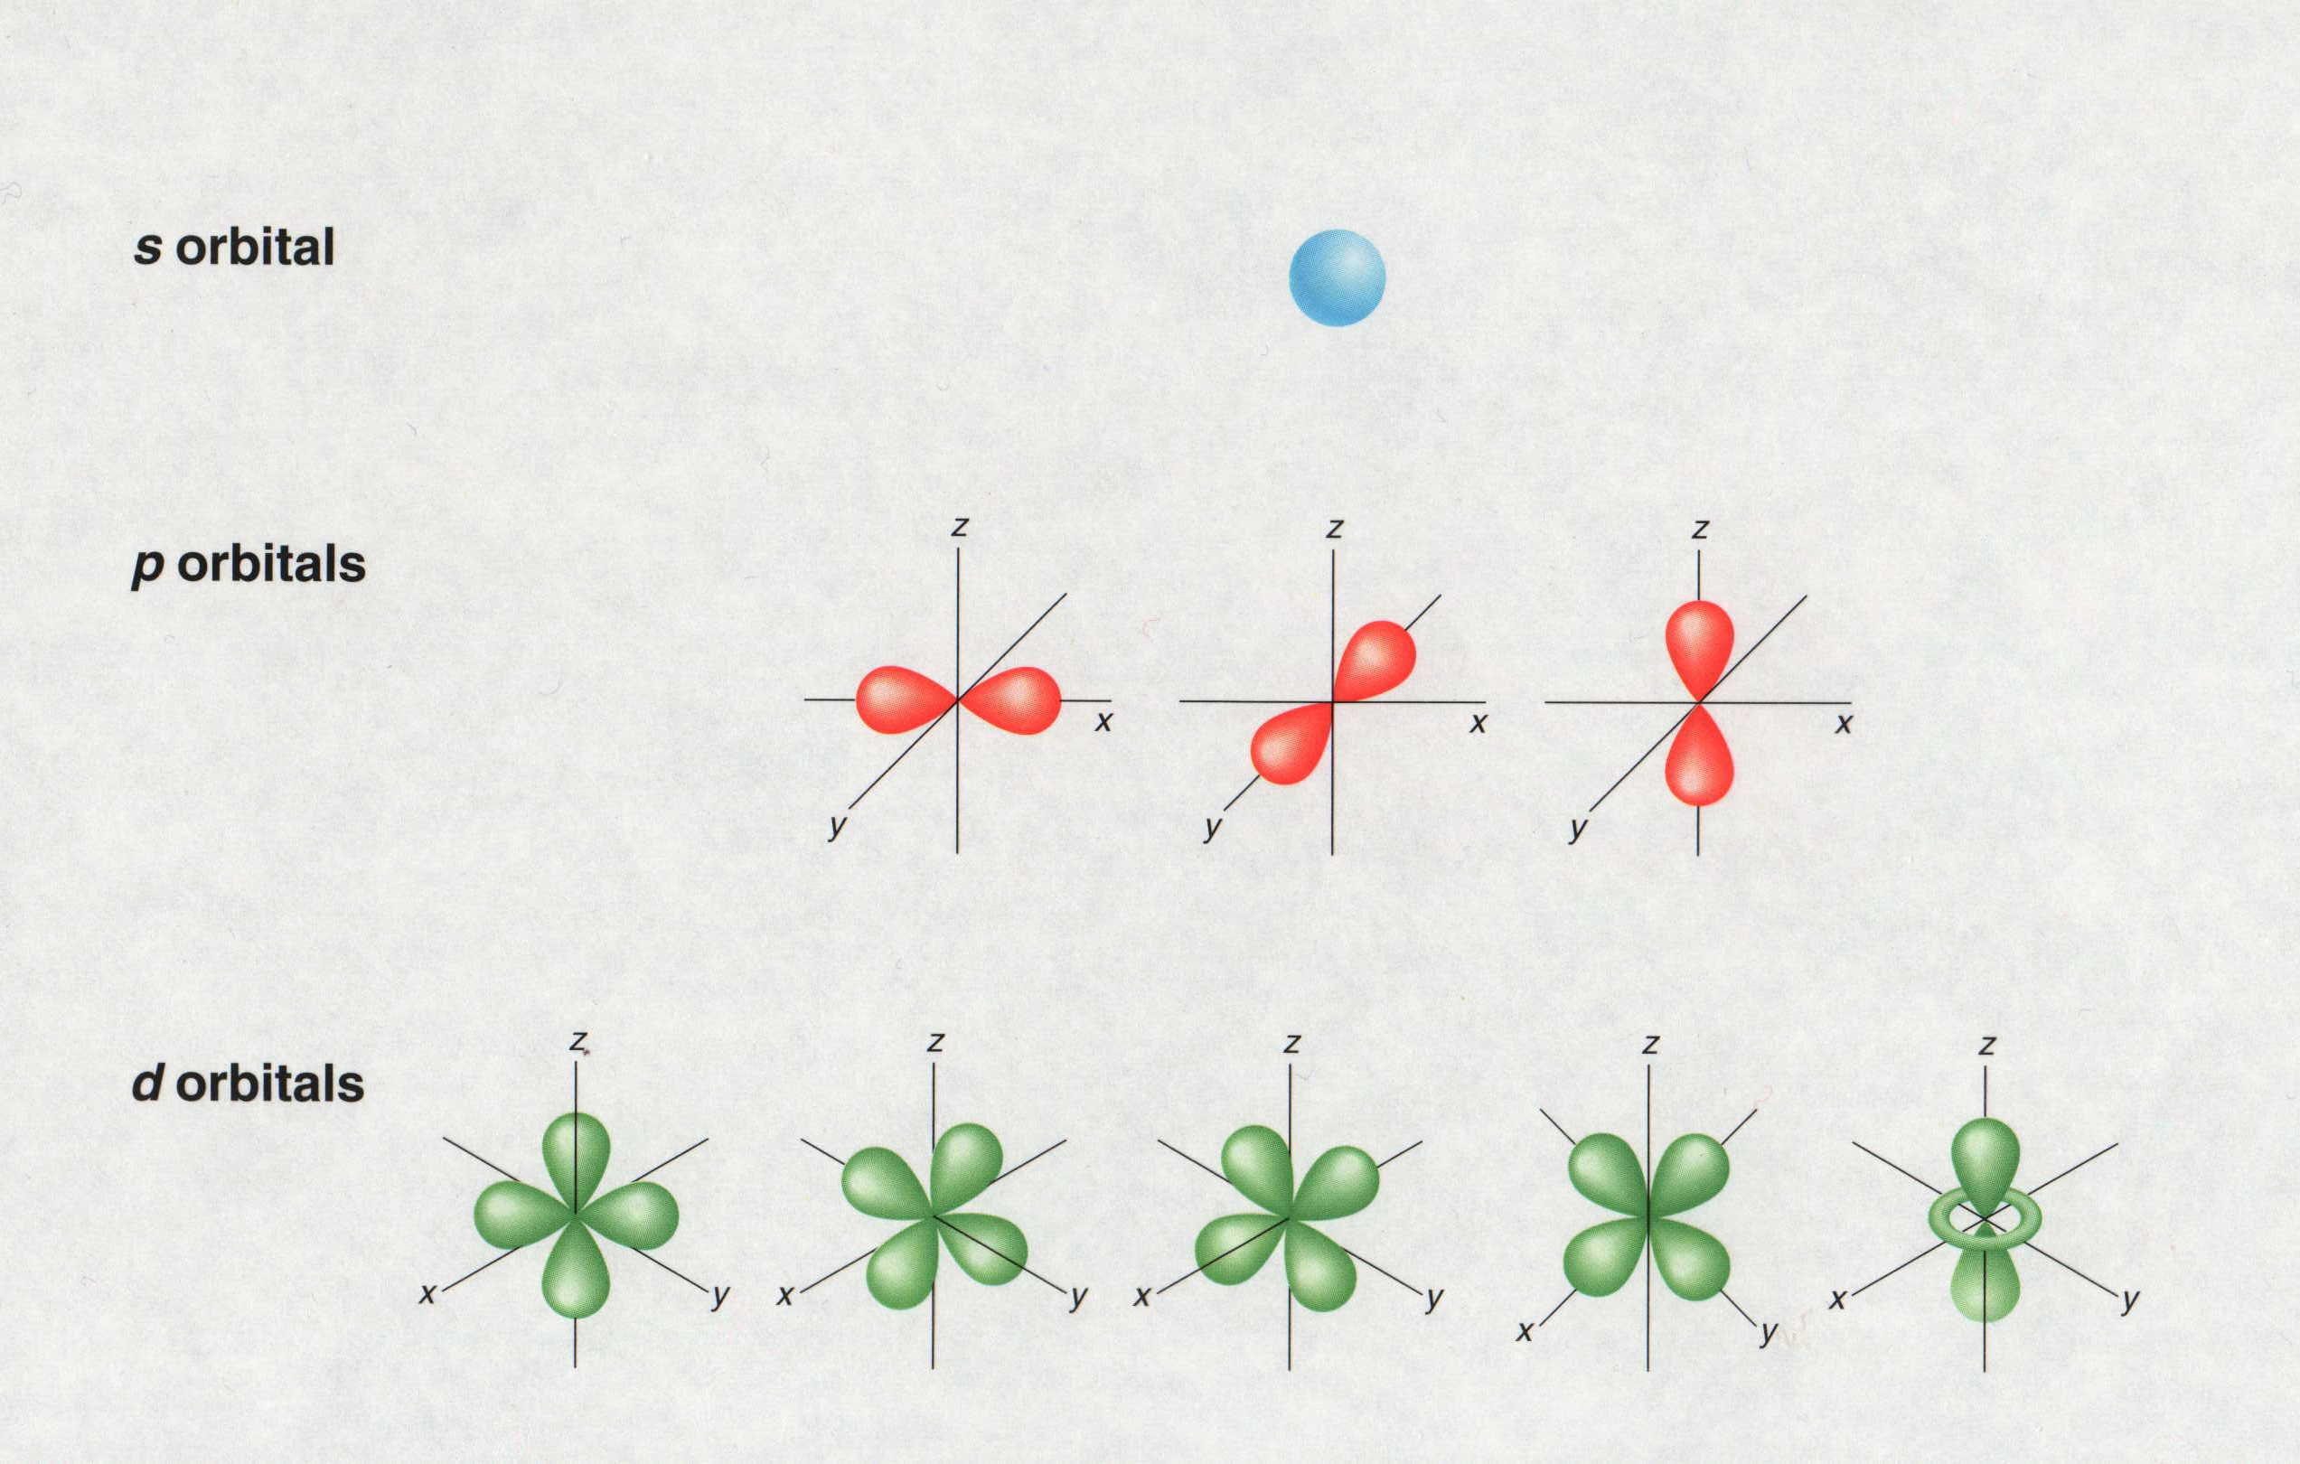
Atomic Orbital Review
s orbital
1 orbital → 2 total e⁻
p orbitals
3 orbitals → 6 total e⁻
d orbitals
5 orbitals → 10 total e⁻

Slide 43
Orbital Review
Maximum Number of Electrons
In Each Sublevel
Maximum Number
Sublevel Number of Orbitals of Electrons
s 1 2
p 3 6
d 5 10
f 7 14
Notes:
43

Slide 44
Maximum Capacities of Subshells and Principal Shells
n 1 2 3 4 ...n
l 0 0 1 0 1 2 0 1 2 3
Subshell
designation s s p s p d s p d f
Orbitals in
subshell 1 1 3 1 3 5 1 3 5 7
Subshell
capacity 2 2 6 2 6 10 2 6 10 14
Principal shell
capacity 2 8 18 32 ...2n²
Notes:
An abbreviated system with lowercase letters is used to denote the value of l for a particular subshell or orbital:
l = 0 1 2 3
Designation s p d f
• The principal quantum number is named first, followed by the letter s, p, d, or f.
• A 1s orbital has n = 1 and l = 0; a 2p subshell has n = 2 and l = 1(and contains three 2p orbitals, corresponding to m_{l} = –1, 0, and +1); a 3d subshell has n = 3 and l = 2 (and contains five 3d orbitals, corresponding to m_{l} = –2, –1, 0, –1, and +2).
Relationships between the quantum numbers and the number of subshells and orbitals are
1. each principal shell contains n subshells;
– for n = 1, only a single subshell is possible (1s);
for n = 2, there are two subshells (2s and 2p);
for n = 3, there are three subshells (3s, 3p, and 3d);
2. each subshell contains 2l + 1 orbitals;
– this means that all ns subshells contain a single s orbital, all np subshells contain three p orbitals, all nd subshells contain five d orbitals, and all nf subshells contain seven f orbitals.

Slide 45
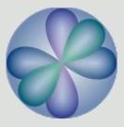
Quantum Numbers
Orbitals combine to form a spherical shape.
2s
2p_{x}
2p_{y}
2p_{z}
Notes:
45

Slide 46
Orbital Occupancy
Electron configuration designates the distribution of an atom’s electrons.
Aufbau Principle:
  Start at the beginning of the periodic table and add one electron per element to the lowest energy orbital available.
Order for filling energy sublevels with electrons can be determined from the periodic table.

Slide 47
Periodic Patterns
s
p
1
2
3
4
5
6
7
1s
1s
2s
2p
d (n-1)
3s
3p
4s
3d
4p
5s
4d
5p
6s
5d
6p
7s
6d
7p
6
7
4f
f (n-2)
5f

Slide 48
Orbital Energies
4f
4d
n = 4
4p
3d
4s
n = 3
3p
Energy
3s
2p
n = 2
2s
n = 1
1s
Notes:
The energy of an electron is determined by its average distance from the nucleus.
Each atomic orbital with a given set of quantum numbers has a particular energy associated with it, the orbital energy.
In atoms or ions that contain only a single electron, all orbitals with the same value of n have the same energy (they are degenerate).
Energies of the principal shells increase smoothly as n increases.
An atom or ion with the electron(s) in the lowest-energy orbital(s) is said to be in the ground state; an atom or ion in which one or more electrons occupy higher-energy orbitals is said to be in the excited state.

Slide 49
Filling Rules for Electron Orbitals
Aufbau Principle: Electrons are added one at a time to the lowest energy orbitals available until all the electrons of the atom have been accounted for.
  Aufbau is German for “building up”.
Pauli Exclusion Principle: An orbital can hold a maximum of two electrons. To occupy the same orbital, two electrons must spin in opposite directions.
Hund’s Rule: Electrons occupy equal-energy orbitals so that a maximum number of unpaired electrons results.

Slide 50
Hund’s Rule
Hund’s Rule
  Within a sublevel, place one electron per orbital before pairing them.
  “Empty Bus Seat Rule”
WRONG
RIGHT

Slide 51
Energy Level Diagram
Hydrogen
6s 6p 5d 4f
Bohr Model
5s 5p 4d
4s 4p 3d
Arbitrary Energy Scale
3s 3p
N
2s 2p
1s
Electron Configuration
NUCLEUS
H = 1s¹

Slide 52
Energy Level Diagram
Helium
6s 6p 5d 4f
Bohr Model
5s 5p 4d
4s 4p 3d
Arbitrary Energy Scale
3s 3p
N
2s 2p
1s
Electron Configuration
NUCLEUS
He = 1s²

Slide 53
Energy Level Diagram
Lithium
6s 6p 5d 4f
Bohr Model
5s 5p 4d
4s 4p 3d
Arbitrary Energy Scale
3s 3p
N
2s 2p
1s
Electron Configuration
NUCLEUS
Li = 1s²2s¹

Slide 54
Orbital Diagrams
An orbital diagram consists of a box (circle or line work as well) for each orbital in a given energy level, grouped by sublevel, with an arrow indicating an electron’s presence and its direction of spin.
  e.g. Orbital diagrams:
    Hydrogen
    Helium
    Lithium
    Beryllium
1s
1s
1s
2s
2p
1s
2s
2p
Notes:
Orbital diagrams show all the orbitals for the highest energy level whether or not they are occupied.

Slide 55
Orbital Diagrams Examples
Draw the orbital diagrams for the following elements:
  Carbon
  Nitrogen
  Oxygen
  Argon
  Sodium
  Phosphorous

Slide 56
Electron Configuration
Shorthand notation showing the same information that an orbital diagram shows.
Consists of the principal energy level, the letter designation of the sublevel, and the number of electrons in the sublevel, written as a superscript.
  Does not indicate spin.
e.g. Electron configurations
  Hydrogen → 1s¹
  Helium → 1s²
  Lithium → 1s² 2s¹
  Beryllium → 1s² 2s²

Slide 57
Electron Configuration Examples
Give the electron configuration for the following elements:
  Carbon
  Oxygen
  Argon
  Sodium
  Phosphorous

Slide 58
Periodic Patterns
s
p
1
2
3
4
5
6
7
1s
1s
2s
2p
d (n-1)
3s
3p
4s
3d
4p
5s
4d
5p
6s
5d
6p
7s
6d
7p
6
7
4f
f (n-2)
5f

Slide 59
Condensed Electron Configuration
Full electron configuration includes all electrons that an atom has.
Condensed electron configuration uses the previous noble gas (filled energy level) to represent the core electrons (called a “noble gas core”). The remainder of the electrons are shown.
  e.g. Sulfur
    Full electron configuration: 1s²2s²2p⁶3s²3p⁴
    Condensed electron configuration: [Ne]3s²3p⁴

Slide 60
Condensed Configuration Examples
Give the condensed electron configuration for the following atoms:
  Aluminum
  Bromine
  Strontium
  Lead

Slide 61
Categories of Electrons
Inner (core) electrons are those in the previous noble gas and any completed transition series. They fill all the lower energy levels of an atom.
Outer electrons are those in the highest energy level (highest n value). They spend most of their time farthest from the nucleus.
Valence electrons are those involved in forming compounds. Among main group elements, the valence electrons are the outer electrons.
  Among transition elements, some inner d electrons are also often involved in bonding and are counted among the valence electrons.

Slide 62
Periodic Patterns for Electron Configuration
Period number is the n value of the highest energy level (subtract for d and f)
For the A group elements, the group number equals the number of outer electrons.
The n value squared (n²) gives the total number of orbitals in that energy level. Because an orbital can only hold two electrons, 2n² gives the maximum number of electrons in the energy level.
Column within sublevel block gives the number of electrons in the sublevel.

Slide 63
Exceptions
There are a few exceptions when dealing with orbital filling.
  Chromium → Instead of the last electron in chromium entering the fourth empty d orbital to give [Ar]4s²3d⁴, chromium has one electron in the 4s sublevel and five in the 3d sublevel, thus, making 4s and 3d half-filled. [Ar]4s¹3d⁵
    Molybdenum follows the pattern of chromium but tungsten does not.
  Copper → Instead of having the configuration [Ar]4s²3d⁹, copper has one electron in the 4s sublevel and a filled (10 electrons) in the 3d sublevel.
    Silver and gold follow the pattern of copper.
  Observation leads to the conclusion that half-filled and filled sublevels are unexpectedly stable.

Slide 64
Electron Configuration Simulation
http://introchem.chem.okstate.edu/DCICLA/Aufbau.swf

Slide 65
Stability
Electron Configuration Exceptions
  Chromium
  EXPECT: [Ar] 4s² 3d⁴
  ACTUALLY: [Ar] 4s¹ 3d⁵
  Chromium gains stability with a half-full d-sublevel.

Slide 66
Stability
Electron Configuration Exceptions
  Copper
  EXPECT: [Ar] 4s² 3d⁹
  ACTUALLY: [Ar] 4s¹ 3d¹⁰
  Copper gains stability with a full d-sublevel.

Slide 67
Stability
Full energy level
Full sublevel (s, p, d, f)
Half-full sublevel

Slide 68
The Octet Rule
Atoms tend to gain, lose, or share electrons until they have eight outer (valence) electrons.
This gives the same electron configuration of the (inert) noble gases.
  Only s and p orbitals are valence electrons.
8

Slide 69
Stability
Ion Formation
  Atoms gain or lose electrons to become more stable.
  Isoelectronic with the Noble Gases.
    e.g. Oxygen ion → O²⁻ ≡ Ne

Slide 70
Isoelectronic Species
Isoelectronic - all species have the same number of electrons.
p = 8
n = 8
e = 10
p = 9
n = 9
e = 10
p = 10
n = 10
e = 10
p = 11
n = 11
e = 10
p = 12
n = 12
e = 10
-
-
-
-
-
-
-
-
-
-
-
-
-
-
-
-
10+
-
-
-
-
-
8+
-
9+
-
-
11+
-
12+
-
-
-
-
-
-
-
-
-
-
-
-
-
-
-
-
-
-
-
-
-
-
-
-
-
Oxygen ion
O²⁻
1s²2s²2p⁶
Fluorine ion
F¹⁻
1s²2s²2p⁶
Neon atom
Ne
1s²2s²2p⁶
Sodium ion
Na¹⁺
1s²2s²2p⁶
Magnesium ion
Mg²⁺
1s²2s²2p⁶
Can you come up with another isoelectronic series of five elements?
Notes:
70
• Most elements form either a cation or an anion but not both.
• There are few opportunities to compare the sizes of a cation and an anion derived from the same neutral atom.
• Ionic radii follow the same vertical trend as atomic radii.
• For ions with the same charge, the ionic radius increases going down a column due to shielding by filled inner shells, which produces little change in the effective nuclear charge felt by the outermost electrons.
• Principal shells with larger values of n lie at successively greater distances from the nucleus.
• Elements in different columns tend to form ions with different charges — it is not possible to compare ions of the same charge across a row of the periodic table.
• Elements that are next to each other tend to form ions with the same number of electrons but with different overall charges because of their different atomic numbers.
• Comparison of the dimensions of atoms or ions that have the same number of electrons but different nuclear charges called an isoelectronic series.
• An isoelectronic series shows a clear correlation between increasing nuclear charge and decreasing size.

Slide 71
Magnetism
An atom with all of its electrons paired is called diamagnetic and is not attracted by a magnetic field (or only very slightly repelled).
An atom with unpaired electrons is called paramagnetic and is weakly attracted by a magnetic field.
Which of the following metals should be attracted by a magnetic field?
  Magnesium or iron?

Slide 72
Review
Write out the complete electron configuration for the following:
  An atom of nitrogen
  An atom of silver
  An atom of uranium (shorthand)
Give an orbital diagram for an atom of nickel (Ni)

Slide 73
Review
Which rule states no two electrons can spin the same direction in a single orbital?
Which rule states that electrons will fill all empty orbitals before pairing with another electron?
How many electrons are possible for an element with a principle quantum number equal to 3?

Slide 74
Electron Dot Diagrams
Electron dot diagrams show the valence electrons around the atomic symbol
Group
1 2 13 14 15 16 17 18
1A 2A 3A 4A 5A 6A 7A 8A
H
He
Li
Be
B
C
N
O
F
Ne
Na
Mg
Al
Si
P
S
Cl
Ar
K
Ca
Ga
Ge
As
Se
Br
Kr
s¹
s²
s²p¹
s²p²
s²p³
s²p⁴
s²p⁵
s²p⁶
= valence electron
Notes:
In an electron dot diagram, each dot represents a valence electron.

Slide 75
Nuclear Charge (Z)
The nucleus of an atom has a positive charge which attracts its electrons.
The farther apart opposite charges are, the weaker the attraction is. When the nucleus and electron are far apart, their attraction is weaker.
The higher the opposite charges are, the stronger the attraction is. When a nucleus of higher charge attracts an electron, the system is more stable than when a nucleus of lower charge attracts an electron.

Slide 76
Shielding and
Effective Nuclear Charge (Z_{eff})
Shielding is caused by one electron repulsing another, consequently reducing the attraction of the positive nuclear charge.
Effective nuclear charge (Z_{eff}) is the positive charge that an electron actually experiences.
  Equal to the nuclear charge but reduced by any shielding or screening from any intervening electron distribution.

Slide 77
Shielding Effect
Valence
+
-
nucleus
-
-
Electrons
-
Electron shield blocks the attractive force of the nucleus from the valence electrons.
Electron
Shield
Notes:
77
Some schools use the term “screening” as I use the term “shielding”.

Slide 78
Shielding Effect and
Effective Nuclear Charge
attractions
repulsions
+
_
_
_
Mg = [Ne]3s²
Notes:
78
"The simplified sketch of a magnesium atom shows the two valence electrons as discrete particles.
The remaining 9 core electrons are shown as a circular cloud of negative electric charge.
Interactions between valence electrons, core electrons, and the atomic nucleus determine an
effective nuclear charge. Attractions are indicated in red and repulsion in blue.“
For an atom or ion that has only a single electron, the potential energy can be calculated by considering only the electrostatic attraction between the positively charged nucleus and the negatively charged electron.
When more than one electron is present, the total energy of the atom or ion depends not only on the attractive electron-nucleus interactions but also on repulsive electron-electron interactions.
One must use approximate methods to deal with the effect of electron-electron repulsions on orbital energies
If an electron is far from the nucleus, then at any given moment, most of the other electrons will be between that electron and the nucleus.
The electrons will cancel a portion of the positive charge of the nucleus and will decrease the attractive interaction between it and the electron farther away.
Electrons farther away experiences an effective nuclear charge, Z_{eff}. that is less than the actual nuclear charge Z (an effect called electron shielding).

Slide 79
Periodic Trends
All physical and chemical behavior of the elements is based ultimately on the electron configurations of their atoms.
Since similar electron configurations occur in groups and periods on the periodic table, certain trends in properties of the elements can be observed. (Periodic trends)
The dominating factors in these trends are effective nuclear charge (Z_{eff}) and the principle quantum number (energy level).

Slide 80
Coulombic Attraction
Coulombic attraction (force of attraction between two substances) is related to
  Charge
    Opposites attract
    Likes repel
  Distance
    The closer two things are, the stronger the force between them.
Rank the following charges in order of decreasing attraction.
2+
2-
A
1+
1-
C
2+
2-
4-
3-
B
D

Slide 81
Atomic Radius
Atomic radius can not be measured in a definite way because the positions of electrons is not precisely known.
Atomic size is defined in terms of how closely one atom lies next to another.
Atomic radius will vary slightly from substance to substance.
Atomic radius increases down a group from top to bottom.
Atomic radius decreases across a period from left to right.

Slide 82
Decreasing Atomic Size Across a Period
As the attraction between the positive (+) nucleus and the negative (–) valence electrons increases, the atomic size decreases due to greater coulombic attraction.
From left to right, size decreases because there is an increase in nuclear charge and Effective Nuclear Charge (# protons – # core electrons).
Each valence electron is pulled by the full Z_{eff}.
Li
Be
B
1s²2s¹
1s²2s²
1s²2s²2p¹
(Z_{eff} = 1)
(Z_{eff} = 2)
(Z_{eff} = 3)
Li
Be
B
+
+
+
+
+
+
+
+
+
+
+
+
Notes:
82

Slide 83
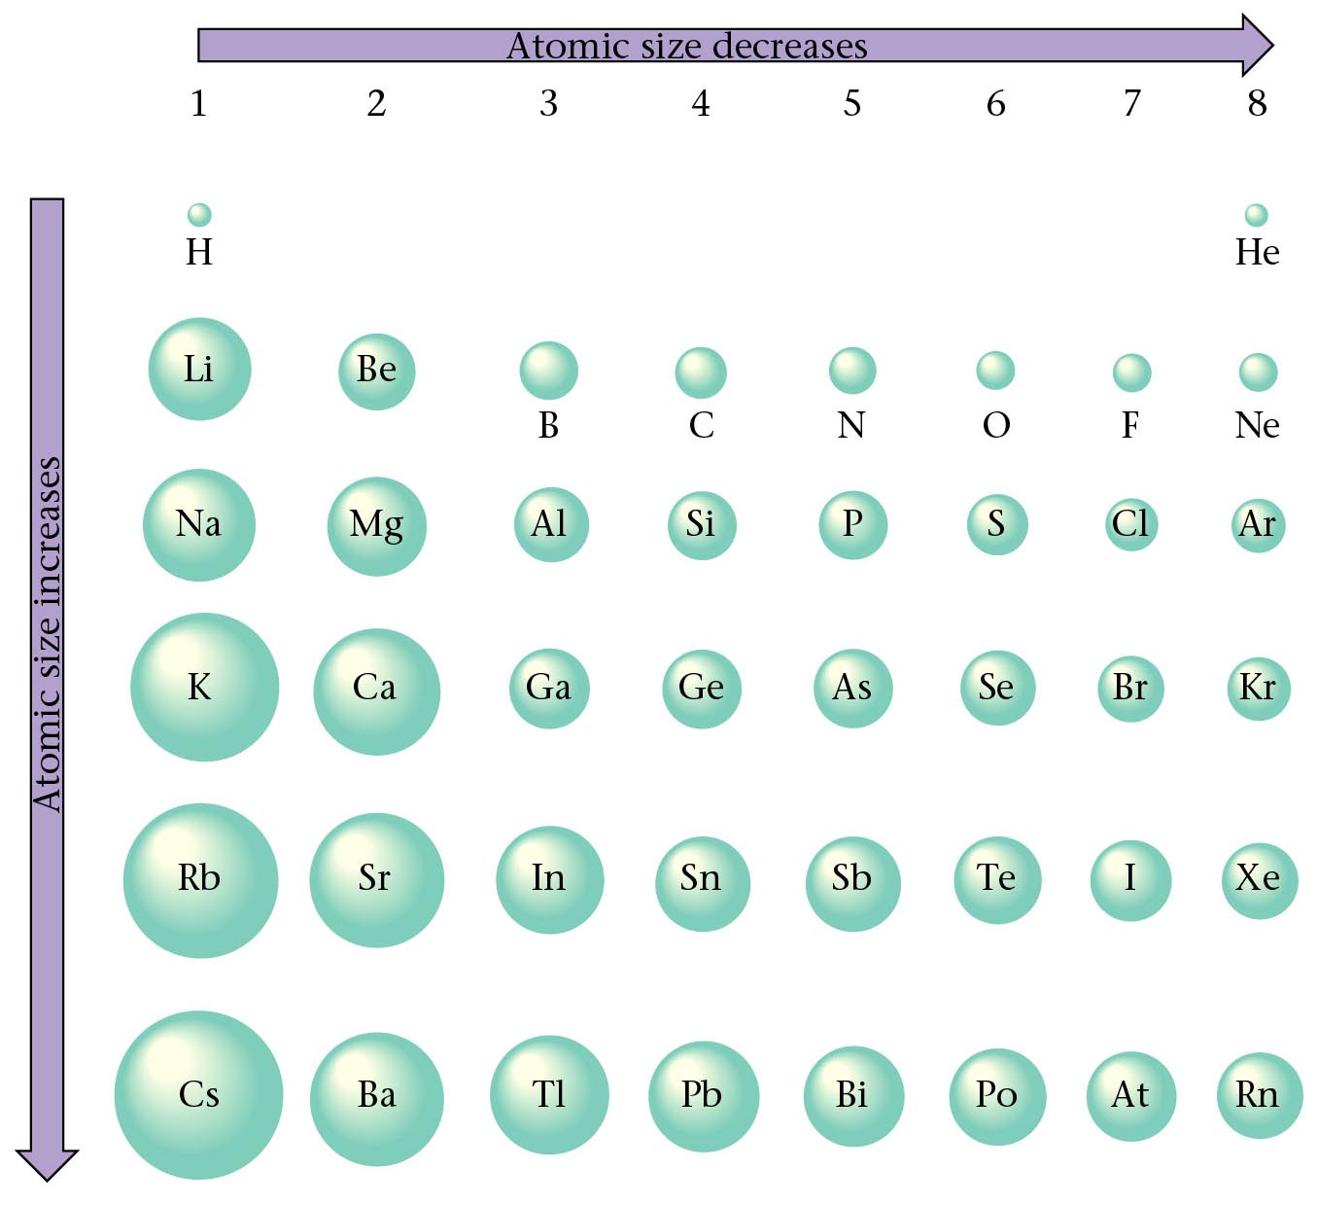
Relative Size of Atoms

Slide 84
Atomic Radius
0.3
Cs
Rb
0.25
K
0.2
Na
3d
transition
series
4d
transition
series
atomic radius
Li
La
0.15
Zn
Xe
0.1
Kr
Cl
F
0.05
He
H
0
0 10 20 30 40 50 60
atomic number
Notes:
84

Slide 85
Atomic Radius Examples
Using the periodic table, rank each set of main group elements in order of decreasing atomic radius.
  Ca, Mg, Sr
  K, Ga, Ca
  Br, Rb, Kr
  Sr, Ca, Rb
  Se, Br, Cl
  I, Xe, Ba

Slide 86
Atomic Radii of Transition Elements
Across a period, transition elements fill the inner d orbitals.
Size of transition metals remains relatively constant across a period because shielding by the inner d electrons counteracts the usual increase in Z_{eff}.
The intervening filling of d electrons causes a major size decrease from Group 2A(2) to Group 3A(13), the two main groups that flank the transition series.

Slide 87
Ions
Anions:
  Anions form by gaining electrons.
  Anions are bigger than the atom they come from.
  Nonmetals form anions.
  Anions of representative elements have noble gas configuration.
Cations:
  Cations form by losing electrons.
  Cations are smaller than the atom they come from.
  Metals form cations.
  Cations of representative elements have noble gas configuration.
Notes:
87

Slide 88
Ionic Size
Valence electrons repel each other.
When an atom becomes an anion, the repulsion between valence electrons increases without changing the Z_{eff}.
  Thus, an anion is larger than its “parent” atom.
When an atom becomes a cation, there is less repulsion between valence electrons without changing the Z_{eff}.
  Thus, a cation is smaller than its “parent” atom.
Notes:
88
.

Slide 89
Trends in Atomic and Ionic Size
Metals
Nonmetals
Group 1
Group 13
Group 17
e
e
Li
Li⁺
F⁻
F
152
60
64
e
136
e
e
e
e
Na
Na+
Al
Al³⁺
Cl⁻
Cl
95
143
50
99
186
181
e
e
K
K+
Br⁻
Br
133
114
227
195
Cations are smaller than parent atoms
Anions are larger than parent atoms

Slide 90
Ionic Size Examples
Rank each set of ions in order of decreasing size:
  Ca²⁺, Sr²⁺, Mg²⁺
  K⁺, S²⁻, Cl⁻
  Au⁺, Au³⁺
  Cl ⁻, Br ⁻, F ⁻
  Na⁺, Mg²⁺, F⁻

Slide 91
Ionization Energy
Ionization energy (IE) is the energy required for the complete removal of an electron from a gaseous atom or ion.
  Pulling an electron away from a nucleus requires energy to overcome the coulombic attraction.
  Ionization energy is generally a positive number.
Atoms with many electrons can lose more than one electron.
  The first ionization energy (IE₁) removes an outermost electron (from the highest energy sublevel) from the atom.
  The second ionization energy (IE₂) removes a second electron.
    This second electron is pulled away from a positively charged ion so IE₂ is always larger than IE₁.

Slide 92
Factors Affecting Ionization Energy
Nuclear Charge: The larger the nuclear charge, the greater the ionization energy.
Shielding Effect: The greater the shielding effect, the less the ionization energy.
Radius: The greater the distance between the nucleus and the outer electrons of an atom, the less the ionization energy.
Sublevel: An electron from a full or half-full sublevel requires additional energy to be removed.

Slide 93
He
Helium (He) has…
a greater IE than H
same shielding
greater nuclear charge
n
H
First Ionization energy
1e⁻
2e⁻
1+
2+
H
He
Atomic number
Notes:
93

Slide 94
He
Li has…
lower IE than H
more shielding
Further away outweighs greater nuclear charge
n
H
First Ionization energy
Li
Atomic number
Notes:
94

Slide 95
He
Be has higher IE than Li
same shielding
greater nuclear charge
n
H
First Ionization energy
2e⁻
2e⁻
Be
3+
2e⁻
1e⁻
2e⁻
3+
1e⁻
4+
2e⁻
2e⁻
4+
Li
Be
Li
Atomic number
Notes:
95

Slide 96
He
B has lower IE than Be
same shielding
greater nuclear charge
p-orbitals available
n
2e⁻
2e⁻
4+
2e⁻
2e⁻
3e⁻
4+
2e⁻
5+
2e⁻
3e⁻
H
5+
First Ionization energy
Be
Be
B
B
Li
2p
2s
1s
Atomic number
Notes:
96

Slide 97
He
n
H
C
First Ionization energy
Be
B
Li
2p
2s
1s
Atomic number
Notes:
97

Slide 98
He
n
N
H
C
First Ionization energy
Be
B
Li
2p
2s
1s
Atomic number
Notes:
98

Slide 99
He
n
N
Breaks the pattern because
removing an electron
gets to ½ filled p-orbital
H
C
O
First Ionization energy
Be
B
Li
2p
2s
1s
Atomic number
Notes:
99

Slide 100
He
n
F
N
H
C
O
First Ionization energy
Be
B
Li
2p
2s
1s
Atomic number
Notes:
100

Slide 101
He
Ne
n
F
N
Ne has a lower IE than He
Both are full energy levels,
Ne has more shielding
Greater distance
H
C
O
First Ionization energy
Be
B
Li
2p
2s
1s
Atomic number
Notes:
101

Slide 102
He
Ne
n
F
N
Na has a lower IE than Li
Both are s¹
Na has more shielding
Greater distance
H
C
O
First Ionization energy
Be
B
3s
Li
2p
2s
Na
1s
Atomic number
Notes:
102

Slide 103
First Ionization Energy Plot
2500
He
Ne
2000
F
Ar
1500
N
Kr
First ionization energy (kJ/mol)
Cl
H
O
Br
C
P
Zn
As
1000
Be
Mg
S
Fe
Ni
Se
B
Si
Ca
Ti
Cr
Co
Ge
Mn
Cu
Sr
500
Al
Sc
V
Ga
Li
Na
K
Rb
0
5
10
15
20
25
30
35
40
Atomic number
Notes:
103
Ionization energies of s- and p-block elements
– For elements in the third row of the periodic table, successive ionization energies increase steadily as electrons are removed from the valence orbitals (3s or 3p) followed by a large increase in ionization energy when electrons are removed from filled core levels.
– First ionization energies tend to increase across the third row of the periodic table because the valence electrons do not screen each other, allowing the effective nuclear charge to increase steadily across the row.
– Valence electrons are attracted more strongly by the nucleus, so atomic sizes decrease and ionization energies increase.
– The first ionization energies of the elements in the first six rows of the periodic table illustrate three trends:
1. Changes seen in the second, fourth, fifth, and sixth rows of the s and p blocks follow a pattern described for the third row of the periodic table.
a. Transition metals are included in the fourth, fifth, and sixth rows.
b. Lanthanides are included in the sixth row.
c. Ionization energies increase from left to right across each row.
2. First ionization energies decrease down a column.
a. Filled inner shells are effective at screening the valence electrons, so there is a small increase in the effective nuclear charge.
b. The atoms become larger as they acquire electrons.
c. Valence electrons farther from the nucleus are less tightly bound, making them easier to remove and causing ionization energies to decrease.
b. The atoms become larger as they acquire electrons.
d. A larger nucleus radius corresponds to a lower ionization energy.
3. Because of the trends described in 1 and 2;
a. the elements that form positive ions most easily (have the lowest ionization energies) lie in the lower-left corner of the periodic table;
b. those elements that are hardest to ionize lie in the upper-right corner of the periodic table;
c. ionization energies increase diagonally from lower left to upper right;
d. minor deviations from this trend can be explained in terms of particularly stable electronic configurations, called pseudo-inert gas configurations, in either the parent atom or the resulting ion.
• Ionization energies of transition metals and lanthanides
– First ionization energies of transition metals and lanthanides change very little across each row.
– Differences in their second and third ionization energies are also small.
– Transition metals and lanthanides form cations by losing the ns electrons before the (n – 1)d or (n – 2)f electrons.
– Because their first, second, and third ionization energies change so little across a row, these elements have important horizontal similarities in chemical properties in addition to the expected vertical similarities.

Slide 104
Ionization Energy Periodic Trends
Ionization energy decreases down a group from top to bottom.
  As the distance from nucleus to outermost electron increases, the attraction between them lessens making the electron easier to remove.
Ionization energy increases across a period from left to right.
  As the effective nuclear charge increases, the attraction between nucleus and outer electrons increases so an electron is harder to remove.

Slide 105
Ionization Energies
Group 1
18
1
H
1312
Mg
738
Symbol
First Ionization Energy
(kJ/mol)
He
2372
1
2
13
14
15
16
17
2
Li
520
Be
900
B
801
C
1086
N
1402
O
1314
F
1681
Ne
2081
2
3
Na
496
Mg
738
Al
578
Si
787
P
1012
S
1000
Cl
1251
Ar
1521
3
3
4
5
6
7
8
9
10
11
12
Period
4
K
419
Ca
590
Sc
633
Ti
659
V
651
Cr
653
Mn
717
Fe
762
Co
760
Ni
737
Cu
746
Zn
906
Ga
579
Ge
762
As
947
Se
941
Br
1140
Kr
1351
4
5
Rb
403
Sr
550
Y
600
Zr
640
Nb
652
Mo
684
Tc
702
Ru
710
Rh
720
Pd
804
Ag
731
Cd
868
In
558
Sn
709
Sb
834
Te
869
I
1008
Xe
1170
5
Cs
376
Ba
503
∗
6
La
538
Hf
659
Ta
761
W
770
Re
760
Os
839
Ir
878
Pt
868
Au
890
Hg
1007
Tl
589
Pb
716
Bi
703
Po
812
At
--
Rn
1038
6
Fr
--
Ra
509
ψ
Uuu
--
Uub
--
Uut
--
Uuq
--
Uup
--
7
Ac
490
Rf
--
Db
--
Sg
--
Bh
--
Hs
--
Mt
--
Ds
--
∗
Ce
534
Pr
527
Nd
533
Pm
536
Sm
545
Eu
547
Gd
592
Tb
566
Dy
573
Ho
581
Er
589
Tm
597
Yb
603
Lu
523
Lanthanide series
ψ
Th
587
Pa
570
U
598
Np
600
Pu
585
Am
578
Cm
581
Bk
601
Cf
608
Es
619
Fm
627
Md
635
No
642
Lr
--
Actinide series
Notes:
105
Linus Pauling (1901 - 1994) awarded Nobel Prize in chemistry in 1954 for his 1939 text, The Nature of the Chemical Bond,
and also won the Nobel Peace Prize in 1962 for his fight to control nuclear weapons.
The greater the electronegativity of an atom in a molecule, the more strongly it attracts the electrons in a covalent bond.
First ionization energies decrease down a column.
a. Filled inner shells are effective at screening the valence electrons, so there is a small increase in the effective nuclear charge.
b. The atoms become larger as they acquire electrons.
c. Valence electrons farther from the nucleus are less tightly bound, making them easier to remove and causing ionization energies to decrease.
b. The atoms become larger as they acquire electrons.
d. A larger nucleus radius corresponds to a lower ionization energy.

Slide 106
Ionization Energy Examples
Using the periodic table, rank the elements in each of the following sets in order of decreasing first ionization energy:
  Kr, He, Ar
  Sb, Te, Sn
  K, Ca, Rb
  I, Xe, Cs
  Sb, Sn, I
  Sr, Ca, Ba

Slide 107
Multiple Ionization Energies
Al
2745 kJ/mol
e⁻
578 kJ/mol
e⁻
Al⁺
1817 kJ/mol
e⁻
Al²⁺
Al³⁺
1st Ionization
energy
2nd Ionization
energy
3rd Ionization
energy
The second, and third ionization energies of aluminum are higher than the first because the inner electrons are more tightly held by the nucleus.
Notes:
107
• In an atom that possesses more than one electron, the amount of energy needed to remove successive electrons increases steadily.
• Define a first ionization energy as (Ι₁), a second ionization energy as (Ι₂) and in general an nth ionization energy (Ι_{n}) according to the equation
E_{(g)} → E⁺_{(g)} + e⁻⁻ Ι₁ = 1st ionization energy
E⁺_{(g)} → E²⁺_{(g)} + e⁻⁻ Ι₂ = 2nd ionization energy
E^{(n-1)+}_{(g)} → E^{n+}_{(g)} + e⁻⁻ Ι_{n} = nth ionization energy

Slide 108
Multiple Ionization Energies
It takes more energy to remove the second electron from an atom than the first, and so on because
  The second electron is being removed from a positively charged species rather than a neutral one, so more energy is required
  Removing the first electron reduces the repulsive forces among the remaining electrons, so the attraction of the remaining electrons to the nucleus is stronger.
Energy required to remove electrons from a filled core is prohibitively large and simply cannot be achieved in normal chemical reactions.

Slide 109
Photoelectric Effect
The photoelectric effect refers to electrons being emitted from substances when they absorb energy from light.
The electrons emitted are referred to as “photoelectrons”.
The energy of the photons is used to eject the electron from an atom (ionization). Any remaining energy from the photon contributes to the speed of the electron.

Slide 110
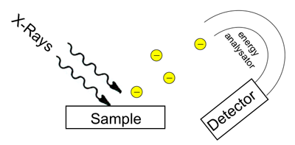
Photoelectron Spectroscopy (PES)
Photoelectron spectroscopy is a laboratory technique that measures the energy of electrons emitted from substances by the photoelectric effect.
This is done to determine the binding energies (related to ionization energies) of electrons in the substance.
Velocity and number of electrons measured
Light of known frequency (and thus energy)

Slide 111
Calculating Binding Energies
The binding energy of an electron is the energy required to remove that electron from the atom (ionization energy).
The binding energy is the energy of the photon minus the kinetic energy of the emitted electron.
If the light has enough energy, multiple electrons can be emitted.
The ionization energy (binding energy) of a particular electron is related to the subshell it is in.
  e.g. There will be 6 electrons that have similar binding energies in the “p” orbitals.

Slide 112
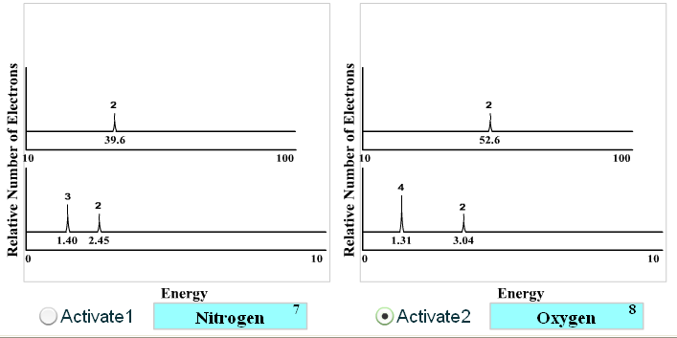
PES Data
Element:
Element:
PES Data Sheet

Slide 113
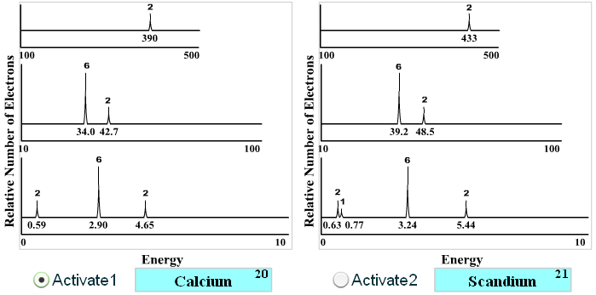
PES Data
Element:
Element:
PES Data Sheet

Slide 114
PES Example Problems
Identify the element: ____________________

Slide 115
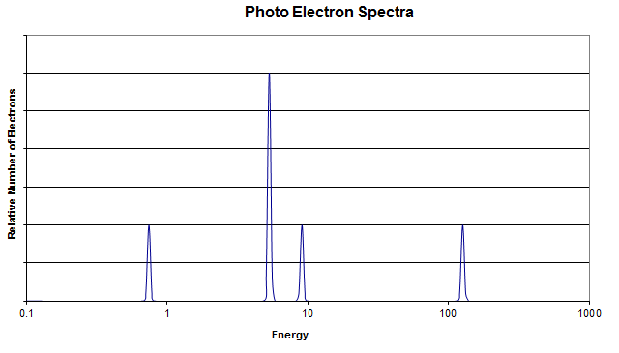
PES Example Problems
Identify the element: ____________________

Slide 116
Electron Affinity
Electron affinity (EA) is the energy change accompanying the addition of an electron to a gaseous atom or ion.
As with IE, there is a first electron affinity, a second, and so forth.
The first electron affinity accompanies the formation of a 1⁻ gaseous ion.
The first electron affinity is generally a negative number, but the second (EA₂) is always a positive number.

Slide 117
Electron Affinity Period Trends
Irregularities in trends appear for electron affinity because factors other than Z_{eff} and atomic size affect EA.
Generally electron affinity has a increasingly negative value across a period from left to right.
  Group 5A elements, however, have a less negative value than the preceding group 4A element.
Electron affinity generally has a less negative value down a group from top to bottom.

Slide 118
Electronegativity
Electronegativity is the relative ability of a bonded atom to attract the shared electrons.
  Inversely related to atomic size.
Electronegativity decreases down a group from top to bottom.
Electronegativity increases across a period from left to right.

Slide 119
Electronegativities
1A
8A
1
H
2.1
1
2A
3A
4A
5A
6A
7A
2
Li
1.0
Be
1.5
B
2.0
C
2.5
N
3.0
O
3.5
F
4.0
2
3
Na
0.9
Mg
1.2
Al
1.5
Si
1.8
P
2.1
S
2.5
Cl
3.0
3
3B
4B
5B
6B
7B
8B
1B
2B
Period
4
K
0.8
Ca
1.0
Sc
1.3
Ti
1.5
V
1.6
Cr
1.6
Mn
1.5
Fe
1.8
Co
1.8
Ni
1.8
Cu
1.9
Zn
1.7
Ga
1.6
Ge
1.8
As
2.0
Se
2.4
Br
2.8
4
5
Rb
0.8
Sr
1.0
Y
1.2
Zr
1.4
Nb
1.6
Mo
1.8
Tc
1.9
Ru
2.2
Rh
2.2
Pd
2.2
Ag
1.9
Cd
1.7
In
1.7
Sn
1.8
Sb
1.9
Te
2.1
I
2.5
5
Cs
0.7
Ba
0.9
∗
6
La
1.1
Hf
1.3
Ta
1.5
W
1.7
Re
1.9
Os
2.2
Ir
2.2
Pt
2.2
Au
2.4
Hg
1.9
Tl
1.8
Pb
1.8
Bi
1.9
Po
2.0
At
2.2
6
Fr
0.7
Ra
0.9
ψ
Ac
1.1
∗
7
Lanthanides: 1.1 - 1.3
ψ
Actinides: 1.3 - 1.5
Below 1.0
2.0 - 2.4
1.0 - 1.4
2.5 - 2.9
1.5 - 1.9
3.0 - 4.0
Notes:
119
Linus Pauling (1901 - 1994) awarded Nobel Prize in chemistry in 1954 for his 1939 text, The Nature of the Chemical Bond,
and also won the Nobel Peace Prize in 1962 for his fight to control nuclear weapons.
The greater the electronegativity of an atom in a molecule, the more strongly it attracts the electrons in a covalent bond.
• Elements with high electronegativities tend to acquire electrons in chemical reactions and are found in the upper-right corner of the periodic table.
• Elements with low electronegativities tend to lose electrons in chemical reactions and are found in the lower-left corner of the periodic table.

Slide 120
Covalent Bonds
Polar Covalent Bonds:
  Electrons are unequally shared
  Electronegativity difference between 0.3 and 1.7
  Example: H₂O
    O = 3.5
    H = 2.1
    Difference = 1.4
Non-polar covalent bonds:
  Electrons are equally shared
  Electronegativity difference between 0 and 0.3
Notes:
120
Metals
– Elements with a low electronegativity and that have electron affinities that have either positive or small negative values and small ionization potentials
– Are good electrical conductors that tend to lose their valence electrons in chemical reactions (they are reductants)
Semimetals
– Elements with intermediate electronegativities
– Elements that have some of the chemical properties of both nonmetals and metals

Slide 121
Summary of Periodic Trends
Shielding is constant
Atomic radius decreases
Ionization energy increases
Electronegativity increases
Nuclear charge increases
Nuclear charge increases
Shielding increases
Atomic radius increases
Ionic size increases
Ionization energy decreases
Electronegativity decreases
1A
0
2A
3A
4A
5A
6A
7A
Ionic size (cations) Ionic size (anions)
decreases decreases
Notes:
121
• Elements with the highest ionization energies are those with the most negative electron affinities, which are located in the upper-right corner of the periodic table.
• Elements with the lowest ionization energies are those with the least negative electron affinities and are located in the lower-left corner of the periodic table.
• The tendency of an element to gain or lose electrons is important in determining its chemistry.
• Various methods have been developed to describe this tendency quantitatively.
• The most important method is called electronegativity (χ), defined as the relative ability of an atom to attract electrons to itself in a chemical compound.
Rules for assigning oxidation states are based on the relative electronegativities of the elements — the more-electronegative element in a binary compound is assigned a negative oxidation state
Electronegativity values used to predict bond energies, bond polarities, and the kinds of reactions that compounds undergo
Trends in periodic properties:
1. Atomic radii decrease from lower left to upper right in the periodic table.
2. Ionization energies become more positive, electron affinities become more negative, and electronegativities increase from the lower left to the upper right.

Slide 122
Periodicity of Main Group Elements
The chemical and physical properties of main-group elements display periodic character.
Metallic-nonmetallic character as well as basic-acidic behavior of element oxides appears in periodic patterns.
Oxides are compounds of an element and oxygen.
A basic oxide reacts with acids.
An acidic oxide reacts with bases.
An amphoteric oxide has both acidic and basic properties.

Slide 123
Hydrogen
Electron Configuration: 1s¹
A colorless gas composed of H₂ molecules.
Should be considered in a group by itself.

Slide 124
Alkali Metals (Group 1A)
Electron Configuration: ns¹
Characteristics:
  Soft
  Reactive (reactivity increases down the group)
React with water to produce hydrogen gas.
  e.g. 2Li(s) + H₂O(l) → LiOH(aq) + H₂(g)
Form basic oxides with the general formula R₂O.
  e.g. Li₂O

Slide 125
Alkaline Earth Metals (Group 2A)
Electron Configuration: ns²
Reactive but less so than alkali metals
  Reactivity increases down the group
Form basic oxides with the general formula RO
  e.g. MgO

Slide 126
Group 3A
Electron Configuration: ns²np¹
Increasing metallic character down the group
Oxides have the general formula R₂O₃
  Boron oxide is acidic.
  Aluminum and gallium oxide are amphoteric.
  Lower oxides in the group become basic, reflecting the increased metallic character.

Slide 127
Group 4A Elements
Electron Configuration: ns²np²
Large change in metallic character down the group
  Carbon is a non-metal
  Silicon and germanium are metalloids
  Tin and lead are metals
Form oxides with the general formula RO₂ and progress from acidic to amphoteric.

Slide 128
Group 5A Elements
Electron Configuration: ns²np³
Transition from nonmetal (N₂) to metal (Bi).
Form oxides with the empirical formulas R₂O₃ and R₂O₅.
Nitrogen, phosphorous, and arsenic have acidic oxides.
Antimony has amphoteric oxides.
Bismuth has the basic oxide.

Slide 129
Chalcogens (Group 6A)
Electron Configuration: ns²np⁴
Transition from nonmetal (O₂) to metal (Po).
Sulfur, selenium, and tellurium form oxides with the formulas RO₂ and RO₃.
  These oxides are acidic except TeO₂ which is amphoteric.
Polonium’s oxide PoO₂ is amphoteric but more basic than TeO₂.

Slide 130
The Halogens (Group 7A)
Electron Configuration: ns²np⁵
Reactive nonmetals with the general molecular formula X₂.
Each halogen forms several compounds with oxygen which are generally unstable, acidic oxides.

Slide 131
The Noble Gases (Group 8A)
Electron configuration: ns²np⁶
Exist as gases consisting of uncombined atoms.
Relatively unreactive

Slide 132
Identifying Elements
Match each set of characteristics below with an element that follows.
  A reactive nonmetal; the atom has a large negative electron affinity
  A soft metal; the atom has a low ionization energy
  A metalloid that forms an oxide of formula R₂O₃
  A chemically unreactive gas
  Sodium (Na)
  Antimony (Sb)
  Argon (Ar)
  Chlorine (Cl₂)

