Slide 1
Unit 6:
Gases and the Kinetic Molecular Theory
Pre-AP Chemistry

Slide 2
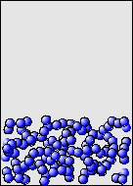
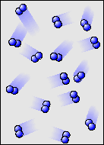
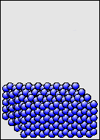
Characteristics of Gases
Gases expand to fill any container.
  Random motion, no attraction
Gases are fluids (like liquids).
  No attraction
Gases have very low densities.
  No volume = lots of empty space
Notes:
2

Slide 3
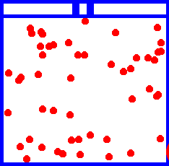
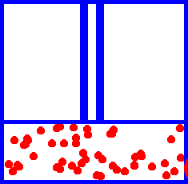
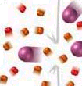
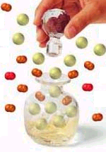
Characteristics of Gases
Gases can be compressed.
  Small molecular volume = lots of empty space
Gases undergo diffusion & effusion.
  Random motion
Notes:
3

Slide 4
Gas Pressure
Pressure (P) is defined as the force exerted per unit of surface area:
  Pressure = force / area
The earth’s gravitational attraction pulls the atmospheric gases toward its surface where they exert a force on all objects. The force of these gases creates a pressure of about 14.7 pounds per square inch (lb/in²; psi) of surface.
In a container, pressure is caused by the collisions of molecules with the container walls.

Slide 5
Pressure
Which shoes create the most pressure?
Notes:
5

Slide 6

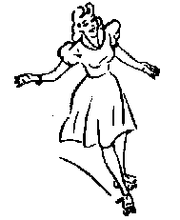
Pressure
Pressure occurs when a force is
dispersed over a given surface area.
F
A
P =
Mass: 2000 kg 55 kg
Foot area: 5000 cm² 60 cm²
If F acts over a large area…
F
=
A
P
F
P
But if F acts over a small area…
=
A
Notes:
6
1 pascal (Pa) = 1 n/m²
1 bar = 10⁵ Pa
1 atmosphere (atm) = 1.01325 bar

Slide 7
Units of Pressure
SI unit of force is the newton (N)
SI unit of pressure is the pascal (Pa)
Other common units of pressure include:
  Standard atmosphere (atm) → the average atmospheric pressure measured at sea level and 0°C.
  Millimeter of mercury (mmHg) → based on measurement with a barometer or manometer
    Also called the torr

Slide 8
Units of Pressure
Unit | Atmospheric Pressure
Pascal (Pa); kilopascal (kPa) | 1.01325x10⁵ Pa; 101.325 kPa
Atmosphere (atm) | 1 atm
Millimeters of mercury (mmHg) | 760 mmHg
Torr | 760 torr
Pounds per square inch (psi or lb/in²) | 14.7 lb/in²
Bar | 1.01325 bar
** These are all equivalent values.
e.g. 1 atm = 760 torr

Slide 9
Converting Units of Pressure
The pressure of a sample of CO₂ is 291.4 mmHg. Calculate the CO₂ pressure in torrs, atmospheres, and kilopascals.
If the pressure of a sample of O₂ is 642.3 mmHg, calculate P_{O2} in torrs, pascals, and lb/in².

Slide 10
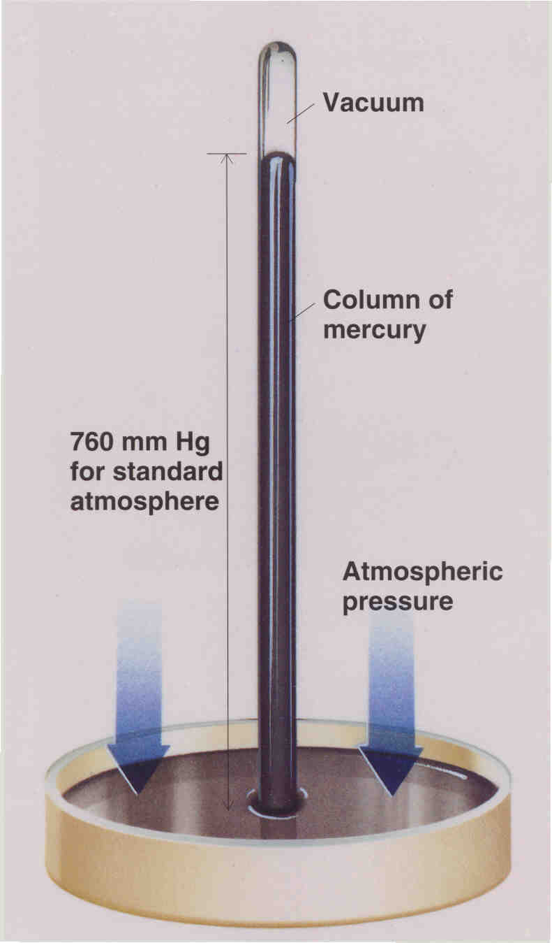
The Barometer
Barometer – a device used to measure atmospheric pressure
Gases in the atmosphere exert a force down on the pool of mercury.
The pressure is measured when equilibrium between the forces of atmospheric gases and the force of the mercury in the tube is reached.
Common unit of pressure is height of mercury column in millimeters (mmHg)

Slide 11
Why Mercury?
Water column
(34.0 ft. high
or 10.4 m)
Mercury filled
  760 mm = 1 atm
Water filled
  10400 mm = 1 atm
Atmospheric
pressure
Mercury column
(30.0 in. high
or 76 cm)
The barometer measures
air pressure
Notes:
11

Slide 12
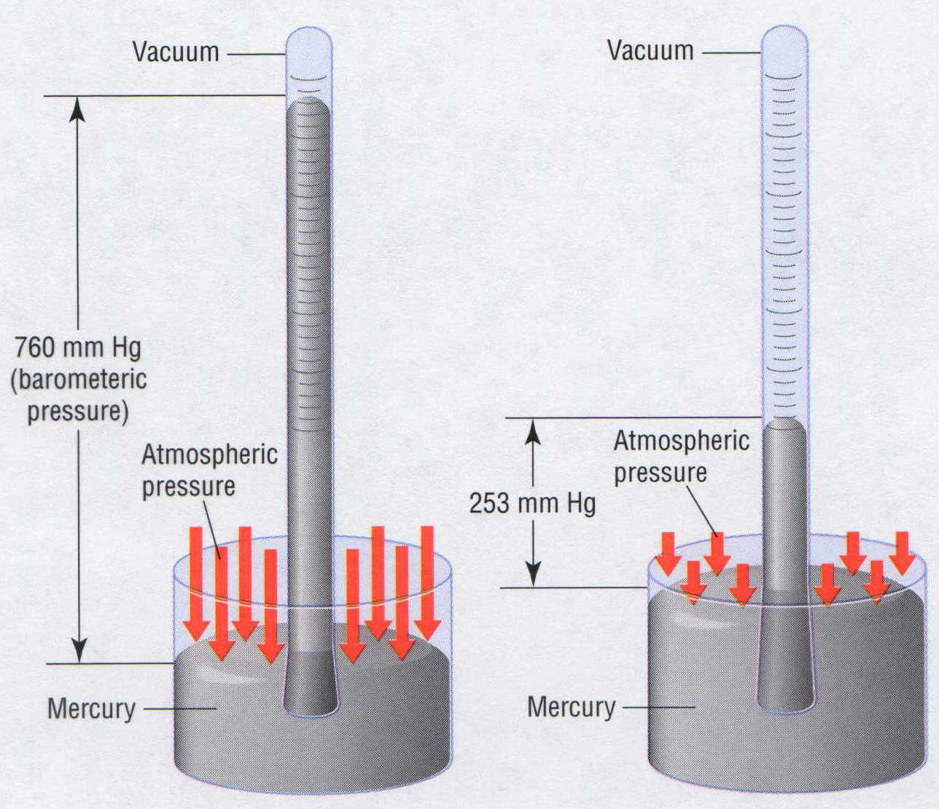
Barometric Pressure
fraction of 1 atm | average altitude
 | (m) | (ft)
1 | 0 | 0
1/2 | 5,486 | 18,000
1/3 | 8,376 | 27,480
1/10 | 16,132 | 52,926
1/100 | 30,901 | 101,381
1/1000 | 48,467 | 159,013
1/10000 | 69,464 | 227,899
1/100000 | 96,282 | 283,076
Sea level On top of Mount Everest
Notes:
12
Every point on Earth’s surface experiences a net pressure called atmospheric pressure.
• Pressure exerted by the atmosphere is considerable.
• A 1.0-m² column, measured from sea level to the top of the atmosphere, has a mass of about 10,000 kg, which gives a pressure of 100 kPa:
pressure = (1.0 x 10⁴kg) (9.807 m/s²) = 1.0 x10⁵ Pa = 100 kPa
1.0 m²
• In English units, this is 15 lb/in^{2.}
Atmospheric pressure can be measured using a barometer, a closed, inverted tube filled with mercury.
• The height of the mercury column is proportional to the atmospheric pressure, which is reported in units of millimeters of mercury (mmHg), also called torr.
Standard atmospheric pressure is the atmospheric pressure required to support a column of mercury exactly 760 mm tall; this pressure is also referred to as 1 atmosphere (atm).
• A pressure of 1 atm equals 760 mmHg exactly and is approximately equal to 100 kPa:
1 atm = 760 mmHg = 760 torr = 1.01325 x 10⁵Pa = 101.325 kPa
Pressure varies smoothly from the earth's surface to the top of the mesosphere. Although the pressure changes with the weather, NASA has averaged the conditions for all parts of the earth year-round. The following is a list of air pressures (as a fraction of one atmosphere) with the corresponding average altitudes. The table gives a rough idea of air pressure at various altitudes.

Slide 13
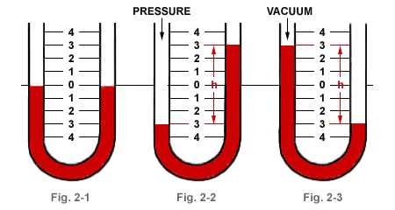
The Manometer
Manometer – a device used to measure the pressure of a gas in an experiment

Slide 14
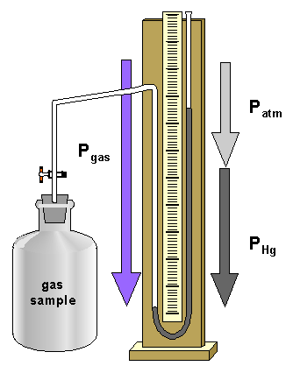
U-Tube Manometer
U-tube Manometer
Notes:
14
Manometers measure the pressures of samples of gases contained in an apparatus.
• A key feature of a manometer is a U-shaped tube containing mercury.
• In a closed-end manometer, the space above the mercury column on the left (the reference arm) is a vacuum (P ≈ 0), and the difference in the heights of the two columns gives the pressure of the gas contained in the bulb directly.
• In an open-end manometer, the left (reference) arm is open to the atmosphere here (P = 1 atm), and the difference in the heights of the two columns gives the difference between atmospheric pressure and the pressure of the gas in the bulb.

Slide 15
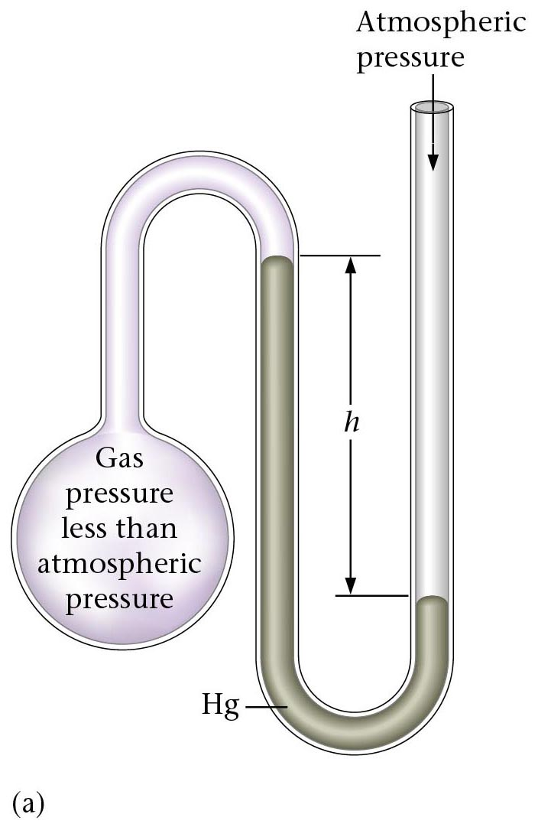
Manometer A
?
Notes:
15

Slide 16
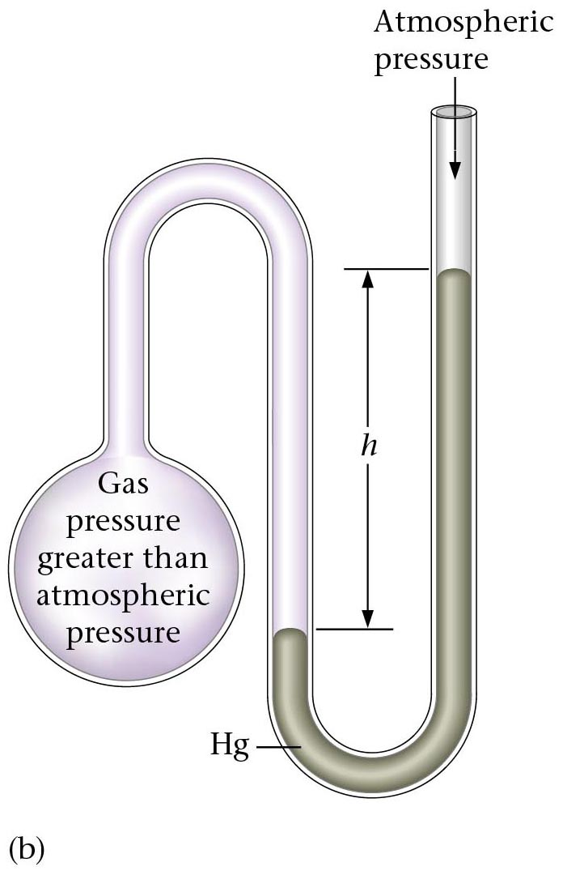
Manometer B
?
Notes:
16

Slide 17
Solving Manometer Problems
BIG
BIG = small + height
112.8 kPa
760 mm Hg
height = BIG - small
=
846.1 mm Hg
101.3 kPa
X mm Hg
=
846.1 mm Hg
-
593 mm Hg
X mm Hg
=
253 mm Hg
253 mm Hg
STEP 1) Decide which pressure is BIGGER
STEP 2) Convert ALL numbers to the unit
of unknown
small
STEP 3) Use formula Big = small + height
0.780 atm
height
X mm Hg
0.780 atm
760 mm Hg
=
593 mm Hg
1 atm
Notes:
17

Slide 18
Manometers Example 1
1.
0.58 atm
98.4 kPa
X mm Hg

Slide 19
Manometers Example 2
2.
X atm
125.6 kPa
0 mm Hg
Because no difference in height is shown in barometer,
you only need to convert “kPa” into “atm”.
Notes:
19

Slide 20
Manometers Example 3
3.
X atm
135.5 kPa
208 mm Hg
Notes:
20

Slide 21
Gas Laws
Physical behavior of a gas can be described by four variables:
  Pressure (P)
  Volume (V)
  Temperature (T)
  Amount (number of moles → n)
Variables are interdependent; that is any one of them can be determined by measuring the other three.
Four key relationships between these four variables:
  Boyle’s Law
  Charles’s Law
  Gay Lussac’s Law
  Avogadro’s Law
Laws are special cases of the ideal gas law.

Slide 22
Temperature
Always use absolute temperature (Kelvin) when working with gases.
ºF
-459
32
212
ºC
-273
0
100
K
0
273
373
K = ºC + 273
Notes:
22
Fahrenheit
Developed by the German physicist Gabriel Daniel Fahrenheit in 1724, the Fahrenheit scale sets zero as the temperature of a mixture of equal amounts of water, salt, and ice. On this scale, the freezing point of water is 32 degrees, and he named the boiling point of water at 212 degrees. (Fahrenheit also invented the mercury thermometer in 1714.) The Fahrenheit scale is the scale most commonly used in the U.S.
Celsius
The Celsius scale is named after the Swedish astronomer Anders Celsius who developed an early version of the scale -- originally called the centigrade scale ("centi" because the scale was divided into 100 degrees). The Celsius scale names the freezing point of water as 0 and the boiling point of water as 100. The Celsius scale is the scale most commonly used everywhere in the world except in the U.S..
Kelvin
The Kelvin scale was invented by Lord Kelvin, a Scottish physicist, in 1848. He set as zero on his scale the coldest any material could possibly get, a point now known as absolute zero. Nothing can ever be colder than absolute zero -- the temperature can only go up from there. That zero point corresponds to -273.15 ºC and -459.67 ºF. The Kelvin scale is the one most often used by scientists who study extremely cold temperatures.

Slide 23
Pressure and Volume
Experiment Pressure Volume P x V (atm) (L) (atm x L)
1 8.0 2.0 16
2 4.0 4.0 _____
3 2.0 8.0 _____
4 1.0 16 _____
Boyle's Law P x V = k (constant) when T remains constant
P₁V₁= 8.0 atm x 2.0 L = 16 atm L
P₂V₂= 4.0 atm x 4.0 L = 16 atm L
P₁V₁ = P₂V₂ = k

Slide 24
Boyle’s Law
Describes the relationship between volume and pressure.
Law states:
  At constant temperature, the volume occupied by a fixed amount of gas is inversely proportional to the applied (external) pressure
  [ T and n fixed]
    PV=constant
    V = constant / P
In general, if volume of the gas increases, the pressure of the gas decreases, and vice versa.

Slide 25
Boyle’s Law Examples
A sample of nitrogen gas is 6.4 L at a pressure of 0.70 atm. What will the new volume be if the pressure is changed to 1.40 atm? (T constant)
A sample of helium gas has a volume of 12.0 L at 600. mm Hg. What new pressure is needed to change the volume to 36.0 L? (T constant)

Slide 26
Boyle’s Law Examples
A sample of oxygen gas is 3.3 L at a pressure of 48.6 kPa. What will the new pressure be if the volume is changed to 1.1 L? (T constant)
Freon-12, CCl₂F₂, is used in refrigeration systems. What is the new volume (L) of a 1.6 L sample of Freon gas initially at 50 mm Hg after its pressure is changed to 200 mm Hg at constant T?

Slide 27
Charles’ Law
V = 125 mL V = 250 mL
T = 273 K T = 546 K
Observe the V and T of the balloons. How does volume change with temperature?

Slide 28
Charles’s Law
Describes the relationship between volume and temperature.
Law states:
  At constant pressure, the volume occupied by a fixed amount of gas is directly proportional to its absolute temperature
    [P and n fixed]
  V/T = constant
  V = constant * T
As temperature increases, volume increases, and vice versa.

Slide 29
Charles’ Law Examples
Use Charles’ Law to complete the statements below:
1. If final T is higher than initial T, final V
is (greater, or less) than the initial V.
2. If final V is less than initial V, final T is
(higher, or lower) than the initial T.

Slide 30
Charles’ Law Examples
A balloon has a volume of 785 mL on a fall day when the temperature is 21°C. In the winter, the gas cools to 0°C. What is the new volume of the balloon?
A sample of oxygen gas has a volume of 420 mL at a temperature of 18°C. What temperature (in °C) is needed to change the volume to 640 mL?

Slide 31
Gay-Lussac’s Law
At constant volume, the pressure exerted by a fixed amount of gas is directly proportional to the absolute temperature
[V and n fixed]
As temperature increases, pressure increases, and vice versa.

Slide 32
Gay-Lussac’s Law Examples
Use Gay-Lussac’s law to complete the statements below:
1. When temperature decreases, the
pressure of a gas (decreases or increases).
2. When temperature increases, the pressure
of a gas (decreases or increases).

Slide 33
Gay-Lussac’s Law Examples
A gas has a pressure at 2.0 atm at 18°C. What will be the new pressure if the temperature rises to 62°C? (V constant)
A gas has a pressure of 3.8 atm at 27°C. What will the temperature be if the pressure decreases to 1.9 atm? (V constant)

Slide 34
Understanding Gas Laws
Complete with 1) Increases 2) Decreases
3) Does not change
A. Pressure _____, when V decreases
B. When T decreases, V _____.
C. Pressure _____ when V changes from 12.0 L to 24.0 L (constant n and T)
D. Volume _____when T changes from 15.0 °C to 45.0°C (constant P and n)

Slide 35
Combined Gas Law
Combining Boyle’s and Charles’ laws gives the Combined Gas Law

Slide 36
Combined Gas Law Problems
If a 2.0 L sample of gas at 3.0 atm and 52°C is compressed to 1.0 L at 25°C, find the pressure of the gas.
If nitrogen gas at 23°C and 746 mmHg occupies 10.1 cm³, what volume would the gas occupy at 0°C and 760 mmHg?

Slide 37
Avogadro’s Law
Describes the relationship between volume and amount.
Law states:
  At constant temperature and pressure, equal volumes of any ideal gas contain equal numbers of particles (or moles).
  [P and T fixed]
  V / n = constant
  V = constant * n
  As number of moles increases, volume increases, and vice versa.

Slide 38
Avogadro’s Law Problems
Assume P and T are fixed.
If 1.5 mol of O₂ occupies 3.2 cm³, how many moles of O₂ would occupy 6.4 cm³?
If a 56 g sample of N₂ occupies 4.6 L, what volume will 168 g of N₂ occupy?

Slide 39
Avogadro’s Law Problems
Assume P and T are fixed.
If 2.6 mol of F₂ occupies 6.1 dm³, what volume will 2.6 mol of Cl₂ occupy?

Slide 40
Standard Conditions
Chemists use a set of standard conditions called standard temperature and pressure (STP):
  STP: 0 °C (273.15 K) and 1 atm (760 torr)
  Standard molar volume = 22.4 L
    The volume of 1 mol of an ideal gas

Slide 41
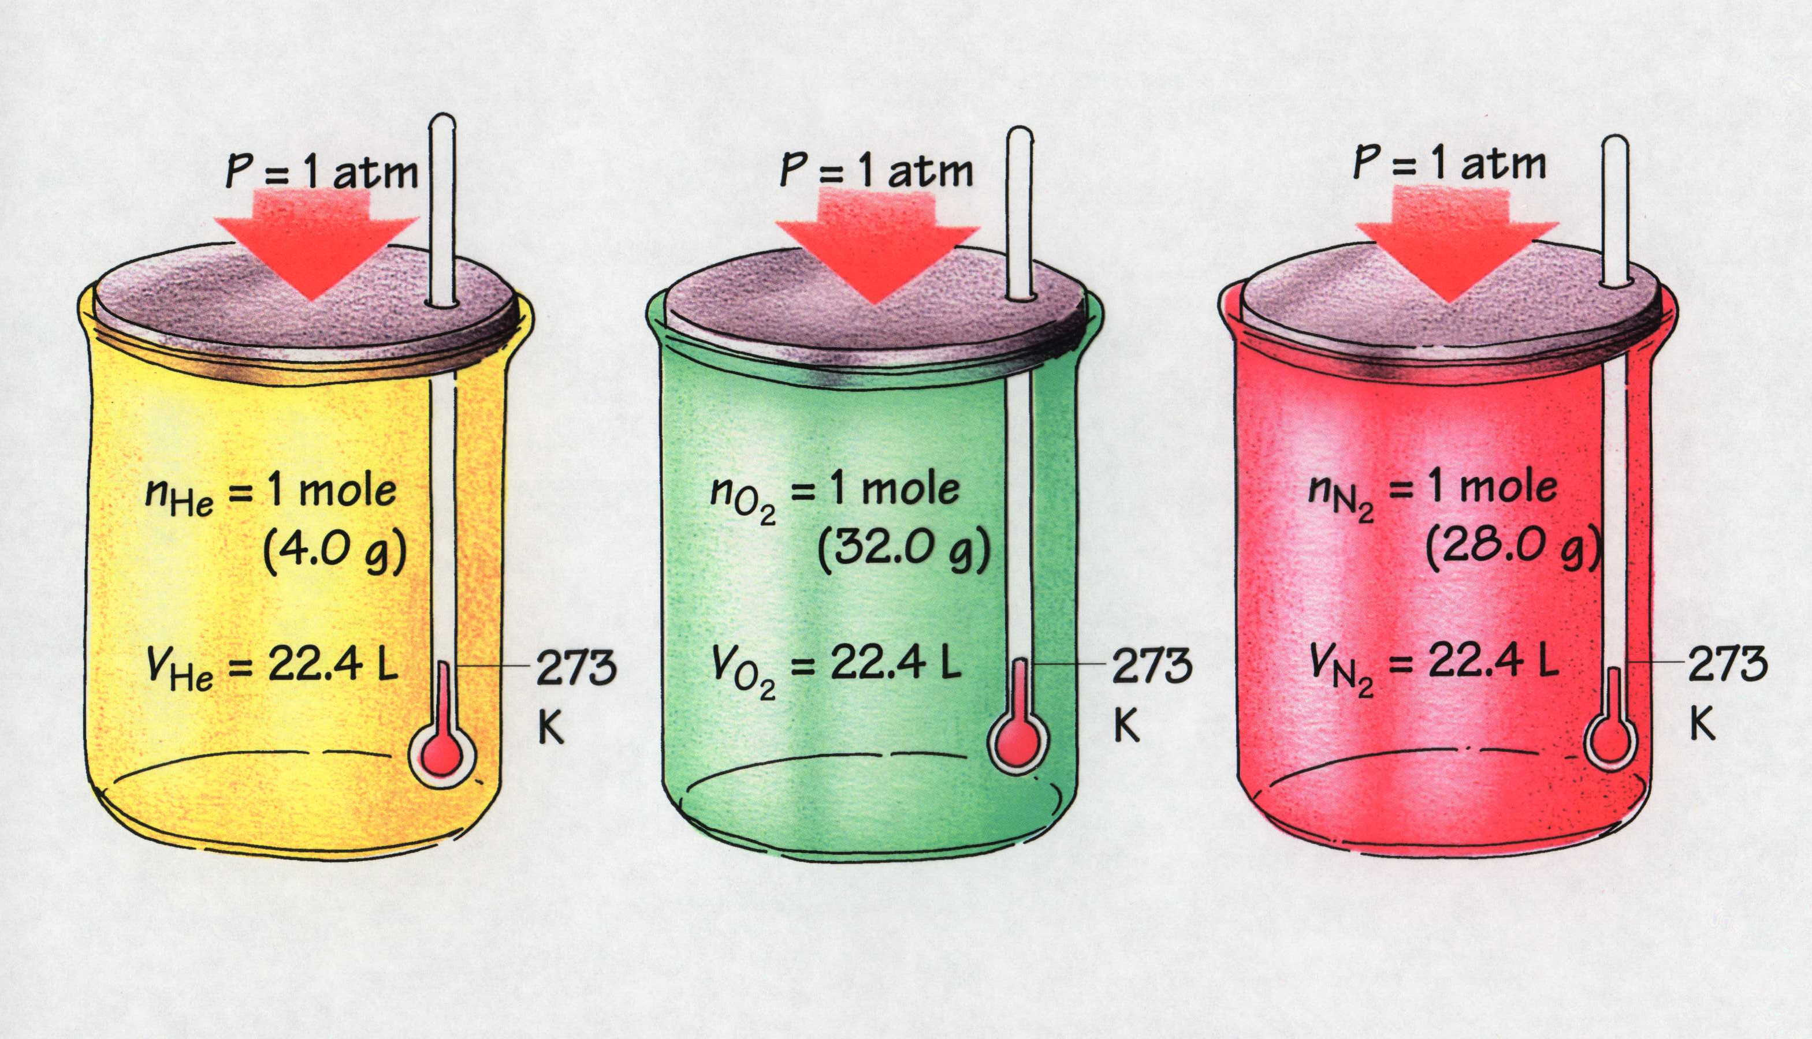
Molar Volume
1 mol of a gas @ STP has a volume of 22.4 L
Notes:
41
MOLAR VOLUME
One mole of any gas occupies 22.4 liters at standard temperature and pressure (STP).

Slide 42
Ideal Gas Law
Each of the gas laws focuses on the effect of changes in one variable on gas volume.
  Can combine these individual effects into one relationship
  R is a proportionality constant known as the universal gas constant

Slide 43
Universal Gas Constant
Values of R

Slide 44
Ideal Gas Law Examples
Given the following sets of values, calculate the unknown quantity.
a) P = 1.01 atm V = ? n = 0.00831 mol T = 25°C
b) P = ? V= 0.602 L n = 0.00801 mol T = 311 K

Slide 45
Ideal Gas Law Problems
At what temperature would 2.10 moles of N₂ gas have a pressure of 1.25 atm and in a 25.0 L tank?

Slide 46
Ideal Gas Law Problems
When filling a weather balloon with gas you have to consider that the gas will expand greatly as it rises and the pressure decreases. Let’s say you put about 10.0 moles of He gas into a balloon that can inflate to hold 5000.0L. Currently, the balloon is not full because of the high pressure on the ground. What is the pressure when the balloon rises to a point where the temperature is -10.0°C and the balloon has completely filled with the gas.

Slide 47
Ideal Gas Law Problems
What volume is occupied by 5.03 g of O₂ at 28°C and a pressure of 0.998 atm?
Calculate the pressure in a 212 liter tank containing 23.3 kg of argon gas at 25°C?

Slide 48
Ideal Gas Law
PV = nRT
or
V = nRT / P
Fixed P and T
Fixed n and T
Fixed n and P
Boyle’s Law
V = constant / P
Charles’s Law
V = constant * T
Avogadro’s Law
V = constant * n

Slide 49
Solving Gas Law Problems
A sample of air occupies 24.8 cm³ at 1.12 atm. The pressure of the air is increased to 2.64 atm. Assuming constant temperature, what is the new volume of the air (in L)?
A sample of argon gas occupies 105 mL at 0.871 atm. If the temperature remains constant, what is the volume (in L) at 26.3 kPa?

Slide 50
Solving Gas Law Problems
A 1.0 L steel tank is fitted with a safety valve that opens if the internal pressure exceeds 1.00x10³ torr. It is filled with helium at 23 °C and 0.991 atm and placed in boiling water at exactly 100 °C. Will the safety valve open?
An engineer pumps air at 0 °C into a newly designed piston cylinder assembly. The volume measures 6.83 cm³. At what temperature (in K) would the volume be 9.75 cm³?

Slide 51
Solving Gas Law Problems
A scale model of a blimp rises when it is filled with helium to a volume of 55.0 dm³. When 1.10 mol of He is added to the blimp, the volume is 26.2 dm³. How many more grams of He must be added to make it rise? Assume constant T and P.
A rigid plastic container holds 35.0 g of ethylene gas (C₂H₄) at a pressure of 793 torr. What is the pressure if 5.0 g of ethylene is removed at constant temperature?

Slide 52
Solving Gas Law Problems
A steel tank has a volume of 438 L and is filled with 885 g of O₂. Calculate the pressure of O₂ at 21 °C.
The tank in problem 7 develops a slow leak that is discovered and sealed. The new measured pressure is 1.37 atm. How many grams of O₂ remain?

Slide 53
Density of a Gas
One mole of any gas occupies nearly the same volume at a given temperature and pressure.
The density (d = m/V) depends on differences in molar mass.
  e.g. at STP, 1 mol O₂ occupies the same volume as 1 mol N₂, but since each O₂ molecule has a greater mass than each N₂ molecule, O₂ is denser.
All gases are miscible when thoroughly mixed but in the absence of mixing, a less dense gas will lie above a more dense one.

Slide 54
Calculating Gas Density
Number of moles is mass divided by molar mass.
The density of a gas is directly proportional to its molar mass.
  A given amount of a heavier gas occupies the same volume as that amount of a lighter gas (Avogadro’s law).
The density of a gas is inversely proportional to the temperature.
  As the volume of a gas increases with temperature (Charles’s law, the same mass occupies more space; thus the density is lower.
Notes:
Relate density of gases rising and falling to real life application. Heating ducts are placed low to the floor because the warm air (temperature goes up, density goes down) has lower density so it will rise. Weather patterns.

Slide 55
Calculating Gas Density
Calculate the density (in g/L) of carbon dioxide
  At STP (0 °C and 1 atm)
  At ordinary room conditions (20 °C and 1.00 atm)
Compare the density of SO₂ at 0 °C and 380 torr with its density at STP.

Slide 56
Molar Mass of a Gas
Rearrange the ideal gas law:

Slide 57
Finding the Molar Mass of a Gas
An organic chemist isolates from a petroleum sample a colorless liquid with the properties of cyclohexane (C₆H₁₂). She obtains the following data to determine its molar mass:
    Volume (V) of flask = 213 mL
    Mass of flask + gas = 78.416 g
    Mass of flask = 77.834 g
    T = 100.0 °C
    P = 754 torr

Slide 58
Finding the Molar Mass of a Gas
At 10.0 °C and 102.5 kPa, the density of dry air is 1.26 g/L. What is the molar mass of dry air at these conditions?

Slide 59
Dalton’s Law of Partial Pressure
Gases mix homogeneously (form a solution) in any proportions.
Each gas in a mixture behaves as if it were the only gas present (assuming no chemical interactions).
Each gas in a mixture exerts a partial pressure, a portion of the total pressure of the mixture, that is the same as the pressure it exerts by itself.
Law states:
  In a mixture of unreacting gases, the total pressure is the sum of the partial pressures of the individual gases.
P_{total} = P₁ + P₂ + P₃ + ….

Slide 60
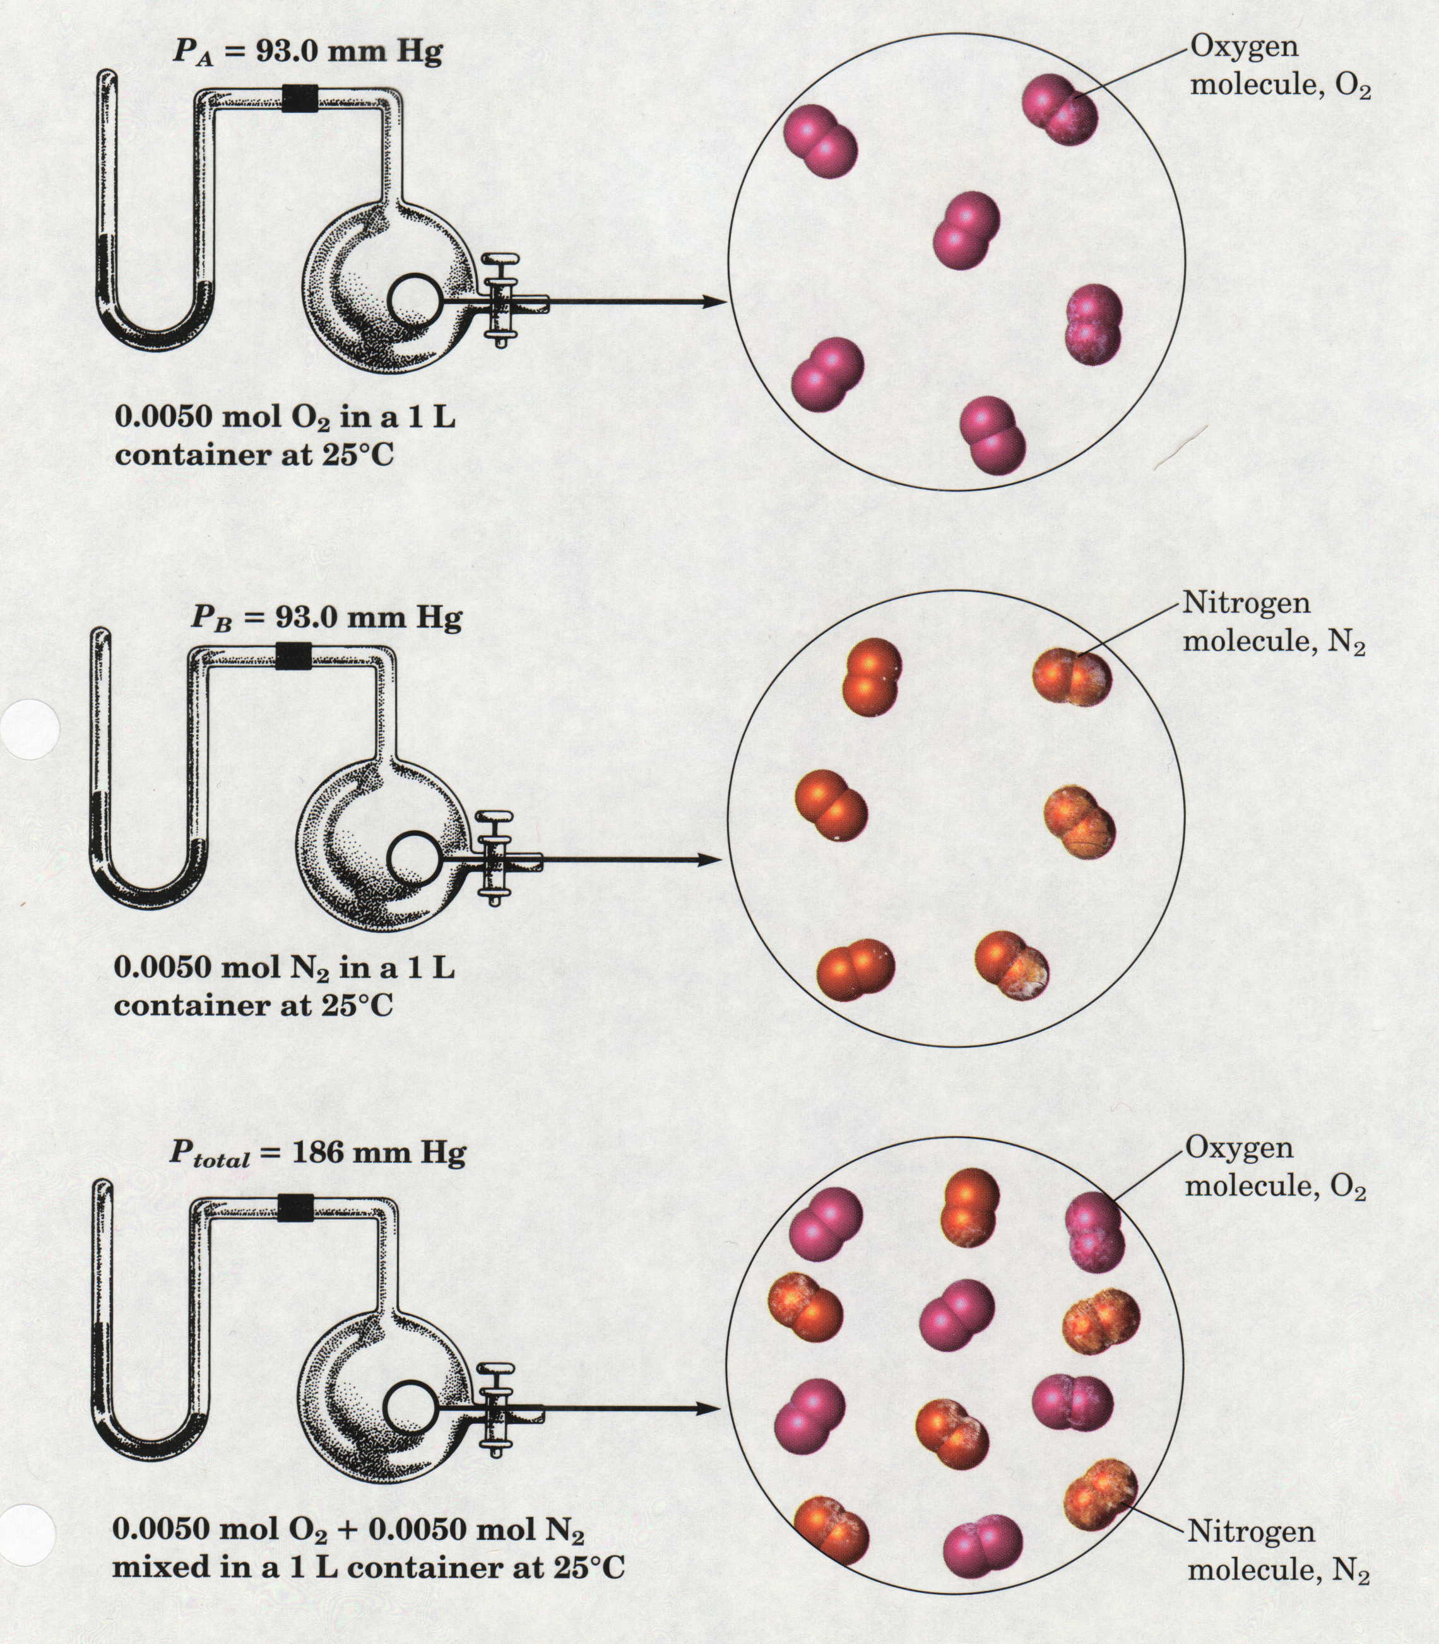
Gas Mixtures and
Dalton’s Law
Notes:
60

Slide 61
Partial Pressure
Each gas in a mixture of gases behaves independently.
Develop a relationship between partial pressure of a gas and the moles of the gas.
  e.g. A mixture of hydrogen and nitrogen gases

Slide 62
Partial Pressure (2)
The fraction of the total number of moles in a mixture that each component in a mixture contributes is called the mole fraction (X) of that component.
  Multiplying X by 100 gives mole percent
The sum of the mole fractions of all components in any mixture must be 1 (mole percent = 100)
Mole Fraction:
Since the total pressure is due to the total number of moles, the partial pressure of gas A is the total pressure multiplied by the mole fraction of A, X_{A}.

Slide 63
Partial Pressure Examples
In a study of O₂ uptake by muscle at high altitude, a physiologist prepares an atmosphere consisting of 79 mole % N₂, 17 mole % O₂, and 4.0 mole % CO₂. The pressure of the mixture is 0.75 atm to simulate high altitude. Calculate the mole fraction and partial pressure of oxygen in the mixture.

Slide 64
Partial Pressure Examples
A mixture of noble gases consisting of 5.50 g of He, 15.0 g of Ne, and 35.0 g of Kr is placed in a piston-cylinder assembly at STP. Calculate the partial pressure of each gas.

Slide 65
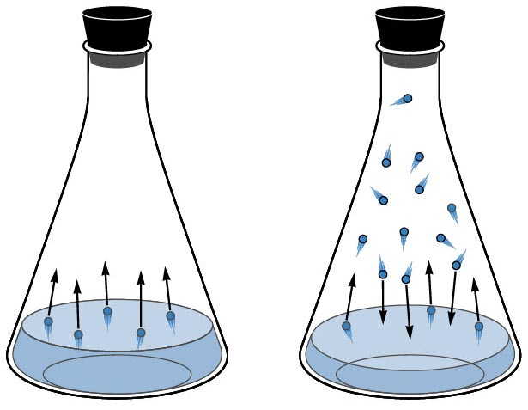
Vapor Pressure
Vapor pressure is the partial pressure of a substance over its liquid/solid form.
Varies with temperature and identity of the substance.
Notes:
65

Slide 66
Vapor Pressure Curves
61.3ºC
78.4ºC
100ºC
101.3
93.3
80.0
66.6
chloroform
Pressure (KPa)
ethyl alcohol
53.3
40.0
water
26.7
13.3
0
10
20
30
40
50
60
70
80
90
100
Temperature (ºC)
Notes:
66

Slide 67
Vapor Pressure of Water
Vapor Pressure of Water at Various Temperatures
Temperature °C | Pressure (mmHg)
0 | 4.6
10 | 9.2
15 | 12.8
17 | 14.5
19 | 16.5
21 | 18.7
23 | 21.1
25 | 23.8
27 | 26.7
30 | 31.8
40 | 55.3
60 | 149.4
80 | 355.1
100 | 760.0

Slide 68
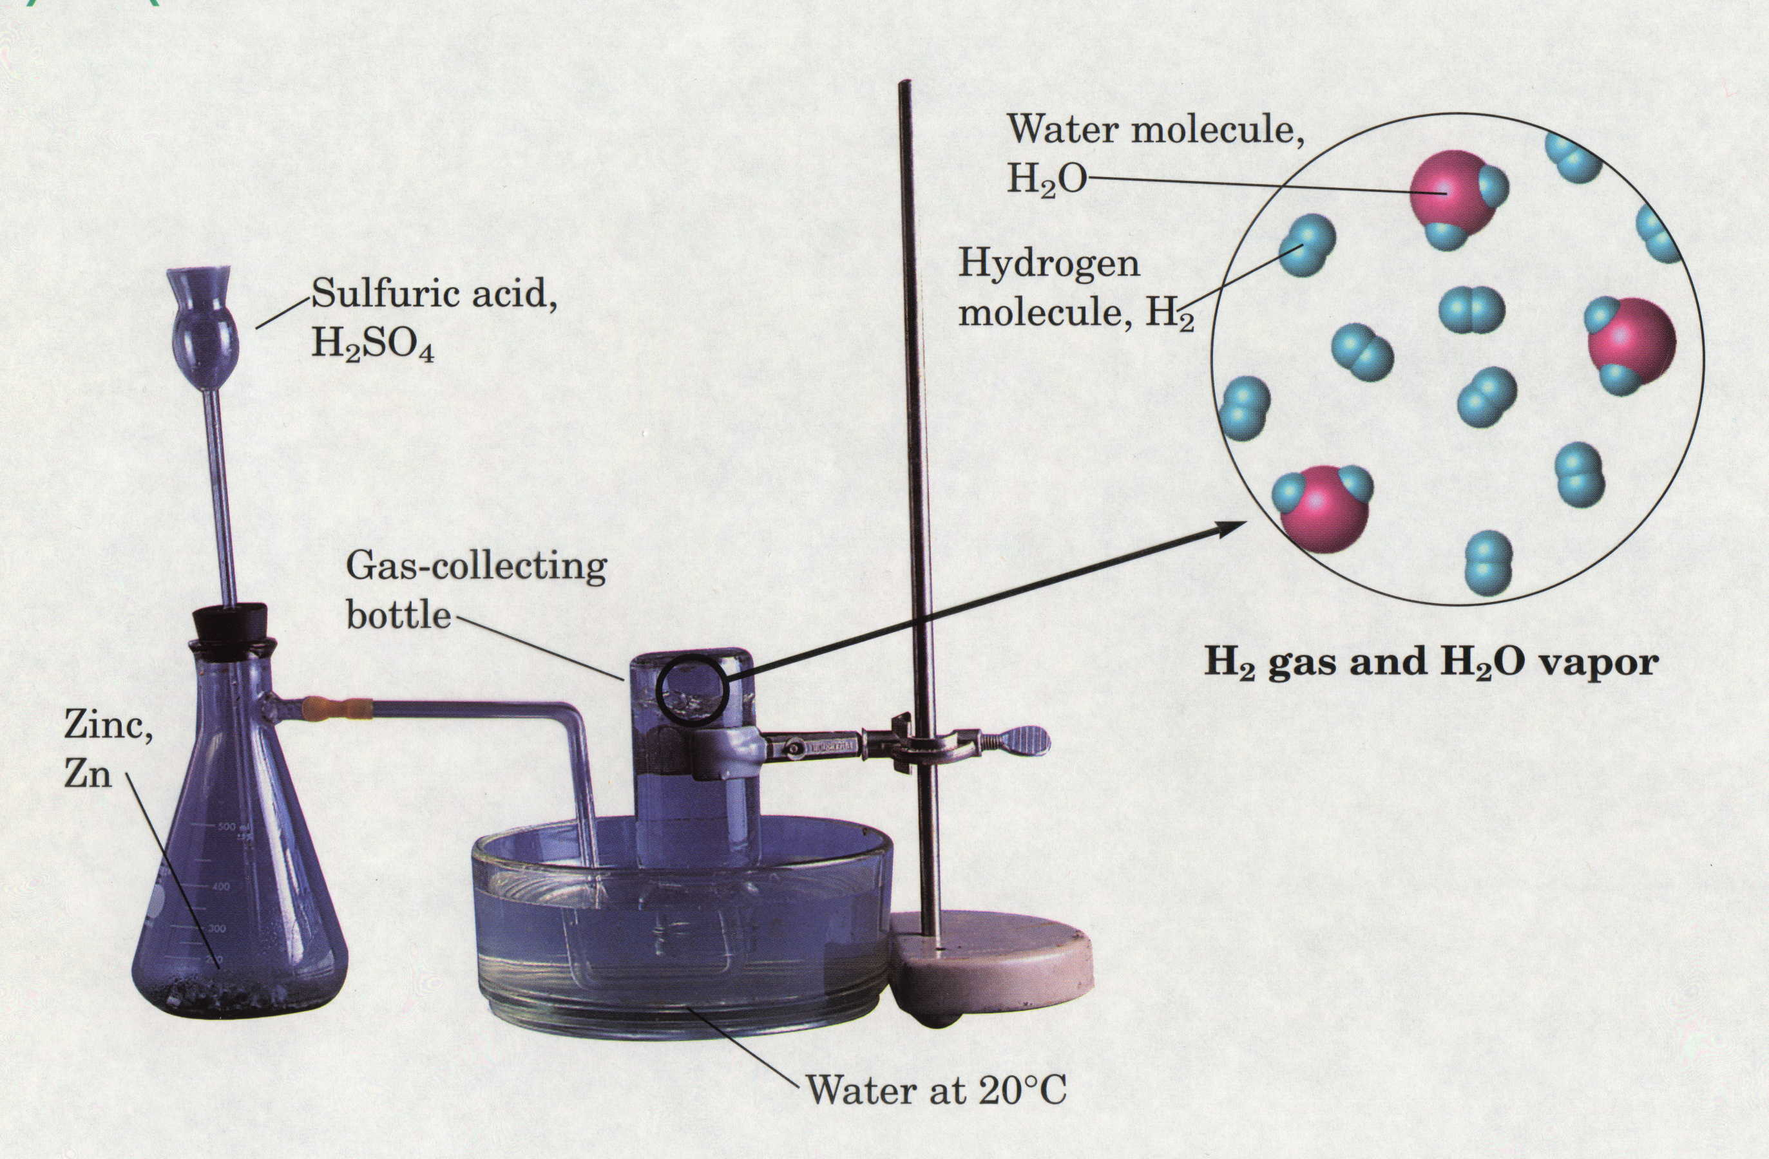
Gas Collected Over Water

Slide 69
Collecting Gases Over Water
Some chemical reactions produce gases which are collected over water.
The total pressure is the sum of the water vapor pressure and the partial pressure of the collected gas.
The partial pressure of the gas can be calculated by subtracting the vapor pressure of water from the total pressure.
The amount of gas collected can be determined from the partial pressure of the gas and the ideal gas law.

Slide 70
Gas Collected Over Water Examples
If 156 mL of hydrogen gas is collected at 19°C and 769 mmHg total pressure,
  Calculate the partial pressure of hydrogen gas.
  Calculate the mass of hydrogen collected.

Slide 71
Gas Collected Over Water Examples
If 254 mL of oxygen gas is collected at 27°C and 655 mmHg total pressure, calculate the mass of oxygen gas collected.

Slide 72
Stoichiometry and the Ideal Gas Law
A laboratory-scale method for reducing a metal oxide is to heat it with H₂. The pure metal and H₂O are products. What volume of H₂ at 765 torr and 225°C is needed to form 35.5 g of Cu from copper (II) oxide?
CuO(s) + H₂(g) → Cu(s) + H₂O (g)

Slide 73
Stoichiometry and the Ideal Gas Law
Sulfuric acid reacts with sodium chloride to form aqueous sodium sulfate and hydrogen chloride gas. How many milliliters of gas form at STP when 117 g of sodium chloride reacts with excess sulfuric acid?

Slide 74
Stoichiometry and the Ideal Gas Law
The alkali metals react with the halogens to form ionic metal halides. What mass of potassium chloride forms when 5.25 L of chlorine gas at 0.950 atm and 293 K reacts with 17.0 g of potassium?

Slide 75
Stoichiometry and the Ideal Gas Law
Ammonia and hydrogen chloride gases react to form solid ammonium chloride. A 10.0 L reaction flask contains ammonia at 0.452 atm and 22°C, and 155 mL of hydrogen chloride gas at 7.50 atm and 271 K is introduced. After the reaction occurs, and the temperature returns to 22°C, what is the pressure inside the flask?

Slide 76
Kinetic Molecular Theory
Developed most notably by James Maxwell and Ludwig Boltzmann
Postulates:
  Postulate 1: Gases are composed of molecules whose size is negligible compared with the average distance between them.
  Postulate 2: Molecules move randomly in straight lines in all directions and at various speeds.
  Postulate 3: The forces of attraction or repulsion between two molecules in a gas are very weak or negligible, except when they collide.
  Postulate 4: When molecules collide with one another, the collisions are elastic.
  Postulate 5: The average kinetic energy of a molecule is proportional to the absolute temperature.
Notes:
Discuss the molecular view of the gas laws with this slide. Need to add pictures of the gas molecules in the fixed container. Maybe animation of them colliding.

Slide 77
Kinetic Molecular Theory
Postulates
Evidence
1. Gases are tiny molecules in mostly empty space. | The compressibility of gases.
2. The molecules move in constant, rapid, random, straight-line motion. | Gases mix rapidly.
3. There are no attractive forces between molecules. | Gases do not clump.
4. The molecules collide elastically with container walls and one another. | Gases exert pressure that does not diminish over time.
5. The average kinetic energy of the molecules is proportional to the Kelvin temperature of the sample. | Charles’ Law
Notes:
77
The kinetic molecular theory of gases explains the laws that describe the behavior of gases and it was developed during the nineteenth century by Boltzmann, Clausius, and Maxwell
Kinetic molecular theory of gases provides a molecular explanation for the observations that led to the development of the ideal gas law
The kinetic molecular theory of gases is based on the following postulates:
1. A gas is composed of a large number of particles called molecules (whether monatomic or polyatomic) that are in constant random motion.
2. Because the distance between gas molecules is much greater than the size of the molecules, the volume of the molecules is negligible.
3. Intermolecular interactions, whether repulsive or attractive, are so weak that they are also negligible.
4. Gas molecules collide with one another and with the walls of the container, but collisions are perfectly elastic; they do not change the average kinetic energy of the molecules.
5. The average kinetic energy of the molecules of any gas depends on only the temperature, and at a given temperature, all gaseous molecules have exactly the same average kinetic energy.
Postulates 1 and 4 state that molecules are in constant motion and collide frequently with the walls of their container and are an explanation for pressure
1. Anything that increases the frequency with which the molecules strike the walls or increases the momentum of the gas molecules increases the pressure.
2. Anything that decreases that frequency or the momentum of the molecules decreases the pressure.
• Postulates 2 and 3 state that all gaseous particles behave identically, regardless of the chemical nature of their component molecules — this is the essence of the ideal gas law.
• Postulate 2 explains how to compress a gas — simply decrease the distance between the gas molecules.

Slide 78
Average Kinetic Energy
Kinetic energy of an object is the energy associated with its motion.
  E_{k} = ½ mass * speed²
  If a heavy object and a light object have the same kinetic energy, the heavy object must be moving more slowly.
  Average kinetic energy for a large population of molecules is
  m is molecular mass and is the average of the squares of the molecular speeds.

Slide 79
Root-Mean-Square Speed
The square root of is called the root mean square speed, or rms speed (u_{rms}).
    A molecule moving at this speed has the average kinetic energy.
Root mean square speed is related to temperature and molar mass by
  R is the gas constant (8.314 J/mol K)
  T is the absolute temperature
  M is the molar mass (kg/mol)
  U_{rms} is in m/s
Notes:
Different gases at the same temperature will have the same average kinetic energy. On average, molecules with a higher mass have a lower speed. (At the same temperature, oxygen molecules move more slowly on average than H2 molecules.

Slide 80
Root Mean Square Speed Examples
Calculate the root mean square speed of O₂ molecules in a tank at 21°C and 15.7 atm.
Calculate the root mean square speed of N₂ molecules in a tank at 33°C and 4.8 atm.

Slide 81
Root Mean Square Speed Examples
At what temperature does the root mean square speed of H₂ molecules in a tank equal 675 m/s?

Slide 82
Effusion
Effusion – the process by which a gas escapes from its container through a tiny hole into an evacuated space.
  Thomas Graham concluded that effusion rate is inversely proportional to the square root of the gas density.
  Effusion rate is the number of moles (or molecules) of gas effusing per unit time.
  Graham’s law of effusion:
    The rate of effusion of a gas is inversely proportional to the square root of its molar mass.

Slide 83
Applying Graham’s Law
Graham’s Law can be used to compare the rates of effusion of two gases.
The ratio of rates of effusion is
The gas with the lower molar mass effuses faster because the most probable speed of its molecules is higher; therefore, more molecules escape per unit time.

Slide 84
Graham’s Law Example Problems
Calculate the ratio of the effusion rates of helium and methane (CH₄)
Calculate the ratio of the effusion rates of hydrogen and carbon dioxide.

Slide 85
Graham’s Law Example Problems
If argon gas effuses twice as fast as an unknown gas, calculate the molar mass of the unknown gas.
If it takes 1.25 min for 0.010 mol of He to effuse, how long will it take for the same amount of ethane (C₂H₆) to effuse?

Slide 86
Diffusion
Gaseous Diffusion – the movement of one gas through another
Closely related to effusion.
Can also be described by Graham’s law.
Diffusion of gases through liquids is much slower because the distances between molecules are much shorter in a liquid than in a gas so collisions are much more frequent.
  Important biological process, e.g. oxygen moving from the lungs to the blood

Slide 87
Gas Law Calculations
Boyle’s Law
Avogadro’s Law
P₁V₁ = P₂V₂
Add or remove gas
Manometer
Charles’ Law
Combined
Ideal
Gas Law
PV = nRT
V₁ = V₂
T₁ = T₂
P₁V₁ = P₂V₂
Big = small + height
T₁ = T₂
Gay-Lussac
Graham’s Law
P₁ = P₂
T₁ = T₂
diffusion vs. effusion
Dalton’s Law
Partial Pressures
P_{T} = P_{A} + P_{B}
Notes:
87
Any set of relationships between a single quantity (such as V) and several other variables (P, T, n) can be combined into a single expression that describes all the relationships simultaneously.
The following three expressions
V ∝ 1/P (at constant n, T)
V ∝ T ( at constant n, P)
V ∝ n (at constant T, P)
can be combined to give
V ∝ nT or V = constant (nT/P)
• The proportionality constant is called the gas constant, represented by the letter R.
• Inserting R into an equation gives V = RnT = nRT
P P
Multiplying both sides by P gives the following equation, which is known as the ideal gas law:
PV = nRT
• An ideal gas is defined as a hypothetical gaseous substance whose behavior is independent of attractive and repulsive forces and can be completely described by the ideal gas law.
• The form of the gas constant depends on the units used for the other quantities in the expression — if V is expressed in liters (L), P in atmospheres (atm), T in kelvins (K), and n in moles (mol), then
R = 0.082057 (L•atm)/(K•mol).
• R can also have units of J/(K•mol) or cal/(K•mol).
A particular set of conditions were chosen to use as a reference; 0ºC (273.15 K) and 1 atm pressure are referred to as standard temperature and pressure (STP).
The volume of 1 mol of an ideal gas under standard conditions can be calculated using the variant of the ideal gas law:
V = nRT = (1 mol) [0.082057 (L•atm)/(K•mol)] (273.15 K) = 22.41 L
P 1 atm
• The volume of 1 mol of an ideal gas at 0ºC and 1 atm pressure is 22.41 L, called the standard molar volume of an ideal gas.
• The relationships described as Boyle’s, Charles’s, and Avogadro’s laws are simply special cases of the ideal gas law in which two of the four parameters (P, V, T, n) are held fixed.

Slide 88
Real Gases – Deviations from Ideal
Real gases differ from the “ideal gas”:
  Molecules have volume and are not simply points of mass.
  Molecules contain attractive and repulsive forces.
At relatively high temperatures and low pressures, most simple gases exhibit nearly ideal behavior, but deviate slightly.
At low temperatures and very high pressures, gases can deviate significantly.

Slide 89
Deviations from Ideal Behavior
At moderately high pressure, values of PV/RT lower then ideal are due predominantly to intermolecular attractions.
At very high pressure, values of PV/RT greater than ideal are due predominantly to molecular volume.

Slide 90
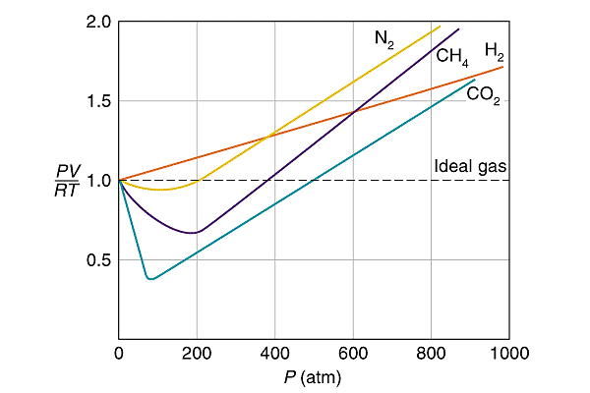
Behavior of Real Gases
** For 1 mole of gas.

Slide 91
Deviations from Ideal Behavior
Intermolecular attractions
  Attractive forces between molecules are much weaker than the covalent bonding forces that hold a molecule together.
  At normal pressures, the spaces between gas molecules are so large that attractions are negligible, but as the pressure rises, the volume of the sample decreases and the average intermolecular distance becomes smaller. Therefore, the attractions have greater effect.
Molecular volume
  At normal pressures, the space between molecules is enormous compared with the volume of the molecules themselves so the free volume is essentially equal to the container volume.
  As pressure increases, the free volume decreases so the molecular volume makes up a greater proportion of the container volume.
  At very high pressures, the free volume becomes significantly less than the container volume and the effect of the molecular volume becomes increasingly important.

Slide 92
van der Waals Equation
van der Waals equation is a redesign of the ideal gas law to account for the behavior of real gases.
  Adjusts the measured pressure up by adding a factor that accounts for intermolecular attractions.
  Adjusts the measured volume down by subtracting a factor from the entire container volume that accounts for the molecular volume.
  a and b are van der Waals constants (experimentally determine positive numbers specific for a given gas)
  a relates to the intermolecular attractions; b relates to the molecular volume
  The constants a and b are zero for an ideal gas because the particles do not attract each other and have no volume.
  At ordinary conditions, the van der Waals equation becomes the ideal gas equation.

Slide 93
Rearranging van der Waals
van der Waals can be rearranged to solve for pressure

Slide 94
Using van der Waals Equation
A 1.98 L vessel contains 4.89 mol of CO₂(g) at 299 K. Calculate the pressure in the vessel using:
  the ideal gas law
  van der Waals equation
    a = 3.59 atm*L²/mol²
    b = 0.0427 L/mol

Slide 95
Using van der Waals Equation
A 3.2 L vessel contains 42 g of ammonia (NH₃) at 338 K. Calculate the pressure in the vessel using:
  the ideal gas law
  van der Waals equation
    a = 4.17 atm*L²/mol²
    b = 0.0371 L/mol

