Slide 1
Unit 5: Major Classes of Reactions
Pre-AP Chemistry

Slide 2
Indications of a Chemical Reaction
Signs of a chemical reaction can include:
Evolution of heat, light, and/or sound
Production of a gas
Formation of a precipitate
Color change
Notes:
2
Objective:
To state four observations that are evidence for a chemical reaction.
Photo of precipitate: http://www.geocities.com/chem_reactions/Images/Precipitate.jpg

Slide 3
Types of Chemical Reactions
Previous classification of reactions:
Synthesis (combination) – two or more reactants formed one product
Decomposition – one reactant formed two or more products
Replacement – the same number of substances on both sides of the equation but the atoms (or ions) exchanged places.
Three major reaction processes:
Precipitation
Acid-Base
Oxidation-Reduction
Notes:
All right, now we’ve got the basics, we are going to start discussing the major reaction processes.
Formerly, there were three different reaction classifications than we use today. These were combination, decomposition, and displacement. Although these are not the ones we are going to be studying in depth here, it is good to understand and be familiar with these terms. Combination simply means that you are combining multiple reactants into one product. Decomposition is the opposite, breaking one reactant down into multiple products. Finally displacement referred to reactions in which the number of substances on either side were the same, but the ions or atoms had rearranged and changed places.
The classification of major reaction types has changed. Today we use three newer classifications that we are going to discuss in detail in the coming slides.
First, we will discuss precipitation reactions which involve something coming out of the solution (like rain/snow). Next, we will discuss acid-base reactions which involve conflicting compounds that work toward neutralization. Thirdly, we will look at oxidation-reduction reactions which involve the transfer of electrons from one compound to another.

Slide 4
Precipitation Reactions
Two soluble ionic compounds react to form an insoluble product called a precipitate.
Driving force for these reactions is the net removal of ions from solution to form the product.
A reaction will occur if there is a possible ion combination that removes ions from solution.
Double replacement reactions (metathesis) occur when the ions exchange partners.
Notes:
First up, precipitation reactions. Precipitation reactions involve two soluble ionic compounds that are mixed together to form a product that is insoluble which is called the precipitate. The reaction we looked at between silver nitrate and sodium chromate is a precipitation reaction. Silver nitrate and sodium chromate were both soluble ionic compounds as we saw from the total ionic equation, but the silver chromate was a solid that was not in solution. This product “precipitated” out of solution. These reactions occur because the reactions “want” to remove ions from solution. Reaction between soluble ionic compounds only occurs if there is some combination of ions that will cause a precipitate to form. This reaction below can also be called a double displacement reaction which just means that the ions switch partners. In this case, silver switched places with sodium as the cation and chromate and nitrate switched places.

Slide 5
Precipitation Reactions
In order to produce a precipitate, reactant chemicals must dissociate so that the ions can recombine with other available ions into a different compound.
e.g. The reaction of NaCl and AgNO₃ is said to produce a precipitate of AgCl. However, to achieve this, NaCl must first dissociate (split apart) and AgNO₃ must also dissociate.
O
Cl⁻
N
Na⁺
Ag⁺
O
O
Dissociate
Dissociate
Cl⁻
O
Na⁺
Ag⁺
N
O
O
Precipitate
Cl⁻
Ag⁺

Slide 6
Practicing Solubility Equations
Show the net ionic equation for the following processes:
Dissociate ammonium nitrate:
Precipitate copper (II) hydroxide:
Dissociate chromium (III) thiocyanate:
Precipitate lead (II) chromate:
Dissociate silicon permanganate:
Precipitate zinc phosphate:
Notes:
6

Slide 7
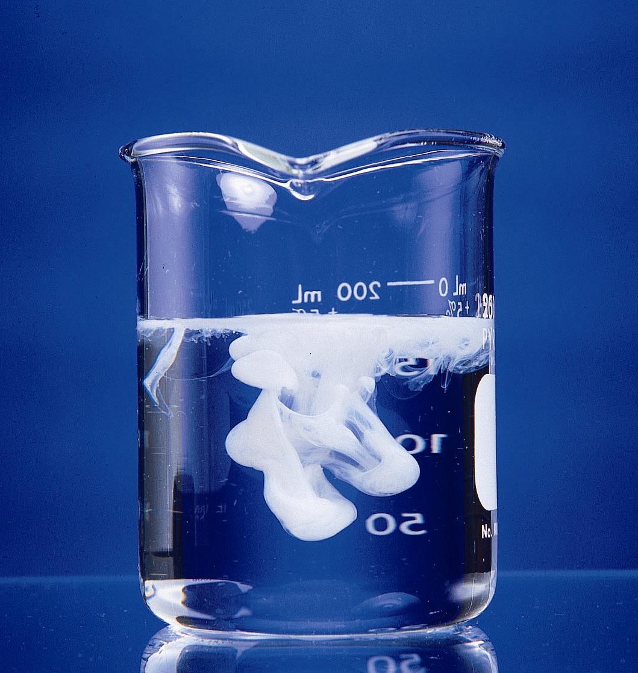
Precipitation Reaction Between
AgNO₃ and KCl
unknown
white solid
AgNO₃(aq) + KCl(aq)
AgCl
Ag⁺ + NO₃⁻ + K⁺ + Cl⁻
unknown white solid
?
in silver
nitrate
solution
in potassium
chloride
solution
K⁺
Ag⁺
Cl⁻
NO₃⁻
K⁺
Cl⁻
NO₃⁻
Ag⁺
Cl⁻
NO₃⁻
Ag⁺ + NO₃⁻ + K⁺ + Cl⁻
Ag⁺ + Cl⁻ + K⁺ + NO₃⁻
Ag⁺
Cl⁻
K⁺
Ag⁺
product
product
AgNO₃(aq) + KCl(aq) AgCl(s) + KNO₃(aq)
AgCl precipitate
AgNO₃(aq) + KCl(aq) → KNO₃ (aq) + AgCl(s)
Notes:
7

Slide 8
Solubility Rules
Soluble Compounds | Insoluble Exceptions
Compounds containing alkali metal ions (Group 1A) and ammonium (NH₄⁺)
Nitrates (NO₃⁻) Acetates (C₂H₃O₂⁻) Perchlorates (ClO₄⁻)
Chlorides (Cl⁻) | Ag⁺, Pb²⁺, Hg₂²⁺
Sulfates (SO₄²⁻) | Ca²⁺, Sr²⁺, Ba²⁺, Ag⁺, Hg₂²⁺, Pb²⁺
Insoluble Compounds | Soluble Exceptions
Carbonates (CO₃²⁻) Phosphates (PO₄³⁻) Sulfides (S²⁻) Chromates (CrO₄²⁻) | Compounds containing Group 1A ions and ammonium
Hydroxides (OH⁻) | Compounds containing Group 1A ions, Ca²⁺, Ba²⁺, Sr²⁺

Slide 9
Solubility Examples
Predict if the following compounds will be soluble in water:
Hg₂Cl₂
KI
Lead (II) nitrate
Calcium hydroxide
Lead (II) sulfate
Lithium sulfide

Slide 10
Predicting Precipitation
To predict if a precipitate will form:
Note the ions present in the reactants.
Consider the possible cation-anion combinations
Decide whether any of the combinations is insoluble.
Must memorize solubility rules for this.
Notes:
To be able to determine if a precipitation reaction is going to occur, we have to know if a precipitate is going to occur. We are going to have to learn some rules in order to be able to predict precipitation. First, we have to identify all the ions present in reactants. Using these, we have to determine all the possible combinations of cations and anions that we could use. Then, determine whether any of these combinations are insoluble. We use a set of solubility rules to determine this and this is something you must memorize.

Slide 11
Predicting Precipitation Reactions
Predict if a reaction will occur between the two reactants given. If so, write the balanced net ionic equation for the reaction and identify spectator ions.
Lead (II) nitrate and potassium iodide
Iron (II) chloride and sodium carbonate

Slide 12
Predicting Precipitation Reactions
Sodium nitrate and lithium chloride

Slide 13
Predicting Precipitation Examples
Predict whether a reaction occurs when each of the following pairs of solutions are mixed. If a reaction does occur, write balanced molecular, total ionic, and net ionic equations, and identify the spectator ions.
Sodium sulfate (aq) + strontium nitrate (aq)
Ammonium perchlorate (aq) + sodium bromide (aq)
Notes:
Ok, here we are given a pair of aqueous ionic compounds that are mixed and we have to determine whether a reaction occurs (a precipitate forms). If it does, then we have to write the molecular, total ionic, and net ionic equations for the reaction as well as picking out the spectator ions. First, sodium sulfate, and strontium nitrate. Following our precipitation procedure, we have to identify all the ions we have. Na+, SO42-, Sr2+, NO3-. Now we have to pick out combinations between these two. We can get sodium nitrate and strontium sulfate (double displacement). Is sodium nitrate soluble or insoluble. Look back at our rules. Sodium is a group 1A element so there is a good chance that it is going to make a soluble compound. Nitrates are also soluble so sodium nitrate is should be soluble. Strontium sulfate: sulfates are supposed to be soluble, but check out the exceptions: strontium sulfate will be insoluble. So we’ve got a reaction! Let’s write our molecular equation. Then we’ll move on to the total ionic and net ionic equations.

Slide 14
Predicting Precipitation Examples
Iron(III) chloride (aq) + cesium phosphate (aq)
Sodium hydroxide (aq) + cadmium nitrate (aq)
Notes:
Ok, here we are given a pair of aqueous ionic compounds that are mixed and we have to determine whether a reaction occurs (a precipitate forms). If it does, then we have to write the molecular, total ionic, and net ionic equations for the reaction as well as picking out the spectator ions. First, sodium sulfate, and strontium nitrate. Following our precipitation procedure, we have to identify all the ions we have. Na+, SO42-, Sr2+, NO3-. Now we have to pick out combinations between these two. We can get sodium nitrate and strontium sulfate (double displacement). Is sodium nitrate soluble or insoluble. Look back at our rules. Sodium is a group 1A element so there is a good chance that it is going to make a soluble compound. Nitrates are also soluble so sodium nitrate is should be soluble. Strontium sulfate: sulfates are supposed to be soluble, but check out the exceptions: strontium sulfate will be insoluble. So we’ve got a reaction! Let’s write our molecular equation. Then we’ll move on to the total ionic and net ionic equations.

Slide 15
Predicting Precipitation Examples
Magnesium bromide(aq) + potassium acetate (aq)
Lithium sulfate (aq) + barium chloride(aq)
Sodium hydroxide(aq) + hydrogen chloride(aq)
Notes:
Ok, here we are given a pair of aqueous ionic compounds that are mixed and we have to determine whether a reaction occurs (a precipitate forms). If it does, then we have to write the molecular, total ionic, and net ionic equations for the reaction as well as picking out the spectator ions. First, sodium sulfate, and strontium nitrate. Following our precipitation procedure, we have to identify all the ions we have. Na+, SO42-, Sr2+, NO3-. Now we have to pick out combinations between these two. We can get sodium nitrate and strontium sulfate (double displacement). Is sodium nitrate soluble or insoluble. Look back at our rules. Sodium is a group 1A element so there is a good chance that it is going to make a soluble compound. Nitrates are also soluble so sodium nitrate is should be soluble. Strontium sulfate: sulfates are supposed to be soluble, but check out the exceptions: strontium sulfate will be insoluble. So we’ve got a reaction! Let’s write our molecular equation. Then we’ll move on to the total ionic and net ionic equations.

Slide 16
Acids and Bases
Characteristics of Acids:
Sour Taste
Turns blue litmus red
Reacts with some metals to produce H₂
Dissolves carbonate salts, releasing CO₂
e.g. vinegar, milk, soda, apples, citrus fruits
Characteristics of Bases:
Bitter taste
Turns red litmus blue
Slippery to the touch
e.g. ammonia, lye, antacid, baking soda
Notes:
16
Properties of acids and bases
Acids
– Sour taste
– Turns blue litmus paper red
– Reacts with some metals to produce H₂
– Dissolves carbonate salts, releasing CO₂
Bases
– Bitter taste
– Turns red litmus paper blue
– Slippery to the touch

Slide 17
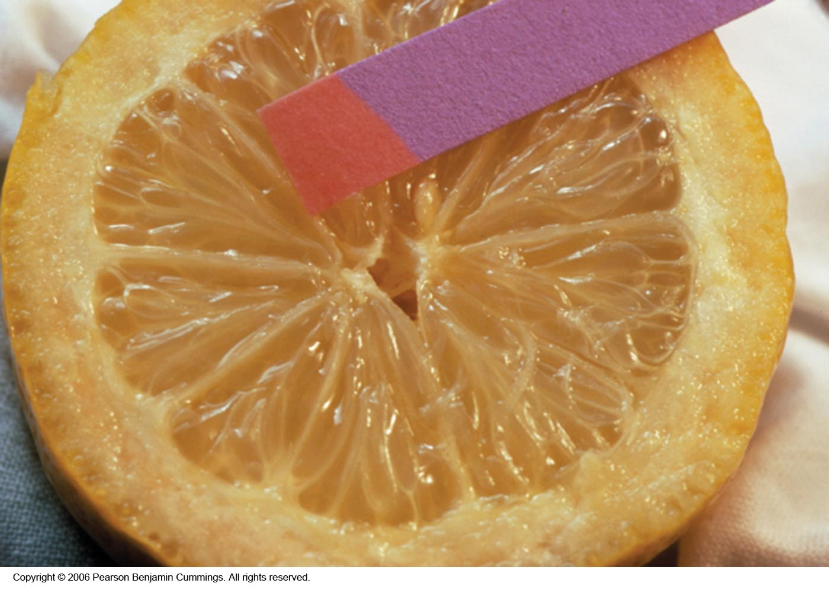
Litmus Paper
Notes:
17

Slide 18
Common Acids
Formula Name of Acid Name of Negative Ion of Salt
HF hydrofluoric fluoride
HBr hydrobromic bromide
HI hydroiodic iodide
HCl hydrochloric chloride
HClO hypochlorous hypochlorite
HClO₂ chlorous chlorite
HClO₃ chloric chlorate
HClO₄ perchloric perchlorate
H₂S hydrosulfuric sulfide
H₂SO₃ sulfurous sulfite
H₂SO₄ sulfuric sulfate
HNO₂ nitrous nitrite
HNO₃ nitric nitrate
H₂CO₃ carbonic carbonate
H₃PO₃ phosphorous phosphite
H₃PO₄ phosphoric phosphate
Notes:
18

Slide 19
Common Bases
Name Formula Common Name
Sodium hydroxide NaOH lye or caustic soda
Potassium hydroxide KOH lye or caustic potash
Magnesium hydroxide Mg(OH)₂ milk of magnesia
Calcium hydroxide Ca(OH) ₂ slaked lime
Ammonia water NH₃ household ammonia
Notes:
19
Bases
– Bases are ionic compounds that contain the hydroxide ion and a metal cation and have the general formula M(OH)_{n} .
– When a base reacts with an acid, it accepts a proton (H⁺) and is therefore called a proton acceptor.
– Aqueous ammonia solution is also a common base.
– Replacing a hydrogen atom of NH₃ with an alkyl group results in an amine (RNH₂), which is also a base. Amines have pungent odors.

Slide 20
Acids and Bases
Strong acids and bases are strong electrolytes.
Weak acids and bases are weak electrolytes.
Acids
Strong | Weak
Hydrochloric (HCl) | Hydrofluoric (HF)
Hydrobromic (HBr) | Phosphoric (H₃PO₄)
Hydroiodic (HI) | Acetic (HC₂H₃O₂)
Nitric (HNO₃) | And a lot more
Sulfuric (H₂SO₄)
Perchloric (HClO₄)
Bases
Strong | Weak
Lithium hydroxide (LiOH) | Ammonia (NH₃)
Sodium hydroxide (NaOH) | And a lot more
Potassium hydroxide (KOH)
Rubidium hydroxide (RbOH)
Cesium hydroxide (CsOH)
Calcium hydroxide (Ca(OH)₂)
Strontium hydroxide (Sr(OH)₂)
Barium hydroxide (Ba(OH)₂)
Notes:
Here is a table of some common acids and bases categorized based on their strength. If you look at the strong acids, most of the halogen acids are strong except hydrofluoric acid. The strong bases include hydroxides. Of note, memorize the strong acids. All other acids should be assumed weak – and do not dissociate well.

Slide 21
Acid Dissociation
Acids have different numbers of H⁺ ions to contribute depending on their identity.
Monoprotic acids have only one acidic hydrogen atom (H⁺) per molecule.
e.g. HCl → H⁺ + Cl⁻
Polyprotic acids have multiple acidic hydrogen atoms per molecule.
e.g. H₂SO₄ → 2H⁺ + SO4²⁻ (diprotic)
e.g. H₃PO₄ → 3H⁺ + PO₄³⁻ (triprotic)
Notes:
21
Acids differ in the number of hydrogen ions they can donate.
– Monoprotic acids are compounds capable of donating a single proton per molecule.
– Polyprotic acids can donate more than one hydrogen ion per molecule.
Polyprotic acids contain more than one ionizable proton, and the protons are lost in a stepwise manner.
• The fully protonated species is always the strongest acid because it is easier to remove a proton from a neutral molecule than from a negatively charged ion; the fully deprotonated species is the strongest base.
• Acid strength decreases with the loss of subsequent protons, and the pK_{a} increases.
• The strengths of the conjugate acids and bases are related by pK_{a} + pK_{b} = pK_{w}, and equilibrium favors formation of the weaker acid-base pair.
When a strong base is added to a solution of a polyprotic acid, the neutralization reaction occurs in stages.
1. The most acidic group is titrated first, followed by the next most acidic, and so forth
2. If the pK_{a} values are separated by at least three pK_{a} units, then the overall titration curve shows well-resolved “steps” corresponding to the titration of each proton

Slide 22
pH
pH is a measure of how acidic or basic a solution is.
pH scale ranges from 0 to 14.
0 is the most acidic
14 is the most basic
7 indicates a “neutral” solution.

Slide 23
pH Paper
pH 0 1 2 3 4 5 6
pH 7 8 9 10 11 12 13

Slide 24
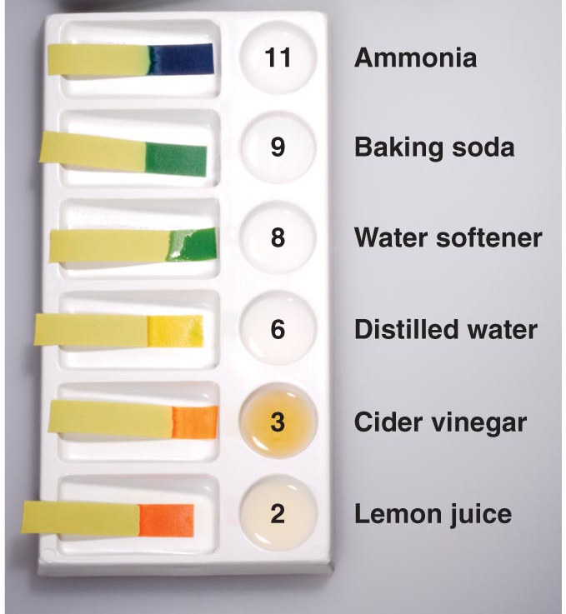
pH of Common Substances
Notes:
24
Paper or plastic strips that contain combinations of indicators estimate the pH of a solution by simply dipping a piece of pH paper into it and comparing the resulting color with standards printed on the container

Slide 25
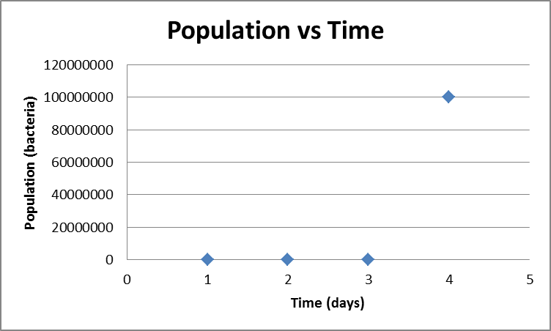
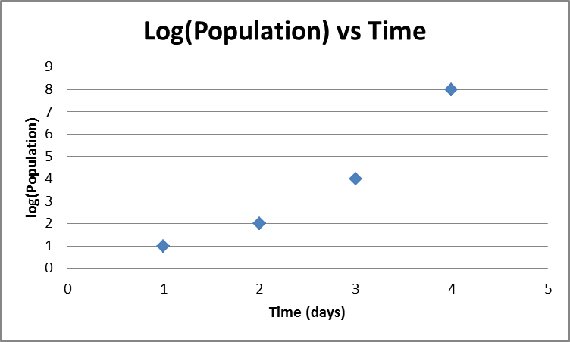
Logarithmic Scales
pH is a logarithmic scale. Logarithmic scales show values based on a interval of orders of magnitude.
Suppose you were asked to graph the following data on bacteria growth:
Day | Population
1 | 10
2 | 100
3 | 10,000
4 | 100,000,000

Slide 26
Calculating pH / pOH
Because most concentrations are values with negative powers of ten, a negative is added to the logarithmic equation for pH.
pH is determined by taking the negative logarithm of the concentration of hydronium ions (or H⁺)
pH = -log[H₃O⁺] or pH = -log[H⁺]
pOH is determined by taking the negative logarithm of the concentration of hydroxide ions (OH⁻)
pOH = -log[OH⁻]
The sum of pH and pOH is equal to 14.
pH + pOH = 14

Slide 27
Calculating pH Examples
 | [H⁺] | pH | [OH⁻] | pOH | Acid/Base?
1 | 2.9x10⁻⁶ M
2 |  | 3.87
3 |  |  | 5.6x10⁻⁴ M
4 |  |  |  | 11.43

Slide 28
pH Examples
The concentration of H⁺ ions in a bottle of table wine was 3.2x10⁻⁴ M right after the cork was removed. Calculate the pH of the wine.
Only half of the wine was consumed. The other half, after it had been standing open to the air for a month, was found to have a H⁺ ion concentration equal to 1.0x10⁻³ M. Calculate the pH of the wine.

Slide 29
pH Examples
In a NaOH solution, [OH⁻] is 2.9x10⁻⁴ M. Calculate the pOH and pH of the solution.
The pH of rainwater collected in a certain region of the northeastern United States on a particular day was 4.82. Calculate the H⁺ ion concentration of the rainwater.

Slide 30
pH Examples
Challenge: What is the pH of a solution made by dissolving 2.5 g HCl in enough water to make 400 mL of solution?

Slide 31
Acid-Base Reactions
Occurs when an acid reacts with a base
Also called a neutralization reaction
An acid is a substance that produces H⁺ ions when dissolved in water. (Arrhenius)
A base is a substance that produces OH⁻ ions when dissolved in water. (Arrhenius)
Strong acids and bases dissociate completely in aqueous solution.
Weak acids and bases dissociate so little that most of their molecules remain intact.
Notes:
Now we’re going to look at our next type of reaction: acid base reactions. These reactions are pretty self explanatory in their name. They occur when an acid reacts with a base; this is also called a neutralization reaction. To understand what compounds are involved in these reactions, we have to know what an acid and base are. An acid is a compound that ionizes to produce H+ when it is dissolved in water, while a base is a compound that ionizes to produce OH- when it is dissolved in water. You will see some other definitions of acids/bases a little later, but this definition is pretty solid. Just like electrolytes, the more an acid or base dissociates in solution, the stronger it is as an acid or base. We are going to look at some strong acids/bases and weak acids/bases.

Slide 32
Driving Force for Reaction
The essential change in all aqueous reactions between strong acids and strong bases is that an H⁺ ion from the acid and an OH⁻ ion from the base form a water molecule.
Only spectator ions differ between reactions
Reaction is driven by the electrostatic attraction of ions and their removal from solution (H₂O product).
A salt is an ionic compound that results from the reaction of an acid and base.
Reactants are acid and base; products are a salt solution and water.
Cation of salt comes from base.
Anion of salt comes from acid.
Notes:
We discussed the driving force for precipitation reactions was the formation of a precipitate that comes out of solution. The driving force for acid base reactions is the removal of H+ and OH- ions from solution to form a water molecule. An acid base reaction involves a H+ ion from the acid combines with the OH- ion to make H2O. Water should be made, but the cation from the base and the anion from the acid combine to make a “salt”.

Slide 33
Acid-Base Neutralization
1+
1-
+
+
H₃O⁺
OH⁻
H₂O
H₂O
Hydronium ion
Hydroxide ion
Water
Water
Notes:
33

Slide 34
Writing Net Ionic Equations for Acid-Base
After identifying a reaction as involving an acid and a base, go through the following steps to write a net ionic:
Is NH₃ the base involved? If so, one of the products will be NH₄⁺ and the other will be the anion of the acid.
If NH₃ is not present and the base contains a hydroxide ion, then one of the products will be water and the other will be the combination of the anion (negative ion) from the acid and the cation (positive ion) from the base.
Once the products are known, balance the molecular equation. Then decide whether to split each substance up or not.
If the acid is one of the 6 strong acids, split it apart. Otherwise the acid stays as is.
If the base is one of the 8 strong bases, split is apart. Otherwise, the base stays as is.
If one of the products is water, leave it as is. Refer to solubility rules to determine whether the other product should be split or not.
Once all substances have been assessed for dissociation, cross out any ion that occurs on both sides of the equation (spectators). The remaining particles will make up your net ionic.

Slide 35
Writing Acid-Base Reactions
Write the net ionic equations for the following reactions and identify any spectator ions:
HClO₄ + Ba(OH)₂ →
HF + LiOH →
H₃PO₄ + KOH →

Slide 36
Writing Acid-Base Reactions
Write the net ionic equations for the following reactions and identify any spectator ions:
HBr + NH₃ →
HC₂H₃O₂ + NH₃ →
Al(OH)₃ + H₃PO₄ →

Slide 37
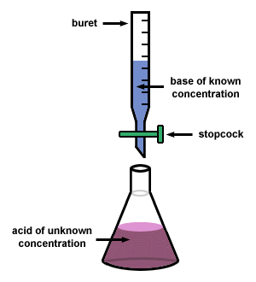
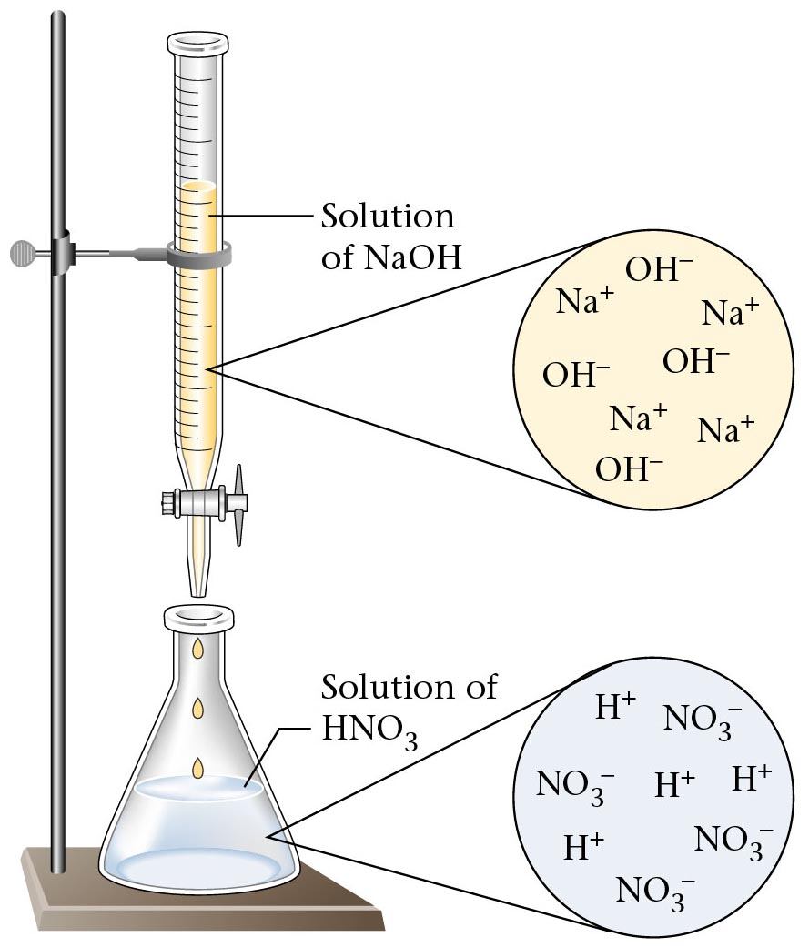
Acid-Base Titration
Notes:
37
In acid-base titrations, a buret is used to deliver measured volumes of an acid or base solution of known titration (the titrant) to a flask that contains a solution of a base or an acid, respectively, of unknown concentration (the unknown).
If the concentration of the titrant is known, then the concentration of the unknown can be determined.
Plotting the pH changes that occur during an acid-base titration against the amount of acid or base added produces a titration curve; the shape of the curve provides important information about what is occurring in solution during the titration.
Before addition of any strong base, the initial [H₃O⁺] equals the concentration of the strong acid.
Addition of strong base before the equivalence point, the point at which the number of moles of base (or acid) added equals the number of moles of acid (or base) originally present in the solution, decreases the [H₃O⁺] because added base neutralizes some of the H₃O⁺ present.
Addition of strong base at the equivalence point neutralizes all the acid initially present and pH = 7.00; the solution contains water and a salt derived from a strong base and a strong acid.
Addition of a strong base after the equivalence causes an excess of OH– and produces a rapid increase in pH.
A pH titration curve shows a sharp increase in pH in the region near the equivalence point and produces an S-shaped curve; the shape depends only on the concentration of the acid and base, not on their identity.
For the titration of a monoprotic strong acid with a monobasic strong base, the volume of base needed to reach the equivalence point can be calculated from the following relationship:
moles of base = moles of acid
(volume)_{b} (molarity)_{b} = (volume)_{a} (molarity)_{a}
V_{b}M_{b} = V_{a}M_{a}

Slide 38
Acid-Base Titrations
A laboratory technique known as a titration uses one solution of known concentration to determine the concentration of another solution through a monitored reaction.
A known volume of the acid solution is placed in a flask with a few drops of indicator solution.
An acid base indicator is a substance whose color is different in acid than in base.
Common indicators are litmus paper and phenolphthalein.
The standardized solution of base is added slowly to the flask from a buret.
The equivalence point in the titration occurs when all the moles of H⁺ ions present in the original volume of acid solution have reacted with an equivalent number of moles of OH ⁻ ions added from the buret.
The end point of the titration occurs when a tiny excess of OH⁻ ions changes the indicator permanently to its color in base.
Assume that the amount of base needed to reach the end point is the same as the amount needed to reach the equivalence point.
Notes:
Now we are going to learn a very important laboratory procedure that involves acids and base reactions. It is known as a titration. The purpose of a titration is to determine the concentration of one solution using a known concentration of another solution and a monitored reaction. There is an illustration of the basic setup for an acid base titration on the following slide and you can reference that to picture the setup. First, a known volume of the acid solution (for which we do not know the concentration) is placed in a flask with indicator solution. An indicator solution is a chemical that changes color between acid and base. Then the base is put into the buret, which is a very thin piece of lab equipment that is used to measure out specific amounts of liquid. The base is of known concentration. The base is slowly added to the flask of acid solution. At a certain point, called the equivalence point, all the acid has been converted into a salt and water through an acid base reaction. When you put just a bit more base into the solution, the indicator solution will change color. This occurs because the acid has all been used up and the small amount of base you just added has turned the solution basic. The amount of base you added between the equivalence point and the end point should be small enough not to matter in the titration. At the end of this process, you should know the volume and concentration of the base used and the volume of the acid used. Now we need the chemical equation to help us figure out the concentration of the acid. We are going to do some example problems with the data from titrations to figure out the unknown.

Slide 39
Titration Curve
Graph shows the change in pH of a solution containing HCl when 0.100 M NaOH is added.
Solution
of NaOH
Solution
of NaOH
Na⁺
OH⁻
Na⁺
OH⁻
OH⁻
Na⁺
Na⁺
OH⁻
Solution
of HCl
H⁺
Cl⁻
Cl⁻
H⁺
H⁺
25 mL
H⁺
Cl⁻
Cl⁻
Notes:
39

Slide 40
Acid-Base Titration Simulation
Acid Base Titration with Indicator
Acid-Base Titration with calculations

Slide 41
Range and Color Changes of Some
Common Acid-Base Indicators
pH Scale
1
2
3
4
5
6
7
8
9
10
11
12
13
14
Indicators
Methyl orange red 3.1 – 4.4 yellow
Methyl red red 4.4 6.2 yellow
Bromthymol blue yellow 6.2 7.6 blue
Neutral red red 6.8 8.0 yellow
Phenolphthalein colorless 8.0 10.0 red colorless beyond 13.0
Bromthymol blue indicator would be used in titrating a strong acid with a strong base.
Phenolpthalein indicator would be used in titrating a weak acid with a strong base.
Methyl orange indicator would be used in titrating a strong acid with a weak base.
Notes:
41
From F. Brescia et al., Chemistry: A Modern Introduction, W. B. Saunders Co., 1978.
Adapted from R. Bates, Determination of pH, Theory and Practice, John Wiley & Sons, Inc., New York, 1964.
Choosing the correct indicator for an acid-base titration
1. For titrations of strong acids and strong bases (and vice versa), any indicator with a pK_{in} between 4 and 10 will do
2. For the titration of a weak acid, the pH at the equivalence point is greater than 7, and an indicator such as phenolphthalein or thymol blue, with pK_{in} > 7, should be used
3. For the titration of a weak base, where the pH at the equivalence point is less than 7, an indicator such as methyl red or bromcresol blue, with pK_{in} < 7, should be used

Slide 42
Acid Base Titration Examples
Remember: moles H⁺ = moles OH⁻ at equivalence. (M*V = moles)
42.5 mL of 1.3M KOH are required to neutralize 50.0 mL of H₂SO₄. Find the molarity of H₂SO₄.
What volume of 0.5 M HCl is required to titrate 100 mL of 3.0 M Ca(OH)₂?

Slide 43
Acid Base Titration Examples
If it requires 10.5 mL of an unknown concentration of HCl to titrate 30.0 mL of 2.0 M NaOH to its endpoint, what is the concentration of the HCl?

Slide 44
Acid Base Titration Examples
You perform an acid-base titration to standardize an HCl solution by placing 50.00 mL of HCl in a flask with a few drops of indicator solution. You put 0.1524 M NaOH into the buret, and the initial reading of 0.55 mL. At the end point, the buret reading is 33.87 mL. What is the concentration of the HCl solution?
What volume of 0.1292 M Ba(OH)₂ would neutralize 50.00 mL of the HCl solution standardized in example #4?
Notes:
The first titration problem has HCl reacting with NaOH. The first thing we need to do is set up a balanced chemical equation for the reaction. Here we are given the readings on the buret of NaOH. The initial reading on the buret was 0.55 mL and the ending reading was 33.87 mL. We should find the difference between these two to find the volume of NaOH we use. If we use the concentration of NaOH and the volume, we can determine the moles of NaOH that it took to react with HCl. Then we can use the molar ratio we have from the balanced chemical equation and the volume of HCl that we treated to determine the molarity of the HCl solution.

Slide 45
Acid/Base Definitions
Arrhenius Acids and Bases
Acids release hydrogen ions in water.
Bases release hydroxide ions in water.
An acid is a substance that produces hydronium ions, H₃O⁺, when dissolved in water.
Brønsted-Lowry Definitions
A Brønsted-Lowry acid is a proton donor; it donates a hydrogen ion, H⁺.
A Brønsted-Lowry base is a proton acceptor; it accepts a hydrogen ion, H⁺.
Lewis Definitions
A Lewis acid is a substance than can accept (and share) an electron pair.
A Lewis base is a substance than can donate (and share) an electron pair.
Notes:
45
SVANTE AUGUST ARRHENIUS
Svante Arrhenius was born in Sweden. He learned to read at the age of three and became interested in mathematics and physics at an early age. He proposed in his doctoral thesis that electrolytes split into ions in water. For his efforts he was awarded the barest of passes. Fortunately, William Ostwald and Jacobus van´t Hoff promoted his work on electrolytic theory. He was awarded the 1903 Nobel prize for Chemistry for roughly the same thesis that had been nearly rejected nineteen years previously. He had universal interests in science and proposed the greenhouse effect.
Although this paper contains the standard chronological biography of Dr. Arrhenius, our goal is broader. First, we hope to show a more personal view of Dr. Arrhenius as related to us by Dr. Hubert Alyea in an interview. Second, we would like to present an overview of Dr. Arrhenius' Nobel Prize winning work and the difficulty he had in gaining acceptance in the scientific community. Finally we will offer a lab that simulates Dr. Arrhenius's work in hopes that some teachers will let their students experience a little piece of chemical history. Reminiscing about Svante A. Arrhenius
Dr. Hubert Alyea worked in Sweden under Dr. S. A. Arrhenius during 1925 and 1926. He was Arrhenius' last graduate student and has very fond memories of the great scientist. The path that led Dr. Alyea to Arrhenius' lab began in 1920 when he entered Princeton at the age of 15. His work and studies were delayed when he contracted polio at the age of 19; however, he feels that the year he spent in bed as a result of his illness was a time of great inner reflection and that he emerged with a strong commitment to accomplish something with his life that would contribute to the good of humanity.
After Dr. Alyea graduated from Princeton he was awarded a grant to study with Arrhenius, and he left for Sweden. At the time of Dr. Alyea's arrival, Svante Arrhenius was already 66 years old, and the bulk of his research had been completed. What had been a bustling lab in earlier years now supported only a few graduate students. Dr. Alyea felt this atmosphere was perfect for him; he received the mentoring that he needed to thrive. Although Dr. Alyea worked directly under Beckstrum, Arrhenius' assistant, he recalls how Svante Arrhenius came in to the lab at least twice every day to ask how the work was going and what Alyea planned to do that day.
Dr. Alyea was working on the idea of a free atom, a concept not readily accepted at that time. Svante Arrhenius seemed very interested in the idea, possibly because he may have thought of it as an extension of his own work on ions. Often Arrhenius would offer suggestions, but he did not insist on a specific research plan. Dr Alyea characterized Arrhenius as a man who "spread joy in the lab".
Dr. Arrhenius related the following story of his youth to Hubert Alyea one day when he visited the lab. He said that he was working in a lab at the time, and one of the chemists gave him a vial of liquid to dispose of. The vial contained mercaptans, an extremely smelly substance, but at the time the young Svante Arrhenius was not aware of this. Having forgotten to dispose of the liquid properly while still at the lab, Arrhenius tossed the vial beside the road as he was riding his bicycle home. The cap of the vial came loose, and the mercaptans diffused rapidly causing a wide area of town to smell. A committee was appointed to investigate the problem, and after several weeks they concluded that unusual meteorological conditions had caused the mercaptans to form. They also concluded it was highly unlikely that this would ever happen again. Arrhenius was very sure that it would never happen again!
Although there were only a few graduate students working under Dr. Arrhenius at this time, there was a constant flow of visitors from around the world, and Dr. Arrhenius seemed to enjoy the attention as well as their company. Often large groups were invited to dinner. One memorable dinner party was interrupted by Arrhenius when the aurora borealis began that evening. Arrhenius required everyone to accompany him outside as he explained to them the cause of this beautiful phenomenon. By the time he allowed his guests to return to dinner, all of the food was cold.
Dr. Alyea said that the aurora borealis was not the only thing about the sky that held Arrhenius' attention. He believed that life on earth was brought here by spores carried through space from other planets by radiation. He believed that likewise these spores could have carried life to many planets resulting in life throughout the universe.
Dr. Svante August Arrhenius won the Nobel Prize for his work in 1903, and Dr. Alyea's favorite story about Dr. Arrhenius as director of the Nobel Institute was about the 1926 Nobel Awards Dinner. Dr. Arrhenius took the podium to honor the guests, and as he said a few words about each of the famous men present he offered a toast with the alcoholic beverage of that man's choice. (Because this was during prohibition in the United States, Dr. Arrhenius toasted the American with water!) By the end of this series of toasts, Dr. Arrhenius appeared to be the only one of the distinguished guests still sober.
In closing this inspirational interview, Dr. Hubert Alyea offered the following classification of teachers. A good teacher is one who explains a concept; a better teacher is one who asks questions about the concept; and the best teacher is one who demonstrates the concept then solicits the questions from the students. Dr. Alyea has been a wonderful role model for all teachers, and he has certainly been among the best of teachers.
Biographical Information
Arrhenius was born in Wijk, Sweden on February 19, 1859. He was an infant prodigy, teaching himself to read at three and graduating from high school as the youngest and brightest in his class. While attending the University of Uppsala studying under E. Edluld he worked on the properties of electricity passing through solutions. As a doctoral candidate he knew of Faraday's "ions", and it seemed to him that the puzzles involved in his conductivity studies could best be explained if one assumed that molecules could break up into electrically charged fragments called "ions". For his PhD thesis in 1884 he presented his "ionic theory", but it turned out to be a bit too revolutionary for his examiners' taste. He just barely passed with a fourth class rank, "not without merit". (See the next section of this paper, Arrhenius' Dissertation, for a more complete discussion of the Thesis, its rejection, and final acceptance.).
Arrhenius obtained a travel grant and worked with Ostwald and Van't Hoff during which time his reputation increased as he clarified the ionic theory to his fellow chemists. In the late 1890's when electrically charged subatomic particles were discovered, Arrhenius' ionic theory suddenly made sense, and in 1903 he received the Nobel Prize in chemistry for it.
In an extension of his ionic theory Arrhenius proposed definitions for acids and bases. He believed that acids were substances which produce hydrogen ions in solution and that bases were substances which produce hydroxide ions in solution. It is interesting that neither Bronsted nor Lewis received the Nobel Prize for continuing the work on the theory of acids and bases and for expanding the definition of these substances. It is noted that Arrhenius never did accept the Bronsted or Lewis definitions of acids and bases.
Arrhenius studied reaction rates as a function of temperature, and in 1889 he introduced the concept of activation energy as the critical energy that chemicals need to react. He also pointed out the existence of a "greenhouse effect" in which small changes in the concentration of carbon dioxide in the atmosphere could considerably alter the average temperature of a planet.
In 1908 Arrhenius advanced a new concept that had less success but has remained interesting to scientists and science fiction readers alike. He suggested that life might have orginated through spores blown up through the atmosphere of life-bearing worlds and then driven by radiation pressure across the gulfs of space to fall on hospitable but as yet sterile worlds.
He died in Stockholm on October 2, 1927.
Arrhenius' Dissertation
Hindsight shows that this young chemist had both great data and a revolutionary explanation, but neither the logic nor the data could change the mind set of the established chemists. Yet in the end his persistence and his model prevailed. He has been recognized by the professional societies and the Nobel Prize committee. This is the story that needs to be told to high school students. At the age of 24, Arrhenius had determined the conductivity of many electrolytes and planned his dissertation proposal. His data may have taken the following format:
Conductivity (ohm-1cm2mol-1)Electrolyte0.001M0.0050.010.050.10.5Acetic acid4120146.54.62.0Hydrochloric acid377373370360351327Sodium acetate757270646149
From this data he noted:
The resistance of an electrolyte is increased when the dilution is doubled.
In very dilute solutions the conductivity is nearly proportional to the concentration.
The conductivity of a solution is equal to the sum of conductivities of the salt and the solvent.
If these laws are not observed, it must be due to a chemical reaction between the substances including the solvent.
The electrical resistance rises with increasing viscosity, complexity of the ion, and the molecular mass of the solvent. (incorrect)
Arrhenius concluded from the above statements that the "molecule" breaks apart into a positive fragment and negative fragment, called ions, by its interaction with the solvent. This was a great leap in thinking. The concept of dissociation did not come at first but developed as time allowed Arrhenius to talk with other chemists. The review committee at University of Uppsala was very reluctant to award the doctorate degree to Arrhenius but finally gave a fourth rank (barely passing) for the dissertation. The disgrace prevented Arrhenius from aspiring to any professorship. Arrhenius accepted a chemistry position at Technical High School of Stockholm. From this position he sent copies of his research to chemists in many of the laboratories of Europe. The older chemists formally and quietly rejected his thesis; they were firmly convinced that molecules could not break up and could not carry an electric charge. They, like the dissertation committee, could not imagine sodium, a metal that violently reacts with water, and chlorine, a gas with toxic properties, existing as independent tragments after sodium chloride dissolved in water.
By 1887 Arrhenius had worked out the language of his model with statements like "In all probability all electrolytes are completely dissociated at extreme dilutions". He could explain weak and strong acids by the concentration of the ions, known as percent dissociation today.
Fortunately a few of the younger men in the new field of physical chemistry were intrigued by the notion of ions and by Arrhenius' reasoning. His model gained acceptance as the network of young chemists started to explain their results in terms of ions and dissociation. Van't Hoff is one example; he explained the higher osmotic pressure than predicted for electrolytes.
Data continued to support the concept that ionic and polar covalently bonded substances dissociate in water. Some substances dissociate to a greater extent. These statements explain the colligitave properties and differences in pH of similar acid concentrations.
Bronsted, Lowry, Lewis and others have developed a more general model of acids and bases for non-water solvent systems. We also must be prepared to accept the next model for the dissociation of substances.
Biographical Resources
Asimov, Issac, Asimov of Chemistry, Anchor Books, Garden City, NY, p103 - This source has a fine portrait and biography. Snelders H. A. M., "Arrhenius, Svante August", Charles C. Gillispie, editor, Dictionary of Scientific Biography, Volume 1, Charles Scribner's Sons, New York, New York, pp296 - 302 - Great seven page chronology of Arrhenius and a description of findings in his dissertation on ionic theory.
Jaffe, Bernard, Crucibles: The Story of Chemistry, Simon and Schuster, Inc., New York,1930, pp 219 - 241. - This is the best 22 page resource for the human side to Arrhenius' personality and for the personal conflicts of accepting a revolutionary idea.
Kendall, James, Great Discoveries by Young Chemists, Thomas Crowell Co, New York, 1935, pp 124 -138.- Chapter V is the chemistry of solutions which shows the supportive relationchip of Van't Hoff, Ostwald and others.
Shakhashiri, Bassam, Demonstrations in Chemistry, Volume 3,University of Wisconsin, 1989, pp 3 - 26. - Within the framework of acid/base concept development, Arrhenius' data on conductivity is simulated with more modern measurements. The table of data, page 8, lists the conductivities of 12 compounds at dilutions of 0.05 M to O.001 M. Demonstration 8.21 shows how to build a light bulb conductivity tester with two sets of electrodes for serial comparison.
http://www.woodrow.org/teachers/chemistry/institutes/1992/Arrhenius.html
GILBERT NEWTON LEWIS: AMERICAN CHEMIST (1875-1946)
At the end of a manuscript in the Bancroft Library at UC Berkeley, we find the words:
"I have attempted to give you a glimpse...of what there may be of soul in chemistry. But it may have been in vain. Perchance the chemist is already damned and the guardian the blackest. But if the chemist has lost his soul, he will not have lost his courage and as he descends into the inferno, sees the rows of glowing furnaces and sniffs the homey fumes of brimstone, he will call out-: 'Asmodeus, hand me a test-tube.'"(1)These are fitting words from a man who was the most eminent figure in a great revolution that brought America to the forefront in chemistry. Gilbert Newton Lewis was probably the greatest and most influential of American chemists. Through the nineteenth century, Europe dominated science, but the first half of the twentieth century brought a tidal wave of scientific research that thrust America to the forefront. Lewis influenced this revolution by both his teaching and his research. During his career he published over 150 papers. Gilbert Newton Lewis was born at Weymouth, Massachusetts, on October 23, 1875. He was educated at home by his parents in the style of the English tutoring system. His only public schooling occurred between the ages of 9 to 14 years in Lincoln, Nebraska. At age fourteen, Lewis entered the University of Nebraska but transferred to Harvard College after three years. In 1899 he was awarded his PhD at age 24 under the supervision of T.W. Richards. Richards trained Lewis in experimental techniques and careful measurements and fostered his interest in thermodynamics. Richards' idea that "Believing in Faraday's methods ... fact is more important than theory..." (2) influenced Lewis' approach to research throughout his career. Conflicts with Richards over bonding in atomic and molecular structures caused Lewis to leave Harvard. This ended a two-year period in which he published nothing, the only non-productive time in his career.
Lewis spent one year in the Phillipines as the Superintendent of the Bureau of Weights and Measures before joining the faculty at MIT where he found a group of young, talented physical chemists interested in doing research. This group was brought together by A.A. Noyes who, like Richards, had received his doctorate under Ostwald at the University of Leipzig. This research center provided an energizing atmosphere where Lewis spent seven productive years during which he undertook the systematic determination of the electrode potentials of the elements.
Lewis left MIT when he was appointed the Chairman of the Department of Chemistry and the Dean of the College of Chemistry at UC Berkeley in 1912, positions he held until his sudden death in his laboratory on March 23, 1946, a remarkable 34-year tenure. Lewis believed that a chemistry department should simultaneously teach science and advance it, always remembering that the most important emphasis must be placed on fundamental principles rather than its technical applications. To achieve his goals, Lewis nurtured the Chemistry Department at Berkeley with his own vision.
Dr. Lewis focused on young brilliant minds in chemistry, choosing to work with the exceptional rather than the average students. Course content was aimed at giving superior understanding of chemistry fundamentals rather that lots of facts. Students were encouraged to think for themselves by free discussions between students and teacher. Following his early training, Lewis had graduate students teach lower division courses. The present use of problem sets which challenge even the best young minds in organic chemistry can be traced back to Lewis' penchant for innovative study sheets.
Upper division honor students were required to do research. Lewis strove to give graduate students freedom in selecting professors for research advisors with the option to change when desired. Students were given the run of the lab facilities and storerooms. Everyone cooperated with each other and no one was too busy to help with another's research. This open policy built initiative and morale among all participants in UC Berkeley's Chemistry Department. There were weekly research seminars at which Lewis sought to educate the graduate students, the staff and himself. At these meetings, research papers were presented by staff, students and eminent visitors on current events, project proposals and journal articles. Throughout his career, Lewis remained open-minded to criticism and was well known for his wit and insight.
At UC Berkeley Lewis built a remarkably strong department which trained a large number of chemists including Nobel Prize Laureates, members of the National Academy of Science, and numerous individuals who became department and division chairs. Besides his contributions to education, his research in four areas of science give Lewis his remarkable status. Most of his research is focused on thermodynamics and its relationship to chemical equilibrium, the electron-pair bonding theory of atoms and molecules, isotopes (mainly deuterium), and the interaction of light with matter.
During his tenure at MIT, Lewis researched standard electrode potentials, conductivity, free energy and other thermodynamic constants for the elements. These tables are still being used. His ability to organize and apply the scattered laws of thermodynamics brought about the evolution of physical chemistry into the science as it is known today. Lewis once defined physical chemistry as encompassing "everything that is interesting".(3)
In his theory of the shared electron pair, Lewis did not believe only that an electron completely transfers from one atom to another, as in the positive-negative theory. He describes the partial transfer of two electrons, one from each of the two bonding atoms, so that there is a shared pair of electrons between them. This eliminates the need for the formation of oppositely charged atoms when there was no indication of individually charged atoms (ions) in a compound. This was the first description of covalent bonding. Lewis theorized that electrons in an atom pair up around the nucleus, usually forming a tetrahedral arrangement. Although he never actually used the term "octet" for four pairs of electrons, the octet rule is often associated with Lewis. His main concern was with individual bonds between atoms rather than with all the electron pairs around each nucleus. Lewis' book, Valence and the Structure of Atoms and Molecules, is a classic, one of the greatest contributions to modern bonding theory.
Lewis' research on isotopes is an example of his wide-ranging and prolific interests. He published twenty-six papers on heavy hydrogen and heavy water, isotopes of lithium, and neutron physics. He predicted the existence of naturally occuring heavy water before he isolated it.
Lewis continued with his research until his death on March 23, 1946, in his laboratory surrounded by his beakers and test tubes. There is no scientist in American history who has contributed more extensively to all fields in chemistry than Gilbert Newton Lewis. His thinking was far ahead of his time and his theories have had profound influence on modern chemistry. Although Lewis was never to receive the Nobel Prize, it is commonly felt that his work in thermodynamics and valence theory more than merited this award.
GILBERT NEWTON LEWIS: AMERICAN CHEMIST (1875-1946)DATEEVENT1875Born on October 23 in Weymouth, Mass.1889Entered Univ. of Nebraska at age 14.1892Transferred to Harvard College.1899PhD at age 24.1900Instructor at Harvard College. Began research on electrochemistry and chemical equilibrium under Richards.1904Superintendent of Weights and Measures in the Phillipines.1905Faculty position at MIT. Began work on thermodynamics and free energies for elements.1912Married Mary Sheldon, daughter of Harvard Professor.1912Appointed Chairman of Dept. of Chemistry and Dean of the College of Chemistry, Berkeley.1918World War I, France. Appointed Chief of the Defense Division of Chemical Warfare Service. Received the Distinguished Service Medal (USA) and the Cross of the Legion of Honor (France).1923Authored Thermodynamics and the Free Energy of Chemical Substances with M. Randall. Authored Valence and the Structure of Atoms and Molecules. Clarified electron-pair bonding in covalent substances. Began work on a more inclusive acid-base theory.1930'sWorked on deuterium. First to prepare pure deuterium and its compounds. Published 26 papers on deuterium and other isotopes.1938Franklin Institute lectures on acids and bases. 1940's Worked on photochemical processes.1946Unexpected death in laboratory on March 23.
Annotated References
Journal of Chem. Ed., "Gilbert Newton Lewis: Report of the Symposium", 1984, 61, p. 2-21, p. 93-108, p. 185-204. --The G.N. Lewis Symposium, presented at the Las Vegas ACS meeting in March of 1982, provides the best overall reference material about Lewis. Chairman Derek A. Davenport of Purdue University organized the symposium honoring Dr. Lewis while many of his friends and colleagues were still alive and able to give valuable insights into his life and far-reaching contributions to modern chemistry. The proceedings of the Lewis symposium were printed in the January 1984 Journal of Chemical Education and its subsequent two issues.
Lewis, Gilbert Newton, Valence and the Structure of Atoms and Molecules, Dover Publications, Inc., New York, 1966. --Lewis' book Valence and the Structure of Atoms and Molecules is one of the few science classics that can be largely understood by teachers at the secondary level. Much of the information is currently being taught in chemical education although some of the material in his book is now known to be inaccurate. Ihde, Aaron J., The Development of Modern Chemistry, "Gilbert Newton Lewis", Dover Books, NY, 1984, p. 505, p. 534, p.536-41, p. 542. --This is a reference for general information about Lewis' research and publications.
Servos, John W., Physical Chemistry from Ostwald to Pauling, Princeton University Press, Princeton, New Jersey, 1990. --This final reference contains materials for the individual who is more interested in specific details and facts on the work and life of G.N. Lewis and other American physical chemists. It is not as useful as the symposium articles.
Bibliography
1. Davenport, Derek A., "Gilbert Newton Lewis: 1875 - 1946", J. of Chem Ed., 1984, 61, p.2.
2. Servos, John W., "G.N.Lewis: The Disciplinary Setting", J. of Chem Ed., 1984, 61, p. 7.
3. Seaborg, Glenn T., "The Research Style of Gilbert N. Lewis", J. of Chem Ed., 1984, 61, p. 93.
http://www.woodrow.org/teachers/chemistry/institutes/1992/Lewis.html

Slide 46
Acid Classifications
Lewis Acid
Brønsted-Lowry
Arrhenius
acids

Slide 47
Acid/Base with Gas Formation
Certain salts react with acids to form a gaseous product
The driving force for these is the formation of a gas and/or water because both products remove reactant ions from solution.
Typical salts involved are carbonates, sulfites, and sulfides.
Carbonates:
Sulfites:
Sulfides:

Slide 48
Gas Formation
The reaction of acids with carbonate salts is important in lab. It is in this way that many acidic waste solutions or acidic spills are neutralized.
Sulfites and sulfides are not used as SO₂ and H₂S are both toxic.
Acid rain will also react with marble statues (calcium carbonate) and dissolve the statue.
Predict the products for the following combinations of reactants
1. HBr + Na₂CO₃ →
2. H₂SO₄ + Li₂CO₃ →
3. HF + K₂SO₃ →
4. HC₂H₃O₂ + Na₂S →

Slide 49
Oxidation Numbers
Oxidation Number (O.N.) [oxidation state] is the charge the atom would have if electrons were not shared but were transferred completely.
General Rules:
For an atom in its elemental form (Na, O₂, Cl₂, etc): O.N. = 0
For a monatomic ion: O.N. = ion charge
The sum of O.N. values for the atoms in a compound equals zero. The sum of O.N. values for the atoms in a polyatomic ion equals the ion’s charge.
Rules for specific atoms or periodic table groups
Group 1A | O.N. = +1 in all compounds
Group 2A | O.N. = +2 in all compounds
Hydrogen | O.N. = +1 in combinations with nonmetals O.N. = -1 in combinations with metals and boron
Fluorine | O.N. = -1 in all compounds
Oxygen | O.N. = -1 in peroxides O.N. = -2 in all other compounds (except with F)
Group 7A | O.N. = -1 in combination with metals, nonmetals (except O), and other halogens lower in the group
Notes:
An important concept you will have to know in order to understand redox reactions is oxidation number. Oxidation number refers to the charge of each atom individually if the electrons were transferred completely and not shared. You’ve seen the basic concept with ionic charge, but oxidation number includes all atoms individually. There are some general rules to follow when assigning oxidation numbers. First, all atoms in elemental form (which includes the diatomic molecules) have an oxidation number of 0. That means if you have a single element as a reactant in an equation, its oxidation number will be zero. Next, monatomic ions have the same oxidation number as their ionic charge. For instance, sodium has an ionic charge of 1+. Its oxidation number will be +1. If you have a polyatomic ion, the oxidation numbers have to add up to equal the charge of the ion. The sum of the oxidation numbers for all the atoms in a compound will equal zero. Just a little side note in here, ionic charge is written with the + / - sign after the number, whereas oxidation number is written with the sign first. Here are some rules for specific atoms or periodic table groups. The first two categories are the first two groups on the periodic table. Notice these groups have the same charge as the monatomic ions they form. Next, we have hydrogen. We have usually seen hydrogen having a 1+ charge in compounds. This is the oxidation number that hydrogen will have in compounds with nonmetals. In compounds with metals and boron, hydrogen will have a -1 oxidation number. Next, fluorine has a -1 O.N. in all compounds. That’s pretty easy. Next, we have to look at oxygen. Oxygen typically has a -2 oxidation number. However, in peroxides, oxygen has a -1 oxidation number. When oxygen combines with fluorine, it can have another oxidation number. Finally, the halogens (group 7a) have a -1 oxidation number with most other elements. The exceptions are oxygen and halogens lower down in the group.

Slide 50
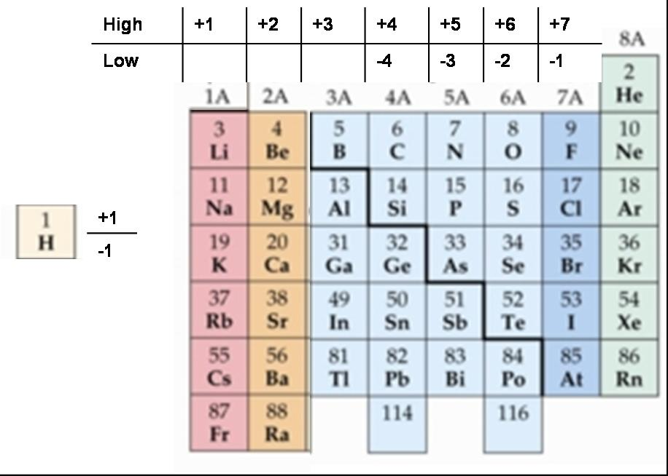
Oxidation Number Trends
For most main group elements, the A group number (1A, 2A, etc) is the highest oxidation number (always positive) of any element in the group (exceptions are O and F)
For main group nonmetals and some metalloids, the A-group number minus 8 is the lowest oxidation number (always negative) of any element in the group.
Notes:
Before we get to some examples, we’re going to look at some trends that occur on the periodic table. First, we look at the main group elements. For most of these, the group number (with the A) is the highest oxidation number (positive) that the elements can achieve. Oxygen and fluorine are exceptions. For main group nonmetals and metalloids, the A group number minus 8 is the lowest oxidation number (negative) of any element. Let’s look at some to give us an example of each. Carbon is in group 4A. Therefore, the highest oxidation number carbon can achieve is +4. The lowest oxidation number carbon can have is (4-8) = -4. Let’s assign some oxidation numbers to help us get comfortable using trends and rules.

Slide 51
Oxidation Number Examples
Determine the oxidation number (O.N.) of each element in these compounds:
ZnCl₂
Sulfur trioxide
Nitric acid
Hydrogen phosphate ion
Iodine trifluoride
Nitrogen gas
Notes:
Ok, here were going to do some examples. Remember for each of these examples, we have to assign oxidation numbers to every atom in the compound, regardless of whether the compound contains polyatomic ions. Ok, number one asks for zinc chloride. The chemical formula for that is ZnCl₂. Ok, so we don’t have a general rule about transition elements like zinc so we look at chlorine. Chlorine is a halogen and zinc is a metal so chlorine has a -1 oxidation number. Therefore, to make the compound neutral, zinc must have a +2 oxidation number.

Slide 52
Oxidation Reduction (“Redox”) Reactions
The key chemical event is the net movement of electrons from one reactant to the other.
The driving force is the movement of electrons that transfers from the reactant with less attraction for electrons to the reactant with more attraction for electrons.
Oxidation is the loss of electrons.
Reduction is the gain of electrons.
Oxidizing agent – the species doing the oxidizing (becomes reduced)
Reducing agent – the species doing the reducing (becomes oxidized)
e.g.
Notes:
Now we are coming to our third type of reaction: the oxidation reduction reaction. Oxidation reduction reactions involve the transfer of electrons from one reactant to another. Again, we have to discuss the driving force for these reactions. This time is that the electrons move from the reactant with less attraction to the reactant with more attraction for the electrons. Oxidation is the term that means the loss of electrons while reduction is the gain of electrons. A good way to remember this is that to be reduced means to get smaller or less. To gain electrons means you are gaining negative amounts or getting a less charge. Now you will here some other terms that can be somewhat confusing. The oxidizing agent is the species doing the oxidizing which means that it is being reduced. The reducing agent is the species doing the reducing which means that it is being oxidized. Let’s look at an example of an oxidation reduction reaction. Here we have magnesium being reacted with oxygen to form magnesium oxide. We are going to have to delve further into oxidation reduction reactions for you to understand the remainder of this reaction and for you to see how to tell electrons are moving. But let’s look at what’s happening in the second and third parts of this reaction. In the 2nd, Magnesium is going from its elemental form to its cation Mg²⁺ by giving up 2 electrons (2e-). In the third, oxygen is in its elemental form and gains two electrons to become the anion O²⁻. The coefficients balance the equation. The ½ O₂ + 2e shows that there are 2 electrons per 1 oxygen atom.

Slide 53
Oxidation/Reduction Examples
Identify the element being oxidized and the element being reduced in each of the following:
2Al(s)+3H₂SO₄(aq)→ Al₂(SO₄)₃(aq)+3H₂(g)
PbO(s)+CO(g)→Pb(s)+CO₂(g)
2H₂(g)+O₂(g)→2H₂O(g)
Notes:
Ok, now we’re going to look at some actual equations. In each of these we are going to assign oxidation numbers to the elements and observe which is the oxidizing agent (being reduced) and which is the reducing agent (being oxidized). Maybe you didn’t understand what it meant to be oxidized or reduced earlier. Now that we have worked with oxidation numbers, maybe it will be more clear. To be reduced means the oxidation number goes down. To be oxidized, the oxidation number goes up. Let’s look at equation a) first we have aluminum. What do we know about aluminum here? It is in its elemental state; therefore its oxidation number is zero. Moving on to sulfuric acid. We know that sulfate has a 2- charge as a polyatomic ion. To make the compound neutral, hydrogen must have a +1 oxidation number (there are two of them). Next, we have to examine the atoms in sulfate. Oxygen is not in a compound with fluorine or a peroxide so its oxidation number is -2. Since there are four of them, this gives us -8 for sulfate. In order to get a 2- charge for the polyatomic ion, sulfur must have a +6 oxidation number. Now we have to look at aluminum sulfate. The sulfate ion still must have a 2- charge so the oxygen has a -2 o.n. and sulfur has +6. There are three sulfate ions which give a -6 total. That means the aluminum must have +6. Since there are two of them, each aluminum atom has an oxidation number of +3. Finally, we move on to hydrogen. What state is hydrogen in? Elemental. Which means its oxidation number is zero. Ok, now let’s look at all the oxidation numbers and see which ones have changed. Aluminum went from 0 to +3 which means it went up and was oxidized. Hydrogen goes from +1 to 0 which means it went down and was reduced. So the oxidizing agent was the compound with H → H2SO4; the reducing agent was the compound with Al → Al.

Slide 54
Oxidation/Reduction Examples
2Fe(s)+3Cl₂(g)→2FeCl₃(s)
2C₂H₆(g)+7O₂(g)→4CO₂(g)+6H₂O(g)
5CO(g)+I₂O₅(s)→I₂(s)+5CO₂(g)
Notes:
Ok, now we’re going to look at some actual equations. In each of these we are going to assign oxidation numbers to the elements and observe which is the oxidizing agent (being reduced) and which is the reducing agent (being oxidized). Maybe you didn’t understand what it meant to be oxidized or reduced earlier. Now that we have worked with oxidation numbers, maybe it will be more clear. To be reduced means the oxidation number goes down. To be oxidized, the oxidation number goes up. Let’s look at equation a) first we have aluminum. What do we know about aluminum here? It is in its elemental state; therefore its oxidation number is zero. Moving on to sulfuric acid. We know that sulfate has a 2- charge as a polyatomic ion. To make the compound neutral, hydrogen must have a +1 oxidation number (there are two of them). Next, we have to examine the atoms in sulfate. Oxygen is not in a compound with fluorine or a peroxide so its oxidation number is -2. Since there are four of them, this gives us -8 for sulfate. In order to get a 2- charge for the polyatomic ion, sulfur must have a +6 oxidation number. Now we have to look at aluminum sulfate. The sulfate ion still must have a 2- charge so the oxygen has a -2 o.n. and sulfur has +6. There are three sulfate ions which give a -6 total. That means the aluminum must have +6. Since there are two of them, each aluminum atom has an oxidation number of +3. Finally, we move on to hydrogen. What state is hydrogen in? Elemental. Which means its oxidation number is zero. Ok, now let’s look at all the oxidation numbers and see which ones have changed. Aluminum went from 0 to +3 which means it went up and was oxidized. Hydrogen goes from +1 to 0 which means it went down and was reduced. So the oxidizing agent was the compound with H → H2SO4; the reducing agent was the compound with Al → Al.

Slide 55
Half-Reactions
A half-reaction is one of two parts of an oxidation-reduction reaction, one part of which involves a loss of electrons and the other a gain of electrons.
Net ionic reactions can be written in terms of the two half-reactions.
e.g.

Slide 56
Half-Reaction Examples
Write the half-reactions for the following redox reactions:
CuCl₂(aq) + Al(s) → AlCl₃(aq) + Cu(s)
Cr(NO₃)₃(aq) + Zn(s) → Cr(s) + Zn(NO₃)₂(aq)

Slide 57
Balancing “Redox” Reactions
Number of electrons lost by the reducing agent must equal the number of electrons gained by the oxidizing agent.
Two methods for balancing redox equations:
Half reaction method
Oxidation number method
Notes:
Now we are going to look at the task of balancing oxidation-reduction reactions which are called redox for short. The only thing we are adding in comparison to balancing equations before is a look at electrons. The number of electrons lost by the reducing agent must equal the number of electrons gained by the oxidizing agent. There are two methods for balancing redox equations: half-reaction and oxidation number. We are only going to look in detail at the half-reaction method now. I believe the oxidation number method to be a little confusing and not all that helpful.
Just a side note about redox. If an elemental substance appears on either side of the equation (but not both), the change is going to be a redox reaction because the oxidation number on that element goes from 0 to something else.

Slide 58
Half-Reaction Method
Divide the unbalanced reaction into two half reactions, each of which contains the oxidized and reduced forms of one of the species.
Balance the atoms and charges in each half-reaction.
Atoms are balanced in the following order: atoms other than O and H, then O, and then H
Charge is balanced by adding electrons (e-).
Added to the left in the reduction half reaction
Added to the right in the oxidation half reaction
If necessary, multiply one or both half-reactions by an integer to make the number of e ⁻ gained in the reduction equal the number of e ⁻ lost in the oxidation.
Add the balanced half-reactions; cancel identical species on either side and include states of matter.
Check that the atoms and charges are balanced.
** Process differs slightly depending on whether the reaction takes place in acidic or basic solution.
Notes:
Now we are going to discuss the half-reaction method. This method is called such because the first step involves dividing the unbalanced reaction into two half-reactions. Each half-reaction contains the oxidized and reduced forms of one of the species. If we look back to the very first oxidation reduction reaction we saw in the beginning of this section, between magnesium and oxygen, we see the two half-reactions given underneath the molecular equation. Next, balance the atoms and charges in each half-reaction. The atoms other than hydrogen and oxygen are balanced first, then oxygen, and then hydrogen. You can balance charges by adding electrons (symbolized e-) to either side. You will add electrons to the left in the reduction because an atom is gaining electrons when it is reduced and electrons are added to the right for the oxidation half-reaction. When each half-reaction is balanced in atoms and charges, then examine them in combination. If the number of electrons do not match on the left and right, then you will have to multiply one or both half-reactions by an integer to make them equal. After the electrons are equaled, add the balanced half-reactions together. If there are the same species or electrons on either side of the equation, they cancel out. Remember to include states of matter. Finally check atoms and charges to make sure everything is balanced. Now, this is not a comprehensive look at what we are going to do because the process will be slightly different depending on whether the reaction takes place in acidic or basic solution. We are going to look how the process differs on the following slides.

Slide 59
Half-Reaction Method Examples
Balance the following redox reactions using the half-reaction method:
Zn(s) + Ag⁺(aq) → Zn²⁺(aq) + Ag(s)

Slide 60
Half-Reaction Method Examples
Cr³⁺(aq) + Zn(s) → Cr(s) + Zn²⁺(aq)

Slide 61
Half-Reaction Method Examples
Cu²⁺(aq) + Al(s) →Al³⁺(aq) + Cu(s)

Slide 62
Half-Reaction Method in Acidic Solution
When balancing half-reactions in acidic solution:
Balance all the elements except hydrogen and oxygen.
Balance oxygen using H₂O
Balance hydrogen using H⁺
Balance the charge using electrons
Notes:
First we are going to look at how the process is changed when you are dealing with acidic solutions. You will still balance all the elements like before with oxygen and hydrogen last. Use water to balance the any oxygen atoms. This simply means add water molecules in for as many oxygen atoms that you need to balance. This water comes from the acidic solution so it is allowed to be added. The water added will put in extra hydrogen atoms. Use the hydrogen ion H+ on the other side to balance out these added hydrogen atoms. Notice the presence of H+ indicates the acidic solution. Finally, make sure the charge is balanced using electrons.

Slide 63
Balancing Redox in Acidic Solutions
Balance the following redox reactions. Each occurs in acidic solution.
S²⁻(aq) + I₂(s) → SO₄²⁻(aq) + I⁻(aq)

Slide 64
Balancing Redox in Acidic Solutions
Mn(s) + NO₃⁻(aq) → Mn²⁺(aq) +NO₂ (g)

Slide 65
Balancing Redox in Acidic Solutions
I₂(s) + OCl⁻(aq) → IO₃⁻(aq)+ Cl⁻(aq)

Slide 66
Balancing Redox in Acidic Solutions
Cr₂O₇²⁻(aq)+ HNO₂(aq) → Cr³⁺(aq) +NO₃⁻ (aq)

Slide 67
Balancing Redox in Acidic Solutions
Br₂(aq) → Br⁻(aq) + BrO₃⁻(aq)

Slide 68
Half Reaction Method in Basic Solution
Follow procedure for acidic solution until half-reactions are added together.
Add a number of OH⁻ ions that is equal to the number of H⁺ ions to both sides of the equation in order to eliminate H⁺ by forming H₂O.
Form H₂O on the side containing both H⁺ and OH⁻ ions, and eliminate the number of H₂O molecules that appear on both sides of the equation.
Notes:
The half-reaction method varies just slightly when the reaction takes place in basic solution. You will follow all the procedures used for acidic solutions including the H+ addition. Continue through the process until you add the half-reactions together. Now, you have a basic solution, so you don’t want H+ ions wandering around in it. In order to get rid of those, add a number of hydroxide ions that is equivalent to the number of H+ ions that you added to both sides. On the side with the H+ and OH-, combine these two ions together to make water. Now, you should have added some water on the other side when you were balancing oxygen. If you have water on both sides of the equation, cancel out as many as appear equally on both sides. The side with more water will have some left over. This process might be a little murky right now so we’re going to do some examples.

Slide 69
Half-Reaction Method Examples
Use the half-reaction method and the skeletal reaction shown to balance the reaction that occurs between NaMnO₄ and Na₂C₂O₄
Notes:
To be able to balance these equations, you have to pay attention to whether the reaction takes place in acidic or basic solution. In question 1, we are asked to balance the reaction between dicromate ion C₂O₇ ²⁻ and iodide ion that forms chromium 3+ ion and solid iodine. This reaction occurs in acidic solution so we know we have to follow that path. Work these out on the board. See work on next page for notes.

Slide 70
Half-Reaction Method Examples
Balance the redox reaction between dichromate ion and iodide ion to form chromium (III) ion and solid iodine, which occurs in acidic solution.
Notes:
To be able to balance these equations, you have to pay attention to whether the reaction takes place in acidic or basic solution. In question 1, we are asked to balance the reaction between dicromate ion C₂O₇ ²⁻ and iodide ion that forms chromium 3+ ion and solid iodine. This reaction occurs in acidic solution so we know we have to follow that path. Work these out on the board. See work on next page for notes.

Slide 71
Half-Reaction Method Examples
Write a balanced molecular equation for the reaction between KMnO₄ and KI in basic solution. The skeleton reaction is:
Notes:
To be able to balance these equations, you have to pay attention to whether the reaction takes place in acidic or basic solution. In question 1, we are asked to balance the reaction between dicromate ion C₂O₇ ²⁻ and iodide ion that forms chromium 3+ ion and solid iodine. This reaction occurs in acidic solution so we know we have to follow that path. Work these out on the board. See work on next page for notes.

Slide 72
Half-Reaction Method Examples
Balance the following redox reactions using the half reaction method
I⁻ + MnO₄⁻ → I₂ + MnO₂ (in basic solution)

Slide 73
Half-Reaction Method Examples
NO₂– +MnO₄– →NO₃– +Mn²⁺ (in acidic solution)

Slide 74
Summary of Classes of Reactions
Chemical reactions
Precipitation
Reactions
Acid-Base
Reactions
Oxidation-Reduction
Reactions
Double Replacement (Metathesis)
Single Replacement Reactions
Combustion
Reactions
Synthesis
reactions
Decomposition
reactions
Notes:
74

