Slide 1
Unit 1:
Introduction to Chemistry
Pre-AP Chemistry
Introduction to Chemistry

Slide 2
Chemistry
The study of matter and its properties, the changes that matter undergoes, and the energy associated with those changes
Notes:
Chemistry may seem like an abstract school subject that has no real life application for you, but regardless of your future study in school, your life will be surrounded by chemistry. Your understanding of chemistry may be a way for you to make a living, a general interest, or an unconscious relationship. If you’ve ever cooked anything, you’ve been a chemist in the kitchen. The cars that you ride in every day run on a very simple, but explosive chemical reaction. The way you are processing the words coming out of my mouth right now is based on the chemistry occurring in your brain. Understanding the discussion on global warming demands an understanding of the chemical processes involved. Though the chemistry we discuss in this class will often involve events on the microscopic level that you cannot see, it is these tiny events that control all the macroscopic activities that we encounter every day and we will attempt to relate some of the things that we are studying to events that you can observe in your daily life.

Slide 3
Natural Science
Physical Science
Earth and Space Science
Life Science
Physics
Chemistry
Geology
Astronomy
Botany
Zoology
Meteorology
Ecology
Oceanography
Genetics
Notes:
3
Science can be broken into social science (social studies, political science, psychology) and natural science. This slides shows some of the diverse areas of natural science.

Slide 4
Alchemy
In Europe, alchemy was the quest for the Philosopher’s Stone (the elixir, the Sorcerer’s Stone).
  Allegedly, this substance would turn cheap substances into gold.
Transmutation – changing one substance into another
  e.g.
In ordinary chemical reactions, we cannot transmute elements into different elements.
Notes:
4

Slide 5
Areas of Chemistry
The study of most carbon-containing compounds
    Organic
    Inorganic
    Analytical
    Physical
    Biochemistry
The study of all substances not classified as organic,
mainly those compounds that do not contain carbon
The identification of the components and composition
of materials
The study of the properties, changes, and relationships
between energy and matter
The study of substances and processes occurring in
living things
Notes:
5
The five areas of chemistry listed: organic, inorganic, analytical, physical and biochemistry are the main areas of chemistry.
Many people work as chemist in related fields – law, pharmaceutical, medical, agricultural, sales.

Slide 6
Careers in Chemistry
Chemistry
Ethnobotany
Environmental Law
Patent Law
Technical Writing
Pharmaceuticals
Oceanography
Software Design
Space Exploration
Government Policy
Forensic Science
Biotechnology
Metallurgy
Ceramics Industry
Plastics Industry
Paper Industry
Medicine
Teaching
Engineering
Geochemistry
Agrochemistry
Military Systems
Notes:
Highlight:
Space exploration
Forensic Science
Biotechnology
Medicine
Teaching
Engineering
Military Systems

Slide 7
Laboratory
Provides controlled conditions in which scientific research, experiments, and measurement may be performed.
Experiments allow the investigation of observed phenomenon and scientific discovery.
Knowledge of proper equipment use and safety rules is required before entering lab.

Slide 8
Lab Safety
Obey the safety contract
Use common sense
No unauthorized experiments
Wear safety glasses
Safety is an attitude!
Don’t take anything out of lab.
Read and follow all instructions.
Wash hands before leaving lab.

Slide 9
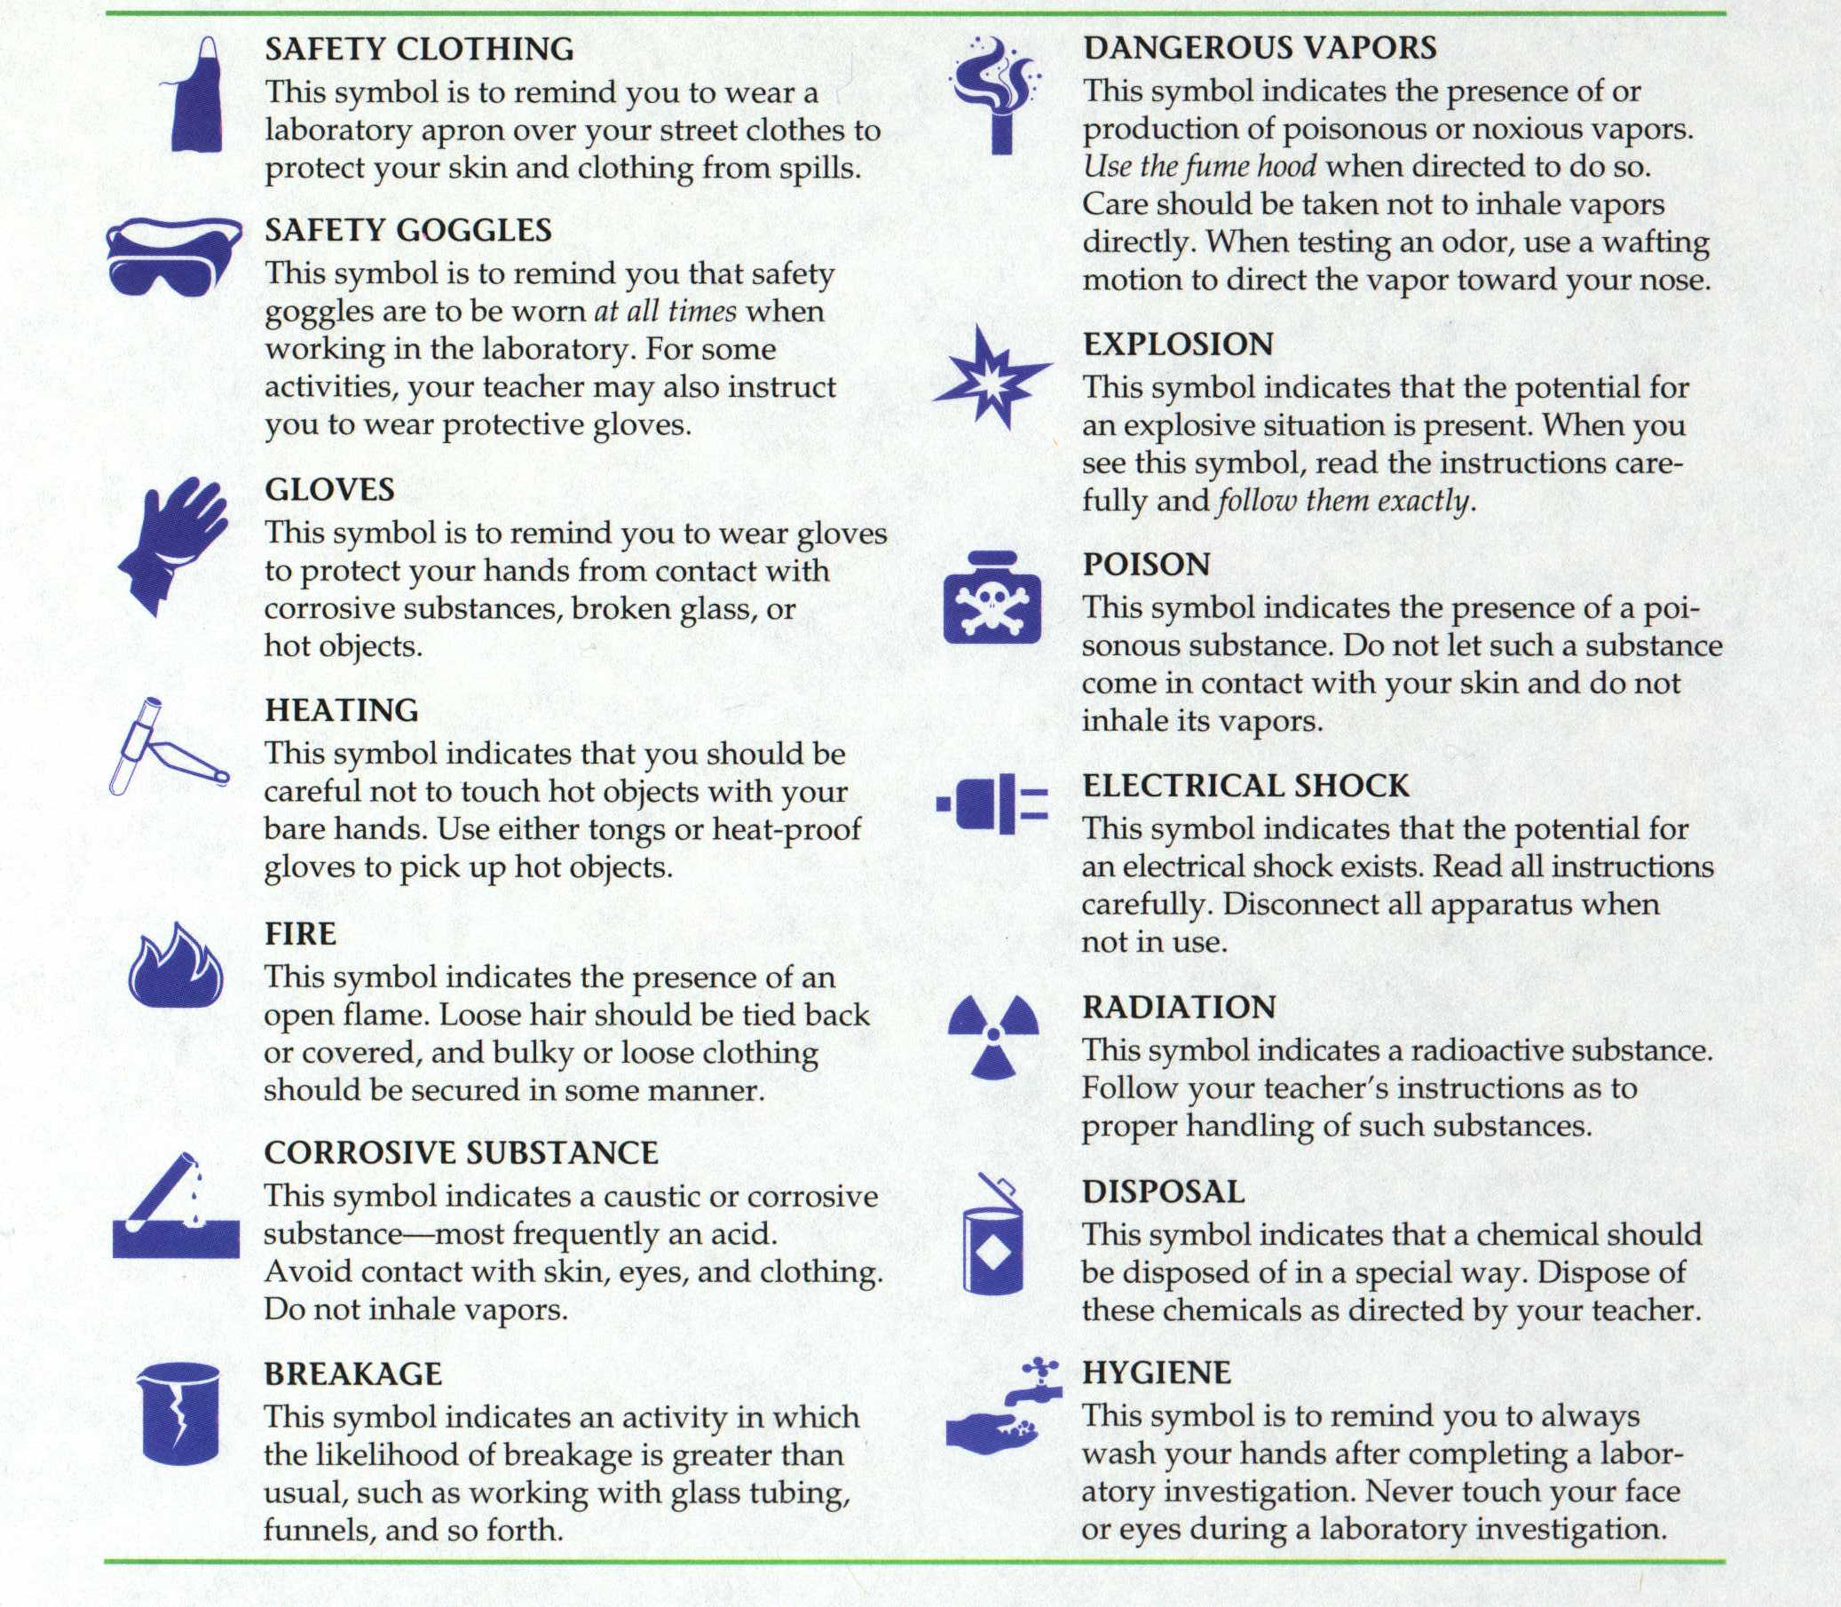
Safety Symbols
SAFETY CLOTHING
This symbol is to remind you to wear a
laboratory apron over your street clothes to
protect your skin and clothing from spills.
DANGEROUS VAPORS
This symbol indicates the presence of or
production of poisonous or noxious vapors.
Use the fume hood when directed to do so.
Care should be taken not to inhale vapors
directly. When testing an odor, use a wafting
motion to direct the vapor toward your nose.
SAFETY GOGGLES
This symbol is to remind you that safety
goggles are to worn at all times when
working in the laboratory. For some
activities, your teacher may also instruct
you to wear protective gloves.
EXPLOSION
This symbol indicates that the potential for
an explosive situation is present. When you
see this symbol, read the instructions care-
fully and follow them exactly..
GLOVES
This symbol is to remind you to wear gloves
to protect your hands from contact with
corrosive substances, broken glass, or
hot objects.
POISON
This symbol indicates the presence of a poi-
sonous substance. Do not let such a substance
come in contact with your skin and do not
inhale its vapors.
HEATING
This symbol indicates that you should be
careful not to touch hot objects with your
bare hands. Use either tongs or heat-proof
gloves to pick up hot objects..
ELECTRICAL SHOCK
This symbol indicates that the potential for
an electrical shock exists. Read all instructions
carefully. Disconnect all apparatus when
not in use.
FIRE
This symbol indicates the presence of an
open flame. Loose hair should be tied back
or covered, and bulky or loose clothing
should be secured in some manner.
RADIATION
This symbol indicates a radioactive substance.
Follow your teacher's instructions as to
proper handling of such substances..
CORROSIVE SUBSTANCE
This symbol indicates a caustic or corrosive
substance - most frequently an acid.
Avoid contact with skin, eyes, and clothing.
Do not inhale vapors.
DISPOSAL
This symbol indicates that a chemical should
be disposed of in a special way. Dispose of
these chemicals as directed by your teacher.
BREAKAGE
This symbol indicates an activity in which
the likelihood of breakage is greater than
usual, such as working with glass tubing,
funnels and so forth.
HYGIENE
This symbol is to remind you to always
wash your hands after completing a labor-
atory investigation. Never touch your face
or eyes during a laboratory investigation.
Notes:
9

Slide 10
Material Safety Data Sheet (MSDS)
Gives information about a chemical.
  Hazards
  Toxicological
  Storage
  First Aid
  Personal Protection
  Disposal
Notes:
10

Slide 11
HCl MSDS 3M-6M

Slide 12
HCl MSDS 3M-6M

Slide 14
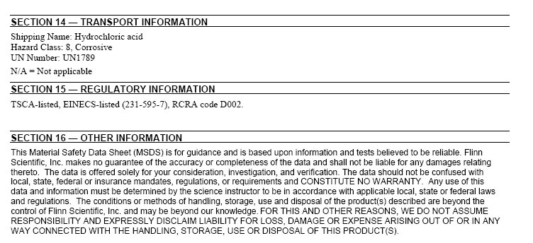
Notes:
ASSIGN ACETONE MSDS WORKSHEET HERE.

Slide 15
Chemical Dangers
Chemicals can cause harm in many ways.
  Flammable
  Explosive
  Radioactive
  Corrosive
  Irritant
  Toxic
    Chronic toxicity: Damage is caused over time by repeated exposure to a substance.
      Carcinogen – causes cancer
      Mutagen – causes mutations (genetic defects)
      Tetragen – causes birth defects
      Neurotoxin – severely poisonous and toxic
    Acute toxicity: Damage is caused immediately from a single exposure to a substance.
Notes:
15
(Photo: Oliver Weiken/European Pressphoto Agency)

Slide 16
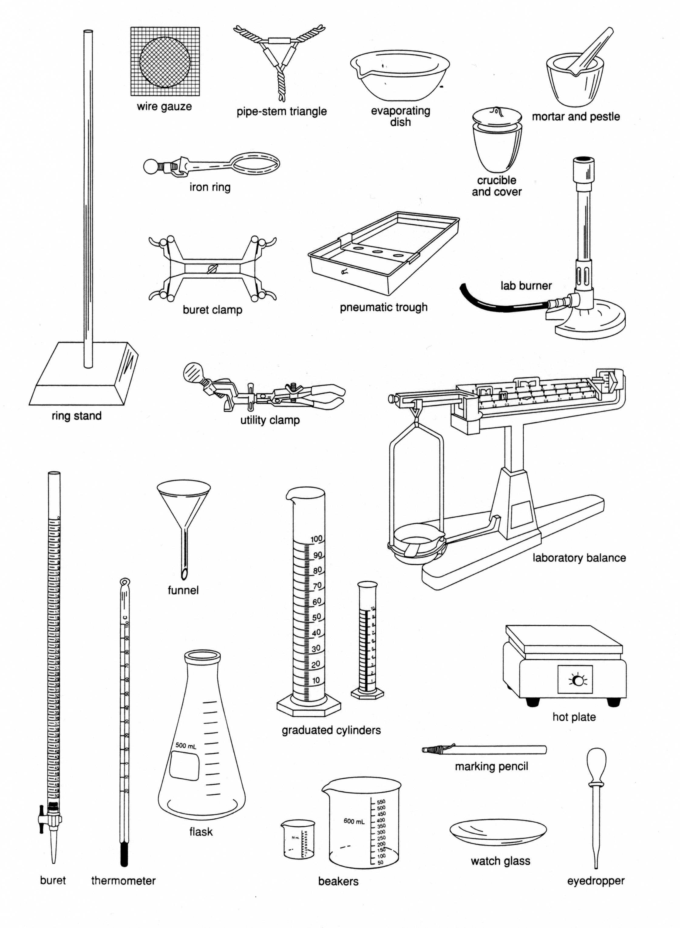
Laboratory Equipment
Notes:
16
Laboratory equipment should never be removed from the labs.
The equipment should never be used in a manner not described by your teacher.
Unauthorized lab experiments are strictly forbidden.
You may not use the lab without a teacher present and with your teachers permission.

Slide 17
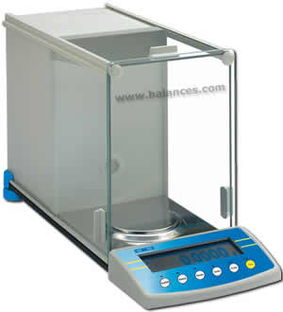
Measuring Mass
Calibrate balance
Use weigh paper

Slide 18
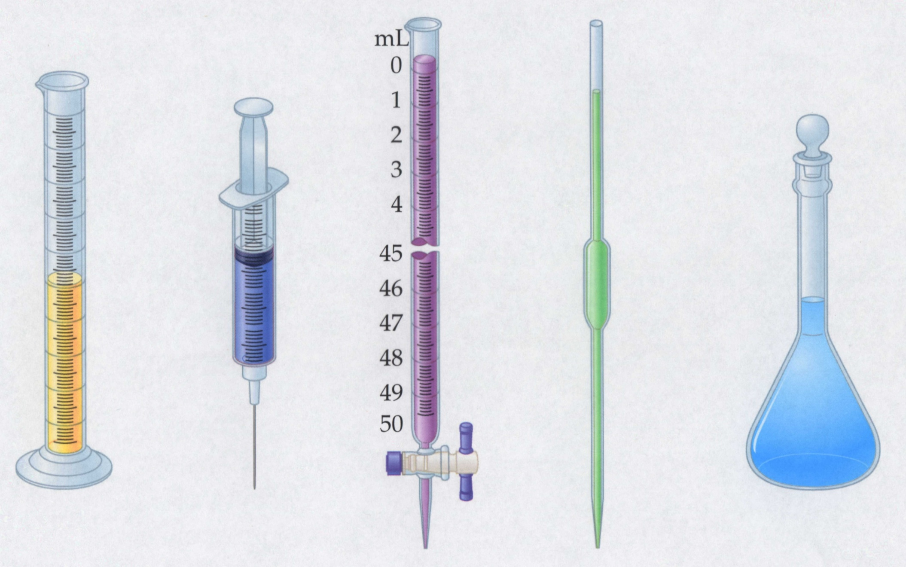
Instruments for Measuring Volume
Graduated
cylinder
Syringe
Volumetric
flask
Buret
Pipet
Notes:
18

Slide 19
Reading Volume
20
Meniscus
10
Notes:
19
A student reads a graduated cylinder that is marked at 15.00 mL, as shown in the illustration.
Is this correct? NO
Express the correct reading using scientific notation. 15.0 mL or 1.50 x10¹ mL

Slide 20
Lab Reports
Represent the experiment performed and results obtained.
Should include the following sections:
  Title
  Purpose
  Materials
  Safety Precautions
  Procedure
  Observations
  Data, Calculations, and Graphs
  Post Lab Analysis and Questions
Requirements given on individual labs.

Slide 21
Scientific Method
A flexible process of creative thinking and testing aimed at objective, verifiable discoveries of how nature works
Hypothesis revised if experimental results do not support it
Model altered if predicted events do not support it
Observations:
Natural phenomena and measured events; universally consistent one can be stated as natural law
Hypothesis:
Tentative proposal that explains observations
Experiment:
Procedure to test hypothesis; measures one variable at a time
Model (Theory):
Set of conceptual assumptions that explains data from accumulated experiments; predicts related phenomena
Further Experiment:
Tests predictions based on model
Notes:
The scientific method is a process that we use to determine if our ideas about our universe are correct. This process can be used for the smallest of everyday observations or on the grandest of scales as we search the galaxies. For instance, let’s say (give everyday example here)
We are going to use this method in the laboratory this year to develop further understanding of science.

Slide 22
Observations
Use the five senses
Inference: involves a judgment or assumption
Data: observations of two types
  Qualitative – descriptions w/o numbers
  Quantitative – numbers with units (measurements)

Slide 23
Experiments
Test the validity of the hypothesis.
Procedure – the order of events in the experiment
Variable – Any factor that can influence the result
Controlled Experiment – only one variable is allowed to change
Conclusion – a reasoned deduction based on the data
If the results of an experiment are reproducible, they are summarized in a law.

Slide 24
Models
A model does not equal reality.
Models are oversimplifications, and are therefore often wrong.
Models become more complicated as they age.
We must understand the underlying assumptions in a model so that we don’t misuse it.
Notes:
24

Slide 25
Law vs. Theory
Law:
  A verbal or mathematical description of a phenomenon that allows for general predictions
  Describes what happens but not why
  Unlikely to change greatly over time unless a major experimental error is discovered.
  e.g. Law of Gravity
Theory:
  Attempts to explain why nature behaves as it does.
  Is incomplete and imperfect, evolving with time to explain new facts as they are discovered.
  e.g. Atomic Theory, Theory of Gravity

Slide 26
Scientific
Method
Make observation
Ask question
Develop
hypothesis
Test hypothesis
with an
experiment
Test hypothesis
with further
experiments
Revise
hypothesis
Analyze data
and draw
conclusions
Hypothesis
IS
supported
Hypothesis
is NOT
supported
Develop
theory
Notes:
26

Slide 27
Measurements – SI System
Quantity Name Symbol
Length meter m
Mass kilogram kg
Time second s
Amount of substance mole mol
Thermodynamic temperature Kelvin K
Electric current amperes amps
Luminous intensity candela cd
Notes:
When we take measurements, we have to use a set of units. In this class as in basically all of the scientific world, we will be using the SI or metric system. This table gives the base units for the metric system along with the abbreviations (symbols) that are used to represent them. You are probably already somewhat familiar with the meter and kilogram as well as the second. Now these are not all the units that we will use. These are the basic units. We will also see other units that are derived (based on) combinations of these units.

Slide 28
Common Derived Units
Quantity Name Symbol
Area square meter m²
Volume cubic meter m³
Force newton N
Pressure pascal Pa
Energy joule J
Power watt W
Voltage volt V
Frequency hertz Hz
Electric charge coulomb C
Notes:
28
Here are some of the common derived units that we will see. Area and volume come from squaring and cubing the meter. As we learn unit conversions throughout the year, you will learn where some of these other units come from. They are all based on the simple base units, but they were given special names of their own.

Slide 29
The Importance of Units
All quantities must have a number and a unit.
Units must be carried into the answer, unless they cancel.
5.2 kg (2.9 m)
=
0.64
(18 s)(1.3 s)
4.8 kg (23 s)
=
0.57
(5.2 s)(37 s)
Notes:
29
UNITS are probably the most important thing you will learn in this class. You may forget a lot of it as the years go by, but I as well as my family are proof that units will stick. In math class, you don’t often have units. You just have numbers. In chemistry, however, a number means nothing without units. For instance, let’s say you are at some practice and your coach tells you that today you are going to run 3. 3 what? 3 miles, 3 sprints, 3 laps. You must have units to make a number mean something. When you are performing calculations with values, you must carry the units that are with the numbers into the answer. The only way for a unit to go away is if it cancels out. Let’s look at a few examples of this to help you see. You will be doing hundreds, maybe thousands, of calculations this year involving units and their cancellation. Ok, problem 1 has a mass being multiplied by a distance and that is being divided by two times. Now look at the units in the answer. The kg and m are still on top. What did we do on the bottom? If there is more than one of the same unit, we represent this by using an exponent. There were two seconds so we use seconds squared.
Problem 2, we have mass times time divided by two times. Now let’s look at the units in the answer. We still have the kg on the top, but the seconds on the top cancelled out with one of the seconds on the bottom. Note, that canceling units does not change the numbers to be multiplied or divided. This canceling of units is a lot like crossing out x’s and y’s in algebra when they appear on the top and bottom. So in the answer here, there was only one second unit on the bottom left.

Slide 30
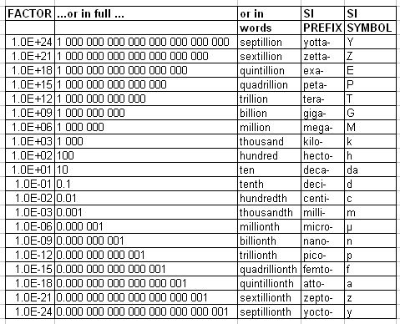
Decimal Prefixes Used w/ SI
Notes:
Here is a list of prefixes that we will be using. Most of our prefixes will lie between 1 billionth and 1 billion, but we will be using scientific notation outside these ranges. Discuss the SI prefixes as they related to everyday life. E.g. gigabyte and nanometer

Slide 31
Scientific Notation
Expresses numbers as a multiple of two factors: a number between 1 and 10 and ten raised to a power or exponent.
Numbers larger than 1 have a positive power of ten.
Numbers smaller than 1 have a negative power of ten.
Express the following quantities in scientific notation:
        700 m
        38 000 m
        4 500 000 m
        685 000 000 000 m
        0.005 4 kg
        0.000 006 87 kg
        0.000 000 076 kg
        0.000 000 000 8 kg
Notes:
Another way we are going to express values in this class is by using scientific notation. Scientific notation allows you to express very large and very small numbers as a number between 1 and 10 with a multiple of ten attached. For example, 12,000 becomes 1.2x10^4. If the original number is greater than one, the power of ten will be positive. If the number was less than one, the power of ten will be negative. The power of ten comes from the number of times you have to move the decimal to reach a number between 1 and 10. For 12,000, I had to more the decimal four times to get 1.2 so the power of ten was 4. It was positive because 12,000 is greater than 1.
7.00x10^2
3.8x10^4
4.5x10^6
6.85x10^11
5.4x10^ -3
6.87x10^ -6
7.6x10^ -8
8x10^ -10

Slide 32
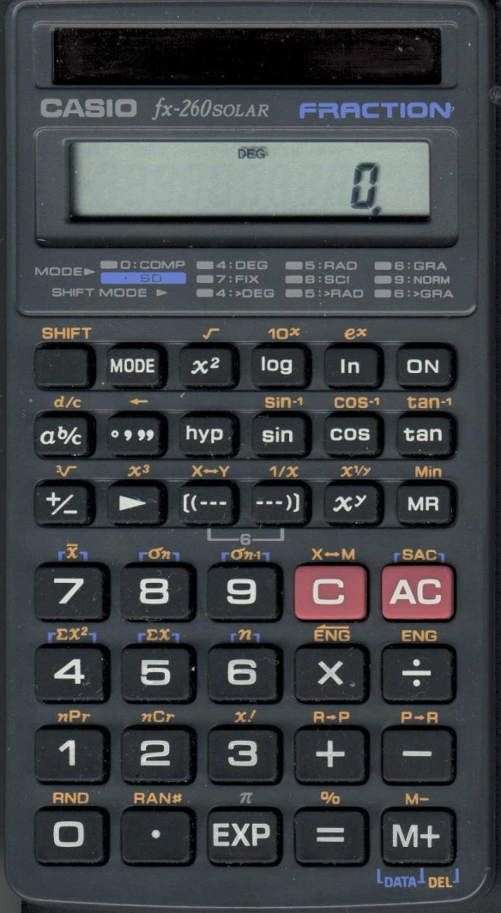
How to Use a Scientific Calculator
.
Divide: (5.44 x 10⁷) (8.1 x 10⁴)
.
How to enter this on a calculator:
.
.
5.44 7 8.1 4
EE
EE
ENTER
OR
.
.
5.44 7 8.1 4
EXP
EXP
=
671.6049383
rounded to 6.7 x 10²
Notes:
32
Just to make sure you can work these problems on your calculator, we are going to practice typing them in. The button for creating the x10^ on your calculator is typically either EE or EXP. Using your calculator, make sure you can arrive at the same answer I have for this problem. Does your calculator give the answer as 671 or does it put the answer back into scientific notation. Can you go back and forth between the two in your head if you were given a multiple choice exam and either one of those answers was on it.

Slide 33
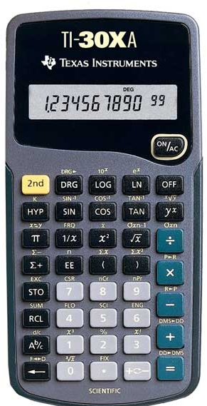
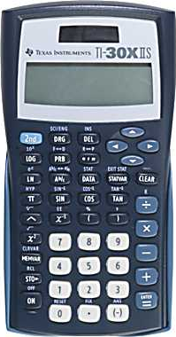
TI Scientific Calculators

Slide 34
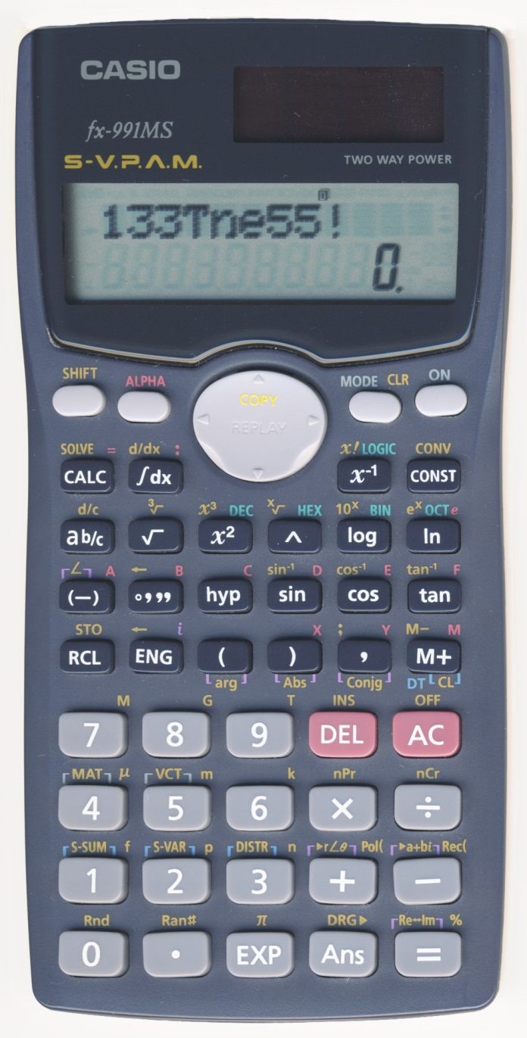
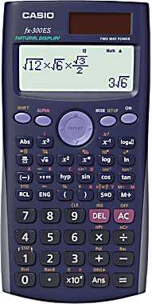
Casio Scientific Calculators

Slide 35
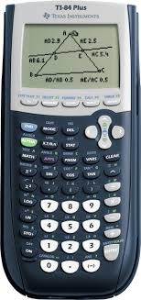
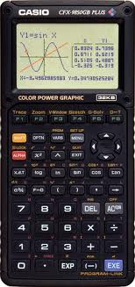
Graphing Calculators

Slide 36
Rule for Multiplication
Calculating with Numbers Written in Scientific Notation
When multiplying numbers in scientific notation, multiply the
first factors and add the exponents.
Sample Problem: Multiply 3.2 x 10⁻⁷ by 2.1 x 10⁵
(3.2) x (2.1) = 6.72
6.72 x 10⁻²
or
0.0672
(-7) + (5) = -2 or 10⁻²
Exercise: Multiply 14.6 x 10⁷ by 1.5 x 10⁴
Notes:
36
We are going to quickly go through some tips to working with scientific notation if you don’t have your calculator and have to estimate an answer. This is possible on the AP test since they do not allow calculators on the multiple choice section. Don’t let this scare you. They won’t make the calculations something you can’t do easily without a calculator. First, if you are multiplying two numbers in scientific notation, you simply have to multiply the two factors (usually small numbers) and then add the exponents on the x10^ part. Here we have 3.2x2.1. If we are just asked to estimate that, we know it’s got to be around 6. Next to get the power of ten we have to add -7 and 5 to give -2. Now we could actually multiply out those two numbers and get 6.72.
Let’s try another one. We have to multiply 14.6 x 1.5. Well half of 14 is 7. So the answer should be around 22 and the power of ten is 11. Let’s check this in the calculator. 21.9 x10¹¹.

Slide 37
Rule for Division
Calculating with Numbers Written in Scientific Notation
When dividing numbers in scientific notation, divide the first
factor in the numerator by the first factor in the denominator.
Then subtract the exponent in the denominator from the
exponent in the numerator.
Sample Problem: Divide 6.4 x 10⁶ by 1.7 x 10²
.
(6.4) (1.7) = 3.76
.
3.76 x 10⁴
(6) - (2) = 4 or 10⁴
Exercise: Divide 2.4 x 10⁻⁷ by 3.1 x 10¹⁴
Notes:
37
The rule for dividing numbers in scientific notation is pretty similar to that for multiplying. The differences are that you are dividing the two factors and you subtract the second exponent (denominator) from the first exponent (numerator). We are going to work some examples now to practice. First we have to divide 6.4 by 1.7 (which is almost 2) so it should be somewhere near 3. Check this on your calculator. Next, we subtract 6-2 to get 4 for our power of ten.
Let’s try another: 2.4/ 3.1 → that’s got to be less than 1. 2 divided by 3 is about 2/3 or 0.67. Then we subtract 14 from -7 and get -21. Let’s check this 0.77x10-21.

Slide 38
Rule for Addition and Subtraction
In order to add or subtract numbers written in scientific
notation, you must express them with the same power of 10.
Sample Problem: Add 5.8 x 10³ and 2.16 x 10⁴
(5.8 x 10³) + (21.6 x 10³) =
27.4 x 10³
2.74 x 10⁴
Exercise: Add 8.32 x 10⁻⁷ and 1.2 x 10⁻⁵
Notes:
38
Finally we get to adding and subtracting. This is very simple as long as your powers of ten are the same. In order to add or subtract numbers in scientific notation, the numbers must have the same power of ten so you may have to change them. Once that is done, you simply add the factors and keep the power of ten the same. Let’s try with 5.8x103 and 2.16x104. Ok, we have to get them in the same power of ten so we can either move the first one up or the second one down. Moving the second one down keeps the first one with a number not just a decimal. Ok so we still have 5.8x103, but the second number is now 21.4x103. Ok, now we have to add 21.4 and 5.8. This comes out as 27.4. The power of ten stays the same. Notice that I have also given the number converted into more traditional scientific notation with a number between 1 and 10. Let’s try another one. We have -7 and -5. The easiest way to move this is move the bigger one down. Which means we have 8.32x10-7 and 120. x10-7. When we add the factors, we get 128.32x10-7. Converting that back into typical scientific notation, we get 1.3x10-5.

Slide 39
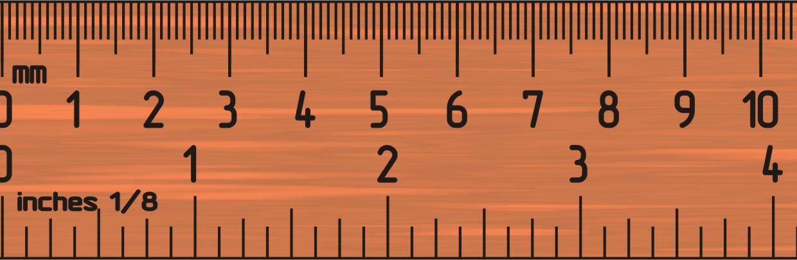
Uncertainty in Measurement
Significant Figures – the digits recorded in measurement, both the certain and the uncertain
  The greater the number of significant figures in a measurement, the greater the certainty.
  Always estimate the rightmost digit when reading a measuring device → assume an uncertainty of one unit in the rightmost digit
Notes:
In most science and math classes, you probably have gotten away with either as many decimals as you want or a specific number for every problem. In my calculus class, we use 3 decimal places as a rule imposed by college board. However, in this class, the number of decimal places that you show, and the number of digits in your answer are different for every problem. You must determine how many you should include for each problem in order to get the correct answer.
Significant figures is the name given to the digits given in a measurement. It makes sense to say that the greater number of significant figures, the greater the certainty. For instance, I could say the drive to the mall is 6 miles or I could say that it is 5.61. In which measurement do you have more certainty on the distance? The second.
When you are measuring, you often need to estimate the final digit (unless your device is digital). For instance, if you are using a ruler to measure a distance, you know for sure the number of inches, but the fraction of that inch is the part that you have to estimate a little on.

Slide 40
Measuring with Uncertainty
0
1
2
3
4
5
4.5 cm
cm
0
1
2
3
4
5
4.54 cm
cm
0
1
2
3
4
5
3.2 cm
cm
Notes:
Here’s some practice at measuring with uncertainty. On the first ruler, we only know for certain the ones digit. We have to estimate the first decimal place. This is the only digit we are allowed to give then. The next ruler, we know the ones digit of centimeters and we also know the first decimal place because it is broken up into tenths. So we know that we have 4.5 and we have to estimate the last digit. Finally, on the third ruler, we are back to only knowing the ones digit so we can only estimate the first decimal place.

Slide 41
Precision vs. Accuracy
Precision (reproducibility) – refers to how close the measurements in a series are to each other
Accuracy – refers to how close a measurement is to the actual value
Good accuracy
Good precision
Poor accuracy
Good precision
Poor accuracy
Poor precision
Notes:
This page has some definitions that you will need to know for lab. The first two are commonly used interchangeably but in chemistry/science, they mean very different things. Accuracy has to do with the right and wrong answer. It is a measure of how close your value is to the correct value. Precise has to do with how close your measurements/answers are to each other if you were repeating the same measurement/calculation. You can be very very wrong (inaccurate) but be very precise if all your wrong answers are very close to each other. Look at these targets to get a better picture of what these terms mean. The first target shows all three darts very close together and in the very center of the target. Thus, they are very close to the actual answer (accurate) and very close to each other (precise). The next target, the darts are again very close together (precise) but they are way off the mark (inaccurate). Finally, on the third target, the darts are scattered (imprecise) and away from the mark (inaccurate).

Slide 42
Experimental Error
Systematic Error :
  Produces values that are either all higher or all lower than the actual value
  Part of the experimental system, perhaps caused by a faulty measuring device or by a consistent mistake in taking a reading
  Reduces accuracy
Random Error:
  Produces some values that are higher and some that are lower than the actual value
  Always occurs, but its size depends on the measurer’s skill and the instrument’s precision
  Reduces precision
Percent Error -- the ratio of an error to an accepted value
Calibration – eliminating or taking into account systematic error by altering the measuring device by comparing it to a known standard
Notes:
Some error types that you will encounter in lab or just in general life are systematic and random. Systematic occurs if you are consistently doing something wrong. For instance, my watch always runs a little fast so when I look at the time, there is a systematic error of about two minutes to my reading every time. Random error just occurs as the little things that are based on our imperfections as scientists and imbalances in equipment. Let’s say you are using a ruler to measure a length and you often have to guess the last decimal place. Sometimes you’ll guess too high and sometimes you’ll guess too low. Look at the definition – this always happens. No one scientist has ever completely eliminated random error. It will happen to you, but also pay attention to the fact that the size of the error depends on the measurer’s skill.
Percent error is a calculation that shows how much the measurement/value is off of the correct value. Let’s do an example. Say you found the mass of an object to be 2.78 g but the actual mass is 2.81 g. If we are going to find percent error, first we find the difference between the measured value and the actual value. Notice in the formula, this calculation is in absolute value bars. You always want this value to be positive regardless of whether your measured value is above or below the actual value. We find this difference to be 0.03 g. Next we divide this value by the actual value and multiply by 100 to get a percent. The result is 1.07% error. This is a very small error as you could probably tell by how close our measurement was, but small errors get multiplied and compounded as we use this value in later calculations so it is very important that every measurement be as accurate as possible.
Finally calibration is a method for removing systematic error by changing a measuring device. You can see this best probably on a scale. If you stood on a scale, it would read your weight. However, if you remained on the scale and recalibrated the device, the reading would go back to zero even though you are still standing on it. This method ensures that your weight will have no bearing on future measurements – say if you were to hold something in your arms, like a dog. You will see this in chemistry labs when you are asked to measure out a certain quantity of a chemical on a balance. Calibration allows you to account for error that you know is going to be there.

Slide 43
Percent Error Example Problems
Determine the percent error for the following experiments:
  Joe found the density of a substance to be 1.124 g/cm³. The actual density is 1.29 g/cm³.
  Tina determined the boiling point of liquid to be 279 °F. The actual boiling point is 271 °F.
  Robert determined the pH of a liquid to be 8.5. The actual pH was 8.2.

Slide 44
Significant Figures
All digits are significant, except zeroes that are not measured but are used only to position the decimal point.
  Make sure that the measured quantity has a decimal point.
  Start at the left of the number and move right until you reach the first nonzero digit.
  Count that digit and every digit to its right as significant.
    Zeroes that end a number and lie either after or before the decimal point are significant.
  Exact numbers do not limit the number of significant figures.
When performing calculations:
  If multiplying/dividing, the number of significant figures in the answer is equal to the lowest number of significant figures in the given values.
  If adding/subtracting, the answer must have only as many decimal places as the given value with the lowest number of decimal places.
Notes:
Everything that’s a number (not including zero) is always a significant figure. Zeroes can go either way. Follow the procedure outlined here. If you understand this, you can see that if you’re starting at the left of the number and having to go right to find a nonzero digit, you understand that all the zeroes that happen before the first nonzero digit are not significant.
We are often going to perform calculations with given or known values. To know how many digits to report in the final answer, you must follow a couple simple rules. First, if your calculation involves multiplying or dividing, the answer will have as many significant figures as the given value with the lowest number of significant figures. If you are adding/subtracting, you must find the given value with the lowest number of decimal places. The answer will have the same number of decimal places as that value. Also, if a calculation involves an exact number (like 60 minutes in an hour – something that is not measured but is known with all certainty – often defined values), the exact number does not limit the significant figures. Let’s do some examples to clarify this.

Slide 45
Significant Figures Example Problems
For each of the following quantities, underline the zeros that are significant figures, and determine the number of significant figures in each quantity. For (d) to (f), express each in exponential notation first.
Perform the following calculations and round the answer to the correct number of significant figures:
a) 0.0030 L | b) 0.1044 g | c) 53,069 mL
d) 0.00004715 m | e) 57,600. s | f) 0.0000007160 cm³
Notes:
For problem 1, we are going to determine the number of significant figures in each value. We are also going to identify which zeroes are significant.
1)
2 significant figures
4 significant figures
5 significant figures
4 significant figures, 4.715 x10^ -5
5 significant figures 5.7600x10 ^ 4
4 significant figures 7.160 x10 -7
2)
Perform the top calculation first → this is subtraction so we must look at the number of decimal places. The lowest number is 3 (1.448) so our answer will have 3 decimal places. The resulting number is 14.904 cm^2. This value we must now divide with the bottom number. For dividing we count the number of significant figures in each given value. Here the top has five and the bottom has 4 so the answer will have four significant figures. The resulting number is 2.104 cm.
The problem involves only multiplication and division so we must find the number of significant figures in each value. There is an exact number in this problem. Can you tell me what it is? 1000 mg/g That is just a known quantity that has no uncertainty. Therefore, it does not matter in our significant figure calculation. The number on top has 3 significant figures and the number on bottom has 4 significant figures. Therefore the answer will have 3 significant figures. The resulting answer is 5.54x10^2 or 554.

Slide 46
Significant Figures Example Problems
2) Perform the following calculations and round the answer to the correct number of significant figures:
Notes:
For problem 1, we are going to determine the number of significant figures in each value. We are also going to identify which zeroes are significant.
1)
2 significant figures
4 significant figures
5 significant figures
4 significant figures, 4.715 x10^ -5
5 significant figures 5.7600x10 ^ 4
4 significant figures 7.160 x10 -7
2)
Perform the top calculation first → this is subtraction so we must look at the number of decimal places. The lowest number is 3 (1.448) so our answer will have 3 decimal places. The resulting number is 14.904 cm^2. This value we must now divide with the bottom number. For dividing we count the number of significant figures in each given value. Here the top has five and the bottom has 4 so the answer will have four significant figures. The resulting number is 2.104 cm.
The problem involves only multiplication and division so we must find the number of significant figures in each value. There is an exact number in this problem. Can you tell me what it is? 1000 mg/g That is just a known quantity that has no uncertainty. Therefore, it does not matter in our significant figure calculation. The number on top has 3 significant figures and the number on bottom has 4 significant figures. Therefore the answer will have 3 significant figures. The resulting answer is 5.54x10^2 or 554.

Slide 47
Graphs
Used to pictorially represent data.
Three types:
  Line – represents trends or continuous change
  Bar – represents information gathered by counting
  Pie – represents the breakdown of a fixed quantity into parts
Graphs should:
  Have appropriate and descriptive titles
  Be clearly labeled with units
  Be neat and easy to read
Notes:
You will be making graphs based on your laboratory work this year. You will also see scientific graphs on the ACT. Graphs are something that you should be able to make well and read easily. Graphs are basically making a picture out of data to be able to better see what the data is telling you. We are going to examine three types of graphs. First, the line graph is something you will use often. This graph represents trends or change based on a certain variable. Next, bar graphs show information that you gained by counting. Finally, pie graphs break up something into parts. We are going to look at examples of each of these graphs. Even though they are different, each of these graphs should have similar qualities: have titles that are descriptive and adequately explain what the graph is about. Next, the graph should be labeled with units. Finally, the graphs should be neat and easy to read.

Slide 48
Line Graphs
Interpolate – predicting data in between known points
  What volume would the gas occupy at 150K?
Extrapolate – predicting data beyond the known points
  What volume would the gas occupy at 250K?
Notes:
First, we are going to look at a line graph. If you look at this graph, it is showing an increase in volume (going up) as the temperature increases (goes up). Check for title and labeled axes with units. Is this graph easy to read?
Two concepts that we are going to use with line graphs are interpolation and extrapolation. These methods are used to predict values that we not actually found during the experiments but can be predicted based on the trend shown. Interpolation tries to predict values that occur between known points. For instance, we don’t actually have a data point at 150K but can we predict the volume? Yes, we would say that it is about 5 L. Extrapolation tries to predict values that occur outside of the known points. For instance, can we predict what the volume would be at 250 K? We know the trend can keep going up. We would estimate this to be around 10L. We are going to look at some calculations involved in interpolation and extrapolation.

Slide 49
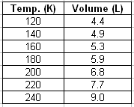
Linear Approximations
Interpolating:
  Pick two data points on either side of the given value to create a line.
  Use the given value as the x-value in the equation. Solve for y.
  e.g. Use the table of data to predict the volume the gas would occupy at 150 K.
Notes:
To predict linearly, we are going to take the data we are given and “pretend” that the data would give straight lines. Excel and other graphing problems can give you the line of best fit. We are going to use a very basic approximation. Look at the next slide. What we are going to do for the interpolation example, finding volume at 150 K, is make a straight line between 140 K and 160 K. Now we can draw this in, but we are also going to find the equation for this line. To make a line, we are going to use y=mx+b. We need slope first. To find the slope, we find y2-y1 / x2 - x1. This gives us 0.4/20 = 0.02. Next we find b by plugging in an x and y value and slope to solve for b. Let’s use 140 and 4.9. This gives us 2.1. So our equation is y = 0.02x+2.1. Now we can plug any temperature in for x and solve for the volume (y). If we plug in 150 K for x, we get 5.1 L. Is this reasonable?
Now for extrapolating. For this, we are going to make a line just like interpolation. We are going to use the two points closest to the temperature we are looking at and make a line. So for 250 K we are using 220 and 240. The slope of this line is 1.3/20 = 0.065. To find b, let’s use 9.0 and 240. Our b is -6.6. Now, we can plug in 250 K for x, and we get 9.65 L. Is this reasonable?

Slide 50
Linear Approximations
Extrapolating:
  Create a line from the given data.
  Use the given value as the x-value in the equation. Solve for y.
  e.g. Use the table of data to predict the volume the gas would occupy at 250K.
Notes:
To predict linearly, we are going to take the data we are given and “pretend” that the data would give straight lines. Excel and other graphing problems can give you the line of best fit. We are going to use a very basic approximation. Look at the next slide. What we are going to do for the interpolation example, finding volume at 150 K, is make a straight line between 140 K and 160 K. Now we can draw this in, but we are also going to find the equation for this line. To make a line, we are going to use y=mx+b. We need slope first. To find the slope, we find y2-y1 / x2 - x1. This gives us 0.4/20 = 0.02. Next we find b by plugging in an x and y value and slope to solve for b. Let’s use 140 and 4.9. This gives us 2.1. So our equation is y = 0.02x+2.1. Now we can plug any temperature in for x and solve for the volume (y). If we plug in 150 K for x, we get 5.1 L. Is this reasonable?
Now for extrapolating. For this, we are going to make a line just like interpolation. We are going to use the two points closest to the temperature we are looking at and make a line. So for 250 K we are using 220 and 240. The slope of this line is 1.3/20 = 0.065. To find b, let’s use 9.0 and 240. Our b is -6.6. Now, we can plug in 250 K for x, and we get 9.65 L. Is this reasonable?

Slide 51
Linear Approximations
Extrapolating
Interpolating
Notes:
Use this for demonstrating interpolating/extrapolating.

Slide 52
Bar Graph
Chemistry Grades
Number of Students
Notes:
52
Here is an example of a bar graph. Remember this graph is a result of counting items. As you can see, we counted the number of students that have each grade each quarter. Can you easily tell what grade was received the most? C. Were there fewer A’s or D’s? D’s.

Slide 53
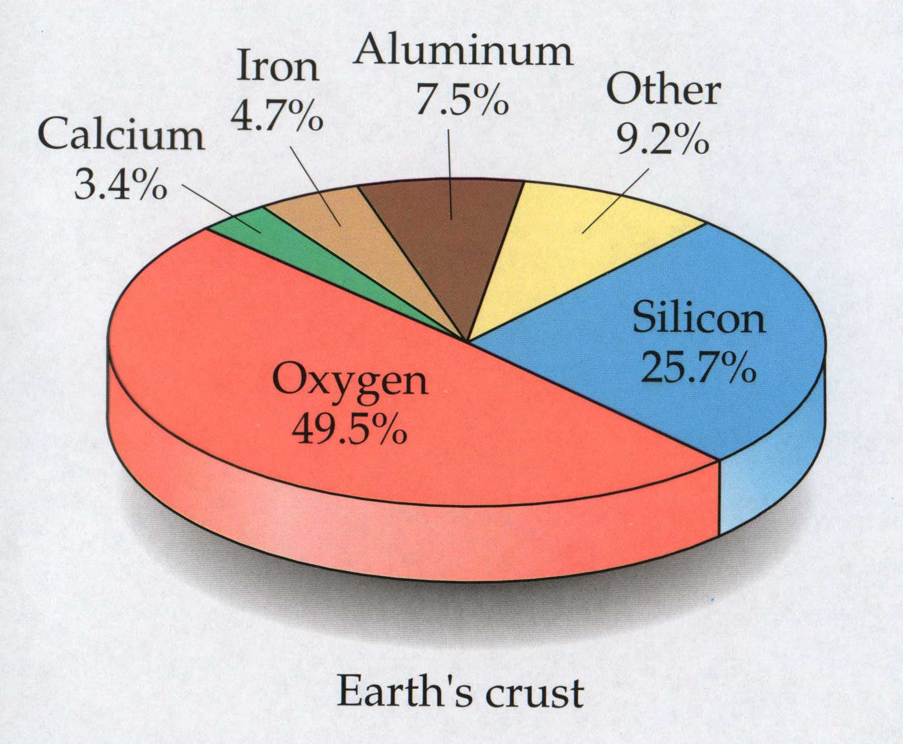
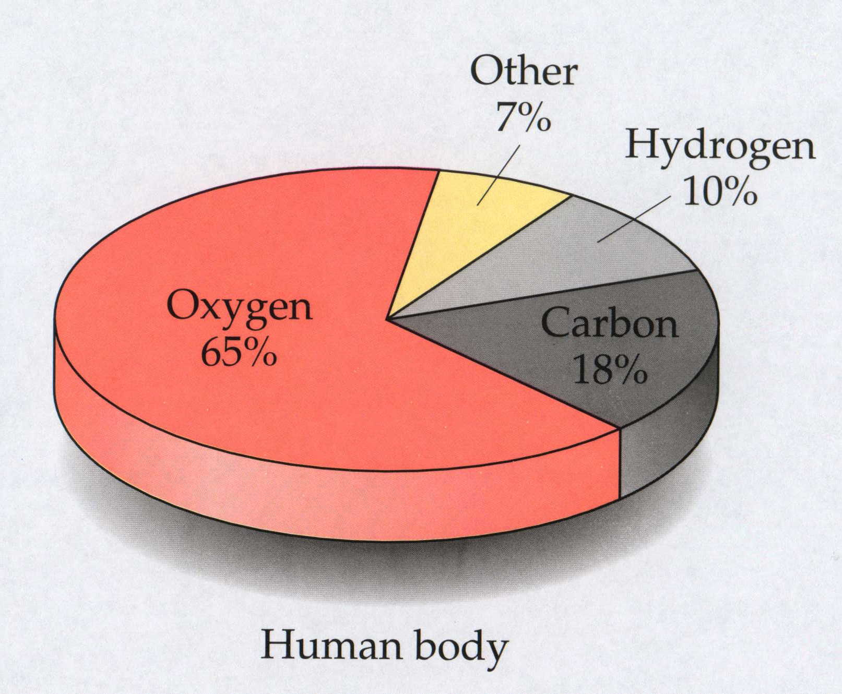
Pie Graph
Notes:
53
Here are two examples of pie graphs. First, we look at the earth’s crust. That is the single entity that we are breaking up. We look at all the different elements that make up the crust. What makes up the majority of the crust? Oxygen What makes up the smallest percentage? Calcium. Notice the percentages are listed with the labels. The other pie graph represents the human body and the percentages that each element makes up. Now the thing that’s probably not good about these graphs is we are not sure what kind of percentage these are. Is it percent by mass or volume?

Slide 54
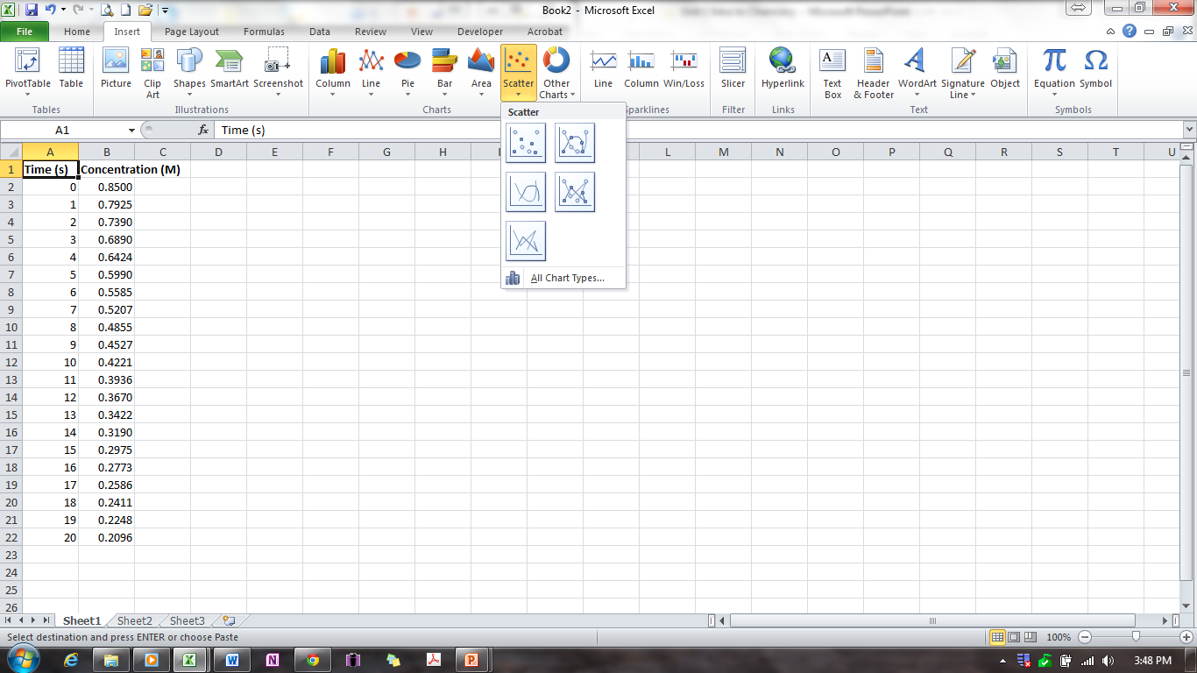
Using Excel to Graph
Use Excel to create a graph of the following concentration and time data.

Slide 55
Dimensional Analysis
Method of calculation using units throughout
Treat units like algebraic quantities
Use conversion factors to change from unit to unit.
e.g. How many centimeters are in 72 in?
Notes:
This is probably the most important concept that you will gain from this class – being able to use units to help solve problems. You will be treating the units just like they are algebraic quantities like x or y. We talked about this briefly before with the canceling of units. For dimensional analysis you will be working between units and having to convert to different units. In order to convert, you will need conversion factors. The next slide has a list of some conversion factors. I will give you a handout of these conversion factors as well. You will need to become familiar with these conversions. Here is an example question – you need to convert inches to centimeters. To be able to do this, you need the conversion factor between inches and centimeters. Check the conversion factor table – there are 2.54 cm per 1 in. You place this conversion so that the inches will cancel out and you will be left with centimeters on the top. Remember significant figures.

Slide 56
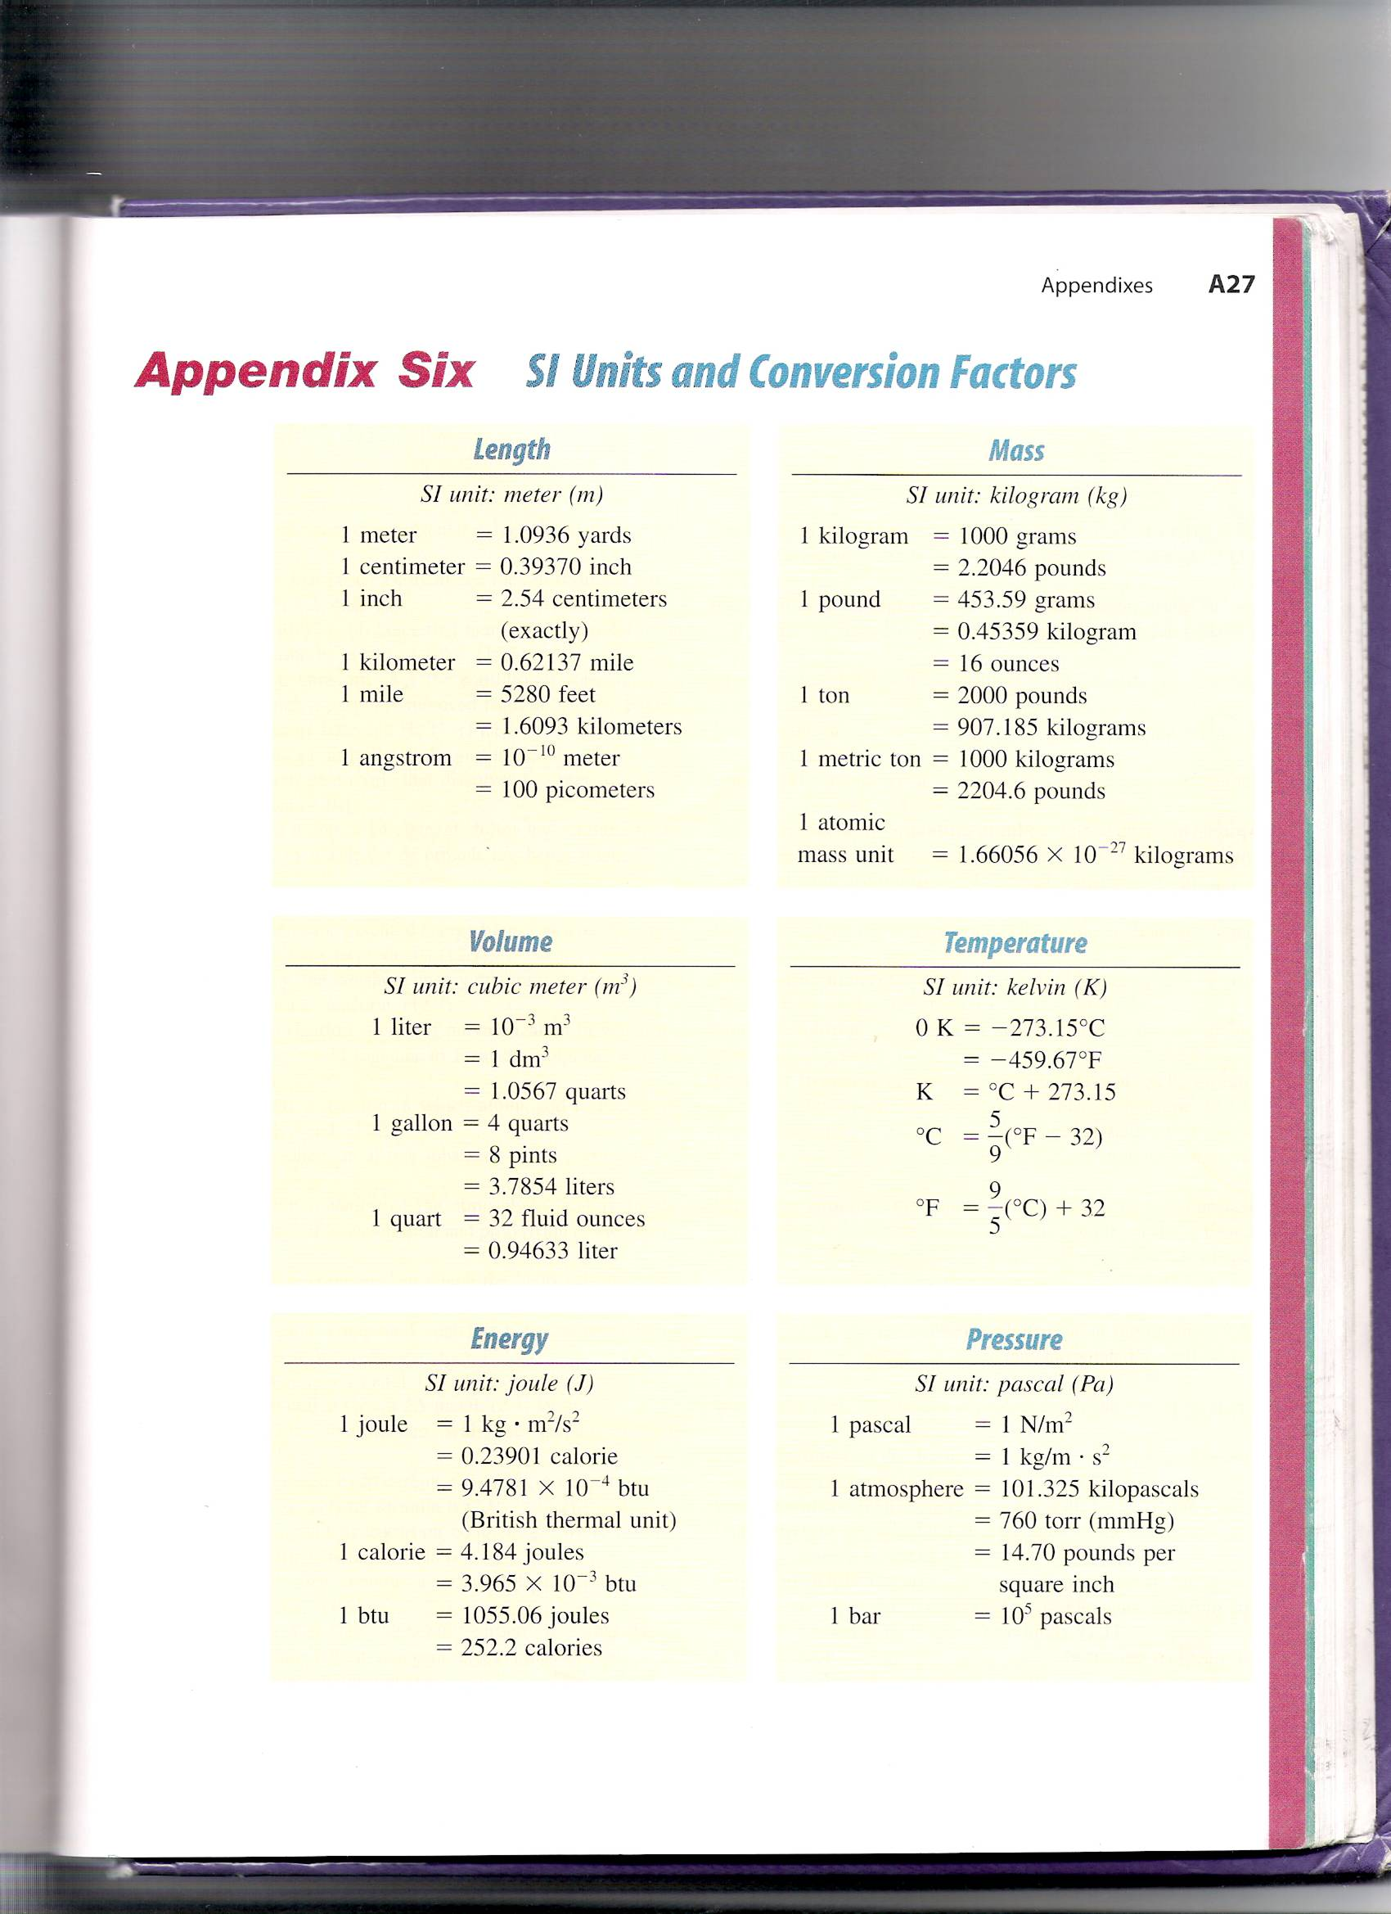
Unit Conversion Factors
Notes:
This table will be very useful to you in converting from one unit to another. You must learn to be comfortable with this table and use it to your advantage. There are a few conversions that you may want to add to this table as we go along this year. One that you might want to add right now is 1 in = 2.54 cm. We are going to do several problems that you will need to convert from one unit to another to begin working with this table. This table is from a much more advanced course textbook so you will not recognize all of these units, nor use all of them, but it is one of the most comprehensive conversion tables that I encountered during school. If this one seems to complex at first, start with the simpler conversion table on page 18 in your textbook.

Slide 57
Dimensional Analysis Example Problems
Determine the number of seconds in 15.6 years.
Determine the number of grams in 135 lbs.
Determine the number of meters in 74 in.
Determine the number of yards in a 100. meter dash.
Notes:
1) Problem 1 gives you a length of copper wire in cm but gives you the price in $ /ft. In order to perform this calculation, you need to convert the cm measurement into ft. Let’s look back at your conversion table to see how this can be done. Work these problems out on the board. You are going to be doing a ton of this type of problem because this skill (called dimensional analysis) is incredibly useful, not only in chemistry. I want you to learn to work these problems just like I’m doing now. When I learned this, we called them railroad tracks; you can come up with your own name if you want. This is the form I want to see your homework problems in. Learning to work with units can tell you how to work a problem even if you are unsure where to begin or what equation to use.

Slide 58
Dimensional Analysis Example Problems
Determine the number of meters in a marathon (26.2 miles).
A Japanese car is advertised as having a gas mileage of 15 km/L. Convert this rating to miles per gallon.
What is the price of a piece of copper wire 325 cm long that sells for $0.15/ft?
Notes:
1) Problem 1 gives you a length of copper wire in cm but gives you the price in $ /ft. In order to perform this calculation, you need to convert the cm measurement into ft. Let’s look back at your conversion table to see how this can be done. Work these problems out on the board. You are going to be doing a ton of this type of problem because this skill (called dimensional analysis) is incredibly useful, not only in chemistry. I want you to learn to work these problems just like I’m doing now. When I learned this, we called them railroad tracks; you can come up with your own name if you want. This is the form I want to see your homework problems in. Learning to work with units can tell you how to work a problem even if you are unsure where to begin or what equation to use.

Slide 59
Dimensional Analysis Example Problems
The acidic constituent in vinegar is acetic acid. A ten mL sample of a certain vinegar contains 501 mg of acetic acid. What is the mass of acetic acid expressed in micrograms?
The different colors of light have different wavelengths. The human eye is most sensitive to light whose wavelength is 555 nm (greenish yellow). What is this wavelength in centimeters.
Water consists of molecules. A water molecule has two hydrogen atoms, each connected to an oxygen atom. The distance between any one hydrogen atom and the oxygen atom is 0.96 Å. (1 Å = 10⁻¹⁰ m)What is this distance in millimeters?
Notes:
1) Problem 1 gives you a length of copper wire in cm but gives you the price in $ /ft. In order to perform this calculation, you need to convert the cm measurement into ft. Let’s look back at your conversion table to see how this can be done. Work these problems out on the board. You are going to be doing a ton of this type of problem because this skill (called dimensional analysis) is incredibly useful, not only in chemistry. I want you to learn to work these problems just like I’m doing now. When I learned this, we called them railroad tracks; you can come up with your own name if you want. This is the form I want to see your homework problems in. Learning to work with units can tell you how to work a problem even if you are unsure where to begin or what equation to use.

Slide 60
Dimensional Analysis Example Problems
The total amount of fresh water on earth is estimated to be 3.73x10⁸ km³. What is this volume in cubic meters? In liters?
A submicroscopic particle suspended in solution has a volume of 1.4μm³. What is this volume in liters?
Notes:
1) Problem 1 gives you a length of copper wire in cm but gives you the price in $ /ft. In order to perform this calculation, you need to convert the cm measurement into ft. Let’s look back at your conversion table to see how this can be done. Work these problems out on the board. You are going to be doing a ton of this type of problem because this skill (called dimensional analysis) is incredibly useful, not only in chemistry. I want you to learn to work these problems just like I’m doing now. When I learned this, we called them railroad tracks; you can come up with your own name if you want. This is the form I want to see your homework problems in. Learning to work with units can tell you how to work a problem even if you are unsure where to begin or what equation to use.

Slide 61
Dimensional Analysis Example Problems
A fish tank is 20.0 in long, 20.0 in deep, and 10.0 in high. What is the maximum volume of water, in liters, that the fish tank can hold?
An aquarium has a rectangular cross section that is 47.8 in by 12.5 in; it is 19.5 in high. How many U.S. gallons does the aquarium contain? One U.S. gallon equals exactly 231 in³.
Notes:
1) Problem 1 gives you a length of copper wire in cm but gives you the price in $ /ft. In order to perform this calculation, you need to convert the cm measurement into ft. Let’s look back at your conversion table to see how this can be done. Work these problems out on the board. You are going to be doing a ton of this type of problem because this skill (called dimensional analysis) is incredibly useful, not only in chemistry. I want you to learn to work these problems just like I’m doing now. When I learned this, we called them railroad tracks; you can come up with your own name if you want. This is the form I want to see your homework problems in. Learning to work with units can tell you how to work a problem even if you are unsure where to begin or what equation to use.

Slide 62
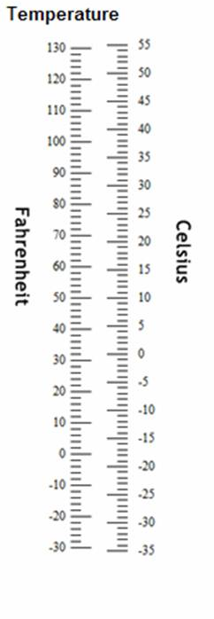
Temperature
Temperature is the measure of how hot or cold a substance is relative to another substance.
We will be using three different temperature scales: Fahrenheit, Celsius, and Kelvin.
Below are the equations that are used to convert between the scales.
Notes:
Temperature is the measure of how hot or cold a substance is relative to another substance. This is different from heat. Heat is the energy that flows between objects that are at different temperature. Temperature is related to the direction of that energy flow. Energy from higher temperature flows to lower temperature. Temperature is an intensive property – we discussed this earlier. The SI temperature unit is K but Celsius is also used often. We use the Fahrenheit scale in our everyday lives for the weather and body temperature. The zero point is different for all three of these scales. 0 K is called absolute zero. We cannot reach temperatures below this point. It is equal to -273.15 °C and -459.7 °F.

Slide 63
Temperature Conversion Examples
Convert:
  61°F to °Celsius
  -7°F to °Celsius
  -41°C to °Fahrenheit
  63°C to Kelvins and °Fahrenheit

Slide 64
Temperature Conversion Examples
Salt and ice are stirred together to give a mixture to freeze ice cream. The temperature of the mixture is -21.1 °C. What is this temperature in degrees Fahrenheit? Kelvins?
A child has a body temperature of 38.7°C. Does the child have a fever (>98.6°F)?

Slide 65
Density Tables
Density is a measure of an object’s mass divided by its volume.
Densities of Some Common Substances at 20°C and 1 atm
Substance | Physical State | Density (ρ) (g/cm³)
Oxygen | Gas | 0.00133
Hydrogen | Gas | 0.000084
Ethanol | Liquid | 0.789
Benzene | Liquid | 0.880
Water | Liquid | 0.9982
Magnesium | Solid | 1.74
Salt (NaCl) | Solid | 2.16
Aluminum | Solid | 2.70
Iron | Solid | 7.87
Copper | Solid | 8.96
Silver | Solid | 10.5
Lead | Solid | 11.34
Mercury | Liquid | 13.6
Gold | Solid | 19.32
Notes:
Density is a measure of an object’s mass divided by its volume. Density is an intensive property. No matter how much of a substance you have, the density of it will always remain the same. Density is the reason objects float on or sink in water. If the substance has a density less than that of waters’, the substance will float. Otherwise, it will sink. These values will be helpful in some of your calculations. Note the particulars in the title of the table. Density does change with temperature and pressure. Note, the water whose value is given here is liquid water. When water is cooled until it becomes ice, the density changes. Do you think the density of ice is greater than or less than that of liquid water? It is actually less than liquid water (one of the few substances whose density decreases from liquid to solid) and that’s why your ice will float in your water.

Slide 66
Density Example Problems
A certain sample of the mineral galena weighs 12.4 g and has a volume of 1.64cm³. What is the density of galena?
A flask contains 25.0 mL of diethyl ether weighing 17.84 g. What is the density of the ether?
A mineral sample has a mass of 31.5 g and a volume of 7.9 cm³. The mineral is either sphalerite (density = 4.0 g/cm³), cassiterite (density = 6.99 g/cm³), or cinnabar (density = 8.10 g/cm³). Which is it?

Slide 67
Density Example Problems
A chemist, trying to identify the main component of a compact disc cleaning fluid, finds that 25.00 cm³ of the substance has a mass of 19.625 g at 20°C. Determine the density of the fluid in g/cm³.
If a small rectangular slab of lithium weighs 1.49 x 10³ mg and has sides that measure 20.9 mm by 11.1mm by 11.9 mm, what is the density of lithium in g/cm³?

Slide 68
Density Example Problems
A piece of galena has a volume of 4.6 cm³. If the density of galena is 7.5 g/cm³, what is the mass in kg of that piece of galena?

Slide 69
Density Lab Question
1. Consider the following compounds and their densities.
You create a column of the liquids in a glass cylinder with the most dense material on the bottom layer and the least dense on the top. You do not allow the liquids to mix.
  First you drop a plastic bead that has a density of 0.24 g/cm³ in the column. What do you expect to observe?
  Next you drop a different plastic bead that has a volume of 0.043 mL and a mass of 3.92x10⁻² g into the column. What do you expect to observe in this case?
  You drop another bead into the column and observe that it makes it all the way to the bottom of the column. What can you conclude about the density of this bead?
Substance | Density (g/mL) | Substance | Density (g/mL)
Isopropyl alcohol | 0.785 | Toluene | 0.866
n-Butyl alcohol | 0.810 | Ethylene glycol | 1.114
Notes:
These two problems come from your book. These two let us think a little bit outside of the box. So let’s try to

Slide 70
Which liquid has the highest density?
least dense 1 < 3 < 5 < 2 < 4 most dense
1
3
2
5
4

Slide 71
Archimedes Principle
Thread
V_{final} = 98.5 cm³
- V_{initial} = 44.5 cm³
V_{fishing} _{sinker} = 54.0 cm³
98.5 cm³
44.5 cm³
Fishing sinker
Water
Before immersion
After immersion
Notes:
Archimedes Principle: water displacement method to find the volume of an irregularly shaped object.
The volume the water level increased is equal to the volume of the submerged object.
The most famous application of buoyancy is due to Archimedes of Syracuse around 250 BC. He was asked to determine whether the new crown that King Hiero II had commissioned contained all the gold that he had provided to the goldsmith for that purpose; apparently he suspected that the smith might have set aside some of the gold for himself and substituted less-valuable silver instead. According to legend, Archimedes devised the principle of the “hydrostatic balance” after he noticed his own apparent loss in weight while sitting in his bath. The story goes that he was so enthused with his discovery that he jumped out of his bath and ran through the town, shouting "eureka" to the bemused people.

Slide 72
Properties of Matter
Matter – anything that has mass and volume
Composition – the types and amounts of simpler substances that make matter up
Physical Change – occurs when a substance alters its physical form not its composition
  e.g. ice melting
Chemical Change (reaction) – occurs when a substance is converted into a different substance
  e.g. electrolysis of water
Notes:
Everything on our planet and in fact in our universe is made up of matter. The desk you are sitting in, the air that you’re breathing, the clothes that you wear, your own body…all of it is made up of matter.
Composition is exactly what it sounds like – what matter is composed of. If you check your shirt labels, they would probably give you a percentage of the different materials that are in the shirt. That is the shirt’s composition. Likewise, when we talk about substances in this class, we will give the chemical composition. We already discussed that the air you are breathing is matter. Can anyone tell me what “air” is made of? Oxygen and nitrogen are the biggest components of air, but carbon dioxide and several other compounds exist in the atmosphere around us.
Physical change occurs when substance just change physical form but don’t change what they are. If I folded a piece of paper, did I change what it was? No. If I tore it down the middle, did I change what it was (and don’t say yes, because it’s two pieces of paper now)? No. In both cases it was still paper. The example given is ice melting. What is ice? Frozen water. If it melts, what is it? Water. In either physical state, it is still water.
Chemical change however involves a substance changing from one to another. Most of this class will involve the discussion of chemical change, which can also be called chemical reaction. If I took the piece(s) of paper from earlier and burn them, is the result still going to be paper? No, I would have broken the paper down into different chemicals. The example given concerning water involves electrolysis. Electrolysis is a process that uses electricity to break water down into the elements that make it up – hydrogen and oxygen. Instead of having water at the end of the process, I would have hydrogen gas and oxygen gas.

Slide 73
Chemical/Physical Change Example Problems
Decide whether each of the following processes is primarily a physical or a chemical change, and explain briefly.
  Frost forms as the temperature drops on a humid winter night.
  A cornstalk grows from a seed that is watered and fertilized.
  Dynamite explodes to form a mixture of gases.
  Perspiration evaporates when you relax after jogging.
  A silver fork tarnishes in air.
Notes:
Let’s go through the following examples to determine whether each situation involves a chemical change or a physical change.
Frost forming is simply the water vapor in the air condensing into a solid form. It is still water so this is a physical change.
The seed absorbs the water and fertilizer and uses sunlight to develop into something else. Those individual components are no longer present. Therefore, this is a chemical change.
The dynamite is a single substance that breaks down into a set of gases – no longer dynamite. Therefore, this is a chemical change.
This is what changing into a gas, but it is still water. Therefore, this is a physical change.
The components of air react with the silver to form a compound that wasn’t present before. Therefore, this is a chemical change.

Slide 74
Properties of Matter
Properties – the characteristics that give each substance its unique identity
  Physical Properties – those that a substance shows by itself without changing into or interacting with another substance
    e.g. color, melting point, electrical conductivity, density
  Chemical Properties – those that a substance shows as it changes into or interacts with another substance or substances
    e.g. flammability, corrosiveness, reactivity with acids
  Extensive Properties – those dependent on the amount of substance present
  Intensive Properties – those that are independent of the amount of substance present
Notes:
A property of matter is simply information that is used to describe and define the substance.
Physical properties are things that a substance has all by itself. For example, the color of your shirt is a physical property or the density of a gold necklace.
Chemical properties are exhibited when a substance changes or interacts with something else. By itself, we would never know how flammable this podium is. We have to introduce a spark or flame to see this property. Likewise, bleach by itself is pretty harmless. However, when we mix it with clothing we can see some of its chemical properties.
Extensive properties have to do with amount. Examples are mass and volume. Something is an extensive property if it changes with how much of the substance there is.
Intensive properties, on the other hand, do not rely on the amount of substance present, e.g. density and temperature. Regardless of how big or small you are, your temperature should be around 98.6 degrees Fahrenheit for your entire body.

Slide 75
Physical and Chemical Properties
Examples of Physical Properties
Boiling point Color Slipperiness Electrical conductivity
Melting point Taste Odor Dissolves in water
Shininess (luster) Softness Ductility Viscosity (resistance to flow)
Volatility Hardness Malleability Density (mass / volume ratio)
Examples of Chemical Properties
Burns in air Reacts with certain acids Decomposes when heated
Explodes Reacts with certain metals Reacts with certain nonmetals
Tarnishes Reacts with water Is toxic
Chemical properties can ONLY be observed during a chemical reaction!

Slide 76
States of Matter
Solid:
  Fixed shape that does not conform to the container shape
  Not defined by rigidity or hardness
Liquid:
  Conforms to the container shape but fills the container only to the extent of the liquid’s volume
  Liquid forms a surface
Gas:
  Conforms to the container shape and fills the entire container
  Does not form a surface
Notes:
These are the three states of matter that you have been hearing about since you were in elementary school. It is important that you be able to understand the differences between the states and how that affects a substances properties. Solid substance do not have to be as hard as this podium. A pillow for instance is a solid. The quality of a solid is that it is a fixed shape that does not conform to the container it is in.
A liquid does conform to the shape of its container. We see that every day in our drinks as water we pour into a glass or bottle holds the shape of whatever it is we put it into. A gas will also take the shape of the container it is in, but there are a few key differences between gases and liquids. A liquid will only fill a container according to the volume of liquid present while a gas, regardless of the amount will spread out and fill a container entirely. A liquid will have a surface to it while you cannot tell accurately where a gas “begins”.
Have three bottles – put a small block in one, water in another, and “air” in the third.

Slide 77
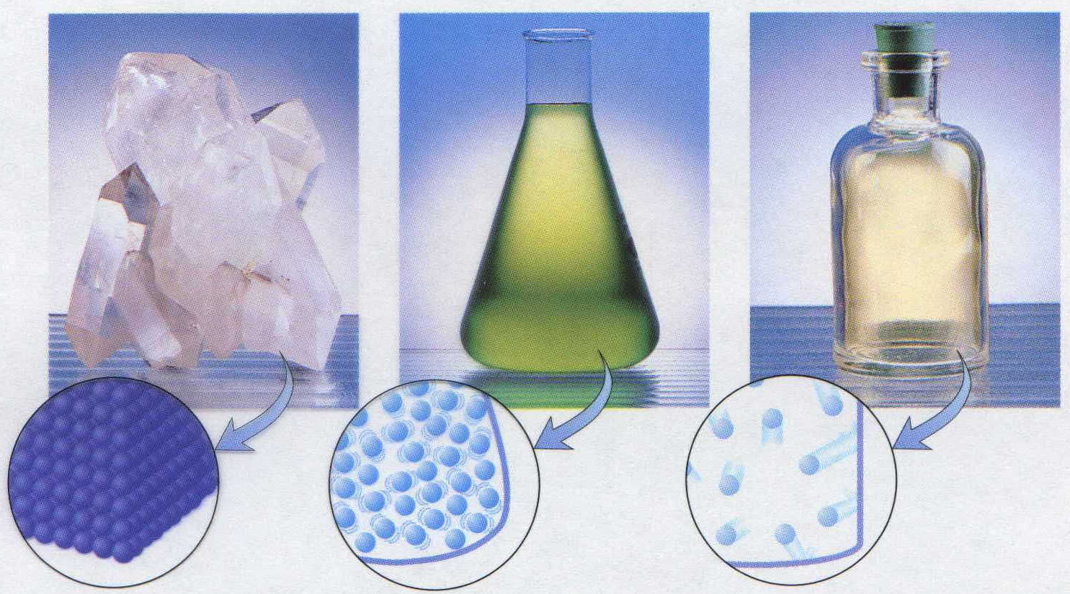
States of Matter
(a) Particles in solid (b) Particles in liquid (c) Particles in gas

Slide 78
Properties of Solids, Liquids, and Gases
Property Solid Liquid Gas
Shape Has definite shape Takes the shape of Takes the shape
the container of its container
Volume Has a definite volume Has a definite volume Fills the volume of
the container
Arrangement of Fixed, very close Random, close Random, far apart
Particles
Interactions between Very strong Strong Essentially none
particles
Notes:
The three common phases (or states) of matter are gas, liquid, and solid
1. Gases
a. Have the lowest density of the three states of matter
b. Are highly compressible
c. Completely fill any container in which they are placed
d. Their intermolecular forces are weak
e. Molecules are constantly moving independently of the other molecules present
2. Solids
a. Dense
b. Rigid
c. Incompressible
d. Intermolecular forces are strong
e. Molecules locked in place
3. Liquids
a. Dense
b. Incompressible
c. Flow readily to adapt to the shape of the container
d. Sum of the intermolecular forces are between those of gases
and solids
• The state of a given substance depends strongly on conditions

Slide 79
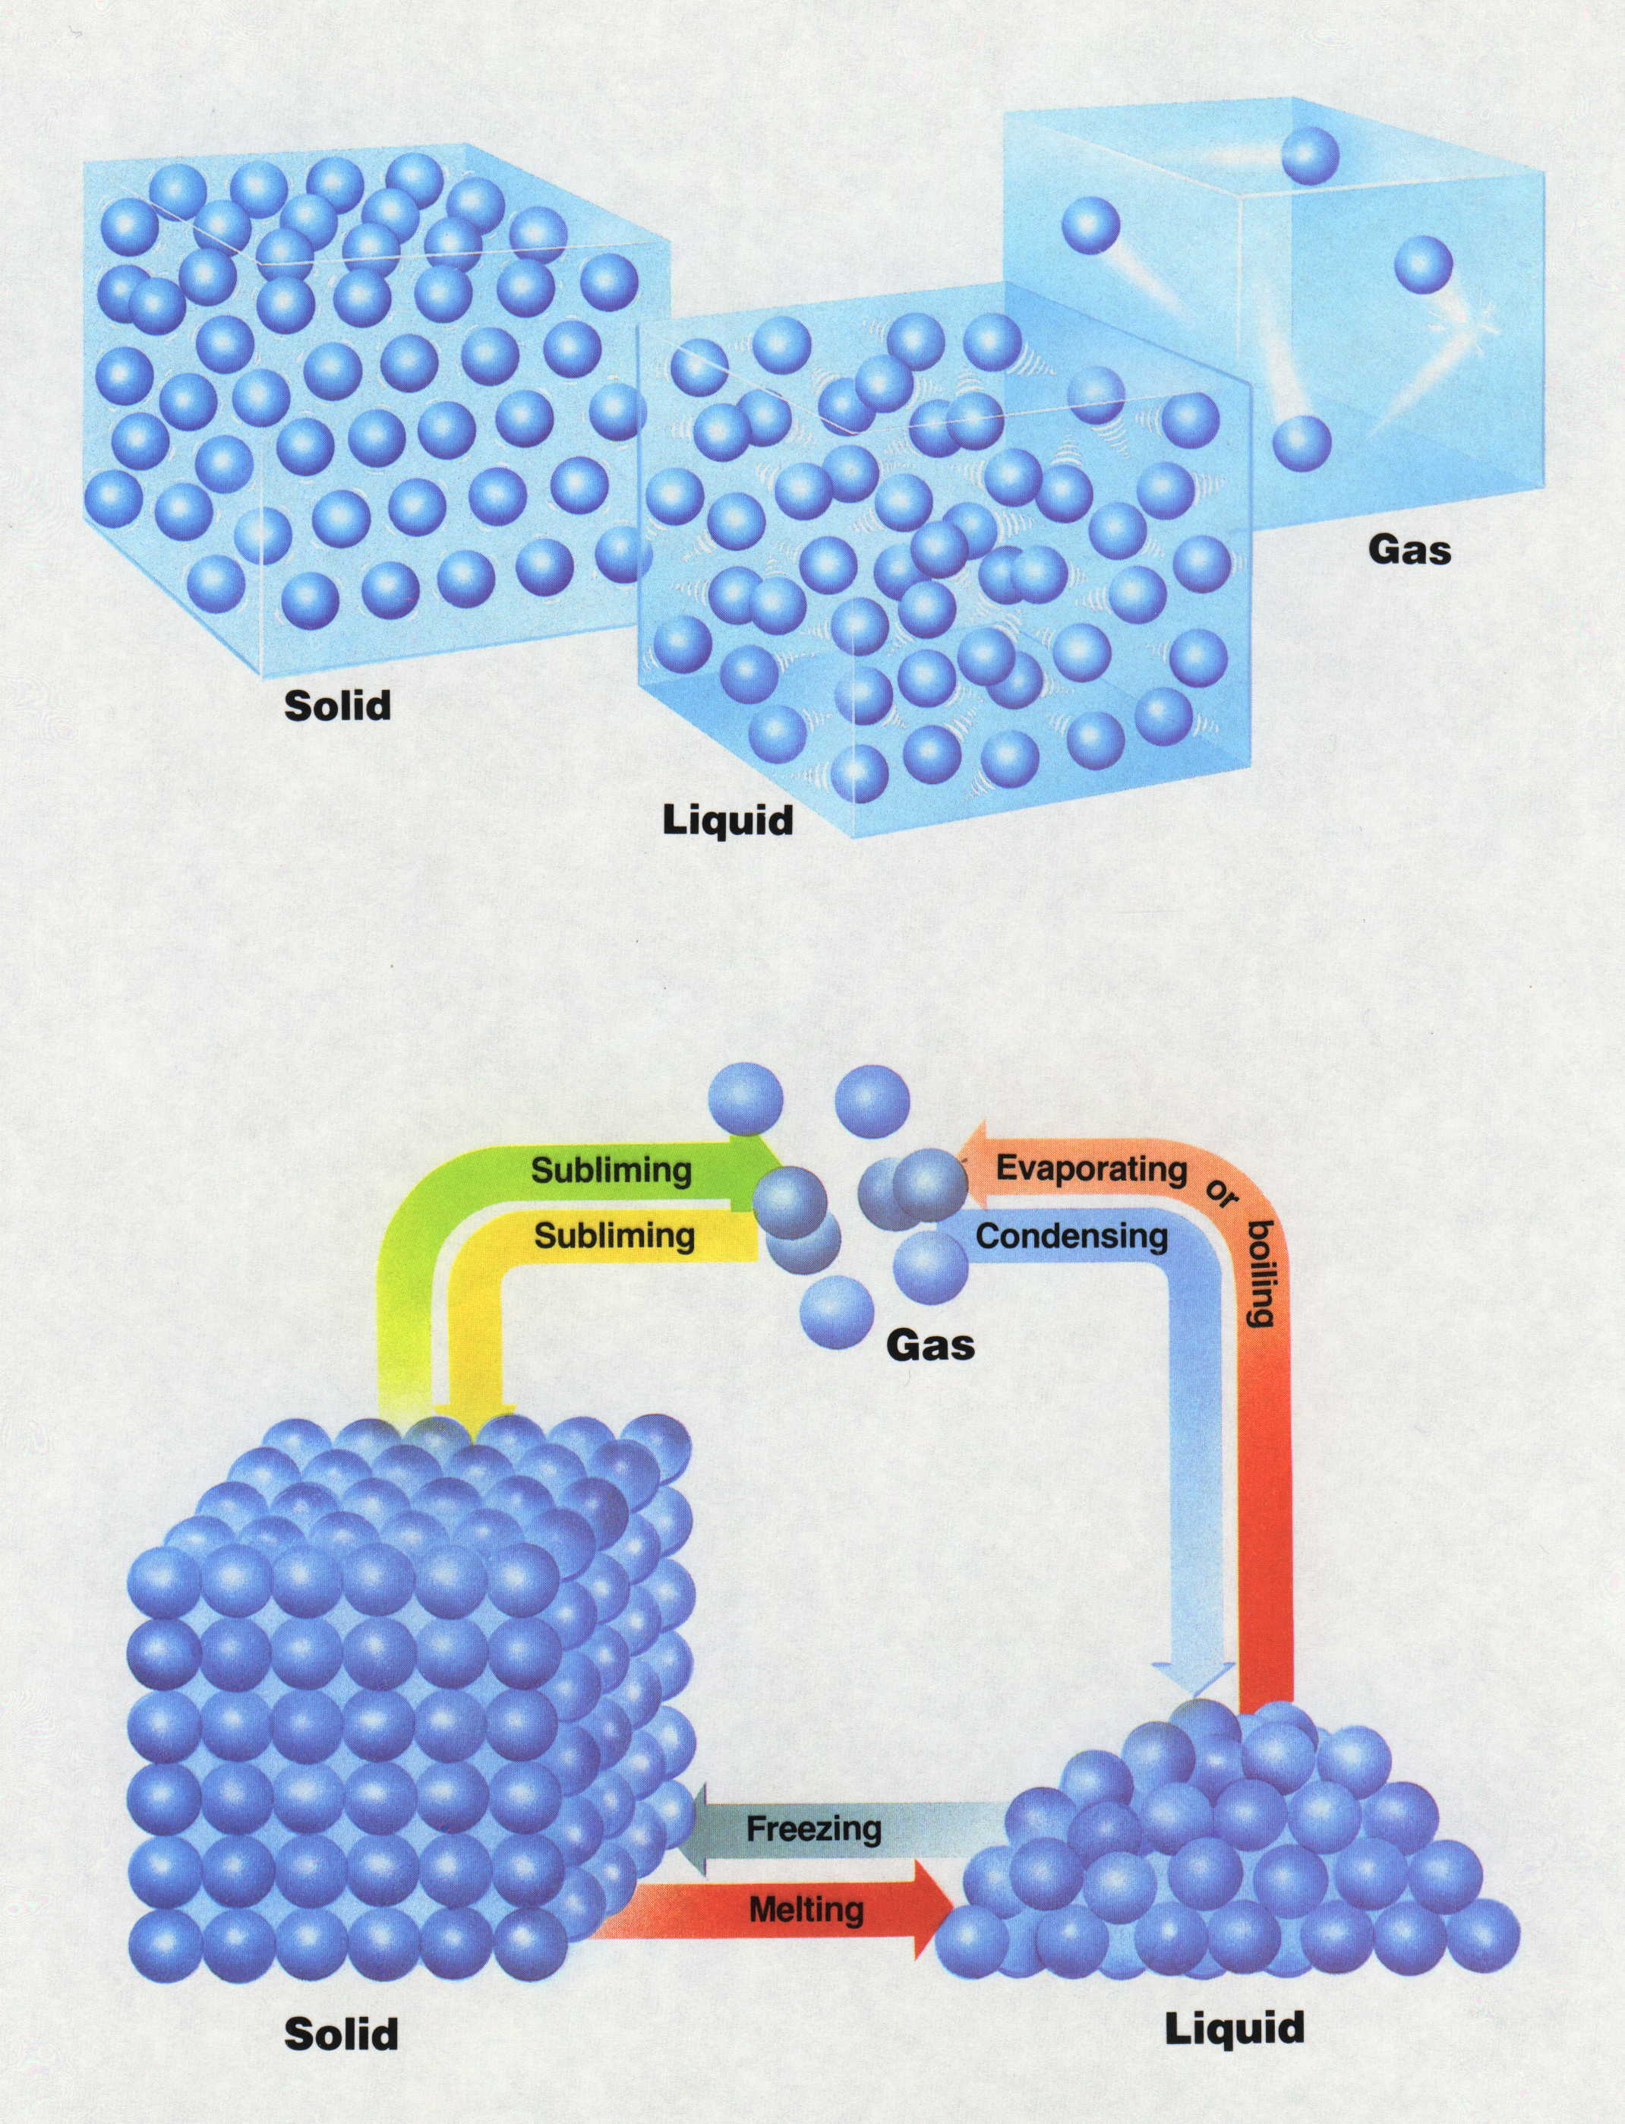
States of Matter
Notes:
Solid, Liquid, Gas are the three states of matter we will deal with.
Plasma and Neutron star are also states of matter.
For more information about plasma and neutron stars try the following links:
Coalition for Plasma Science – What is plasma?
http://www.plasmacoalition.org/what.htm
Neutron Stars and Pulsars – Introduction
http://imagine.gsfc.nasa.gov/cgi-bin/print.pl

Slide 80
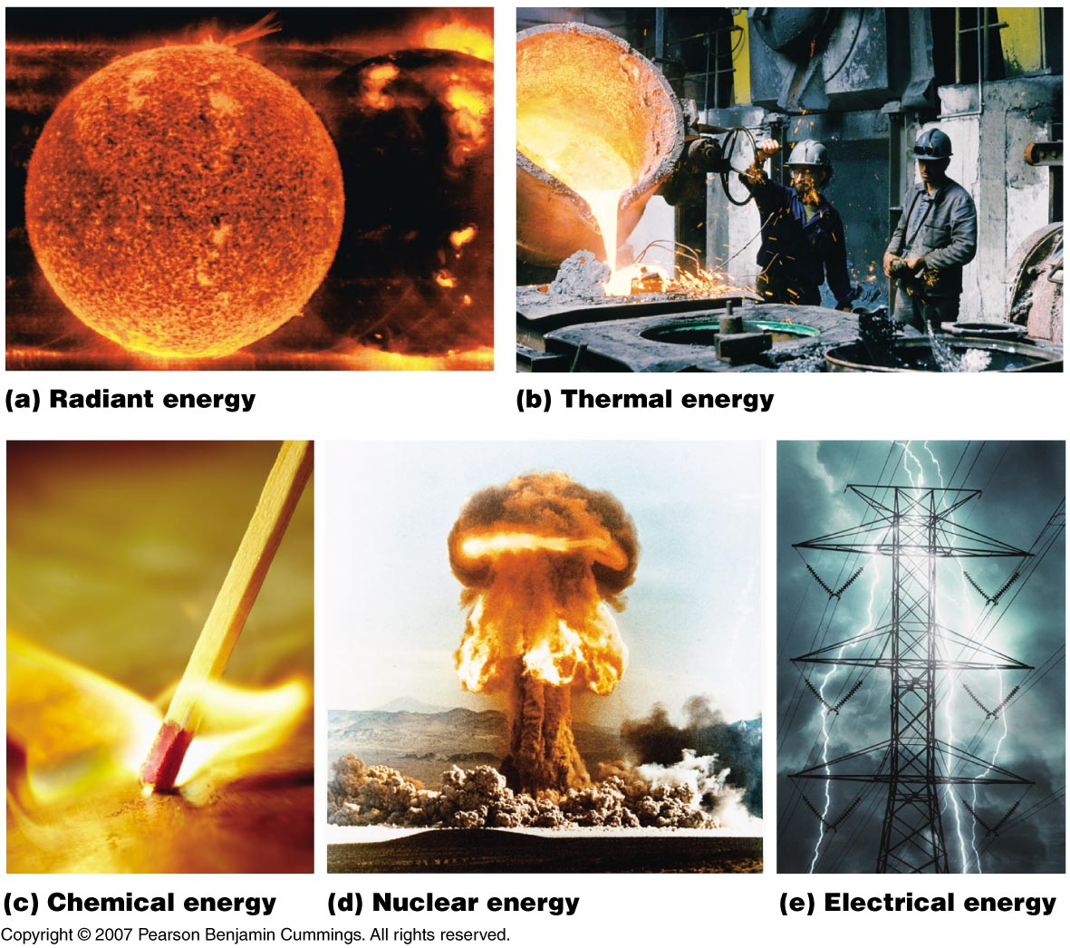
Forms of Energy
(a) Radiant energy
(b) Thermal energy
(c) Chemical energy
(d) Nuclear energy
(e) Electrical energy
Notes:
Forms of energy
1. Radiant — energy in light, microwaves, and radio waves
2. Thermal — results from atomic and molecular motion
– Temperature of an object is a measure of the thermal energy content
3. Chemical — results from the particular arrangement of atoms in a chemical compound; heat and light produced in this reaction due to energy released during the breaking and reforming of chemical bonds
4. Nuclear — released when particles in the nucleus of the atoms are rearranged
5. Electrical — due to the flow of electrically charged particles

Slide 81
Energy
Energy – the ability to do work
Potential Energy – energy due to the position of the object (stored energy)
Kinetic Energy – energy due to the motion of the object
The total energy an object possess is the sum of its potential and kinetic energy.
1st Law of Thermodynamics – energy is conserved: it may be converted from one form to the other, but it is not destroyed
Notes:
Energy – very very important concept. This is how we move our bodies to do anything, this is how all our electronics and transportation methods operate. Energy is what keeps the universe “moving”. The definition as the “ability to do work” simply means that energy is the capability to perform any task, whether it is our traditional idea of work such as carrying something, or the smallest of chemical processes. Energy is required.
Potential energy – we see this a lot in our every day life. The easiest way to think about this practically is that this is energy due to height. For instance, if I hold this marker over the desk by about two inches, it has a certain potential energy. However, if I raise it up so it is several feet above the desk, I have increased the potential energy. The higher marker will hit the desk with much more force than the lower marker because of the potential energy it contained and subsequently released. Think about this on a pendulum ride. When the ride reaches the “top” of either side, it stops for just a split second. The energy in the ride at that point is potential energy.
Kinetic energy is the energy that is due to motion of an object. If an object is moving, it has some amount of kinetic energy. When I dropped the marker earlier, the potential energy that it had was converted into kinetic energy. The marker with the greater amount of potential energy had a similarly greater amount of kinetic energy. When that pendulum ride swings through its arc, it is exhibiting kinetic energy.
Total energy is simply a combination of potential and kinetic energy. An object does not have to have just one or the other. Most things have a combination.
1st law of thermodynamics – sounds like a big deal (which it is) that you would only care about in school. However, this law is vital to understanding why things work like they do. This law says that energy cannot be destroyed. Thus, there is the exact same amount of energy in the universe today as there was millions and billions of years ago. It is in many different forms that are ever changes, but the quantity remains the same. Let’s examine this. When I raised the marker up and said I had increased the potential energy, did I create energy? No, I had to expend some of my own energy to raise the marker up against gravity. Thus, some of my energy was converted to the potential energy of the marker. What about when the marker hit the ground? Did that energy disappear? No, it was transferred into the surface it hit. Now I know you didn’t see anything groundbreaking when it hit, but that’s because the desk could absorb such a small amount of energy and transfer it on to the ground without being affected. What if I had taken a huge stack of textbooks and dropped them. Could you see the effect of the transfer of energy then? We see the transfer of energy when a car traveling along with kinetic energy hits an object or vehicle. That energy is transferred to the object and we feel the results of the transfer. When we eat food, we convert the energy within the food to energy within our own bodies. This concept is something you must remember: Energy cannot be destroyed!!! It is somewhere out there.

Slide 82



Potential vs. Kinetic Energy
Potential energy
Energy in
Energy out
kinetic energy
kinetic energy

Slide 83
Kinetic Energy
Kinetic Energy: KE = ½ m v²
Determine the kinetic energy of a speeding bullet. The bullet has a mass of 30 g and is fired at a speed of 900 m/s. Convert this value to joules.
mass
velocity (speed)
Notes:
Potential energy
– Energy stored in an object because of the relative positions or orientations of its components
- Gravitational potential energy formula = m*g*h
Kinetic energy
– Energy due to the motion of an object
Kinetic energy, KE, of an object is related to its mass, m, and velocity v:
KE = ½ mv²
Potential energy is equivalent to work:
PE = Fd = mad = mgh
m = mass, g = gravity (9.81 m/s²) and h = height

Slide 84

Potential Energy
Potential Energy:
Batteries (chemical potential energy)
Spring in a watch (mechanical potential energy)
Water trapped above a dam (gravitational potential energy)
PE = m*g*h
Notes:
Potential energy
– Energy stored in an object because of the relative positions or orientations of its components
- Gravitational potential energy formula = m*g*h
Kinetic energy
– Energy due to the motion of an object
Kinetic energy, KE, of an object is related to its mass, m, and velocity v:
KE = ½ mv²
Potential energy is equivalent to work:
PE = Fd = mad = mgh
m = mass, g = gravity (9.81 m/s²) and h = height

Slide 85
Conservation of Energy in a Chemical Reaction
In this example, the energy of the reactants and products increases,
while the energy of the surroundings decreases.
In every case, however, the total energy does not change.
Surroundings
Surroundings
System
Energy
System
Before
reaction
After
reaction

Slide 86
Conservation of Energy in a Chemical Reaction
In this example, the energy of the reactants and products decreases,
while the energy of the surroundings increases.
In every case, however, the total energy does not change.
Surroundings
Surroundings
System
Energy
System
Before
reaction
After
reaction

Slide 87
Law of Conservation of Energy
E_{after} = E_{before}
2C₂H₂ + 5O₂ → 4 CO₂ + 2H₂O + energy
Energy Changes
heat, light, sound
ENERGY
KE_{stopper}
PE_{reactants}
PE_{products}
C₂H₂ + O₂
C₂H₂ + O₂

Slide 88
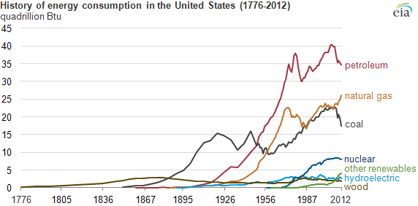
Energy Sources in the United States
Notes:
Source: US Energy Information Administration (2005 Electricity Generation)
49.9% Coal
3.1% Renewable (biomass, geothermal, solar, wind)
6.6% Hydroelectric
2.5% Petroleum
18.8% Natural gas
19.3% Nuclear
Society requires the constant expenditure of huge amounts of energy.
The United States consumes 10⁶ kJ per person per day or 30% of the world’s total energy usage.

Slide 89
Energy Production in United States

Slide 90
Classifying Matter
Element:
  The simplest type of matter with unique physical and chemical properties
  Consists of only one kind of atom
  Cannot be broken down into a simpler type of matter by any physical or chemical methods
  A pure substance → matter whose composition is fixed.
Molecule:
  An independent structural unit consisting of two or more atoms that are chemically bound together.
Notes:
Elements are all the basic building block behind all matter. Elements do have smaller particles called atoms that make them up but an element is a substance with unique physical and chemical properties. Each element is unique and different from every other element. The atoms of an element are different from the atoms of all other elements. Elements are pure substances, that is their composition is fixed. There are other pure substances as well.
Molecules are combinations of atoms, either of the same element or different elements, bonded together. Molecules are independent units – the water molecule is an example of this (the two hydrogen atoms bonded to the single oxygen atom).

Slide 91
Classifying Matter
Compound:
  A type of matter composed of two or more different elements that are chemically bound together.
  The elements are present in fixed parts by mass (fixed mass ratio)
  Properties of the compound are different from those of the component elements
Mixture:
  A group of two or more substances (elements and/or compounds) that are physically intermingled.
  The components can vary in their parts by mass.
  Composition is not fixed.
  Retains many of the properties of its component
Notes:
Compounds – most of nature exists within some kind of compound. Water is a compound. It is composed to hydrogen and oxygen bonded together. Think of making compounds like you are making cookies. More than one ingredient is needed to make a cookie, but to make a particular type of cookie you have to use the right ingredients in just the right amounts. The amounts don’t change to make a specific cookie. And the final product is much different than the individual ingredients that make it up.
Mixtures are not bonded chemically like compounds. Mixtures are just two or more substances physically put together. Think of sugar water. To make it, you simply put the water and sugar together in a physical space. Does the amount of sugar matter to make the mixture? No, whether you put a teaspoon of sugar in or a half a cup, the mixture is still sugar water. Unlike the cookies, the sugar water does not differ much from its original components and often can be separated into its components by physical methods. Some other examples of mixtures are wood, air, and gasoline.
A mixture may be labeled heterogeneous or homogeneous. Heterogeneous mixtures are those that do not mix evenly throughout and you can still identify the individual components. Homogenous mixtures blend smoothly and are constant throughout. This kind of mixture is called a solution.

Slide 92
Classification of Matter
This well-known molecule is a compound
because it contains more than one element.
Ordinary solid salt is a compound but not a molecule.
It is built from interpenetrating lattices of sodium and
chloride ions that extend indefinitely.
A molecule but not a compound
Ozone, O₃, is not a compound because it contains only a single element.
Notes:
http://www.chem1.com/acad/webtext/pre/chemsci.html

Slide 93
Mixtures: Classification and Separation
Matter usually occurs as mixtures.
There are two broad classes of mixtures:
  Heterogeneous → has one or more visible boundaries between the components; non-uniform composition
  Homogeneous → has no visible boundaries because the components are mixed as individual atoms, ions and molecules; uniform composition
    Also called a solution
    Aqueous solutions are solutions in water which comprise a major portion of the environment.
Mixtures differ from compounds in three ways:
  The proportions of the components can vary.
  The individual properties of the components are observable.
  The components can be separated by physical means.
Notes:
Most of matter exists as mixtures. There are two main categories of mixtures: heterogeneous or homogeneous. Heterogeneous mixtures are those that do not mix evenly throughout and you can still identify the individual components. Homogenous mixtures blend smoothly and are constant throughout. This kind of mixture is called a solution. A major portion of our earth consists of aqueous solutions – like the ocean.
Mixtures are different from compounds. In a compound, the proportions of the components is constant and defined. This is not true in a mixture. We discussed this above. A mixture still retains the properties of its individual components whereas the components of a compound are bonded to give new properties to the substance. Finally, a compound can only be separated by chemical means, but a mixture can be separated by a variety of physical means. We will describe and define some of those methods in the upcoming slides.

Slide 94
Basic Separation Techniques
Filtration – uses a porous barrier to separate a solid from a liquid
  A mixture is poured through a piece of filter paper folded into a cone shape; the liquid passes through and the solids are trapped in the filter paper.
  Separation is based on a difference in particle size.
Distillation – separation technique that is based on differences in the boiling points of the substances involved
  A mixture is heated until the substance with the lowest boiling point boils to a vapor that can be condensed into a liquid and collected.
  Separates components through differences in volatility, the tendency of a substance to become a gas
Crystallization – separation that results in the formation of pure solid particles of a substance from a solution containing the dissolved substance
  A mixture is saturated with a dissolved substance until the substance comes out of solution and collects as crystals on some available surface.
  Separates the components of a mixture on the basis of differences in solubility
  The solubility of a substance is the amount that dissolves in a fixed volume of solvent at a given temperature.
Notes:
We are going to discuss 5 different basic separation techniques.
The first is filtration. You might all be familiar with this concept if you have or have heard about water filters that go on your tap or the refrigerator or if you drink or know someone who drinks coffee. What filtration does is use a porous barrier, like a coffee filter (although the filters get much more complex in chemistry) to separate a liquid from a solid. The mixture is poured through the filter, and the liquid is allowed to pass through, but any solids are caught in the filter. This separation is based on the difference in particle size. The particles in the solid are much larger than those in the liquid and cannot pass through the holes in the filter.
Next up is distillation. This one is a particular favorite of mine because it was used in great extent in my former job in an oil refinery. What distillation does to separate a mixture is based on the different boiling points of the substances involved. The mixture gets heated. The substance in the mixture with the lowest boiling point will vaporize first and float up as gas. Basic distillation then collects this gas as it rises and cools it back down to a liquid. This separation is based on volatility which describes the tendency of a substance to vaporize and become a gas.
Next is crystallization. This separation is based on solubility – which is the amount that will stay dissolved in a volume of solvent at a specific temperature. Think about if I were mixing sugar and water together. If I add a little bit of sugar to the water and stir, the sugar dissolves into the water and you can’t see it. If I were to keep adding sugar, I would eventually reach a point where no more sugar could be dissolved (a saturated solution) and the sugar would start crystallizing (appearing in solid form) in the solution.

Slide 95
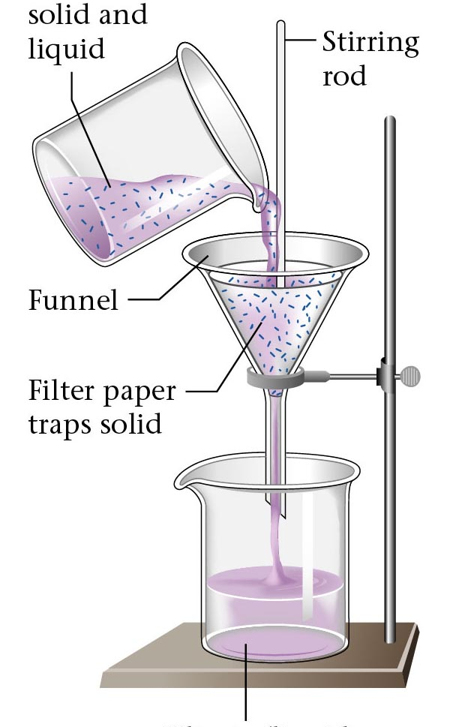
Filtration
Mixture of
solid and
liquid
Stirring
rod
Separates a solid from a liquid
Funnel
Filter paper
traps solid
Filtrate (liquid
component
of the mixture)

Slide 96
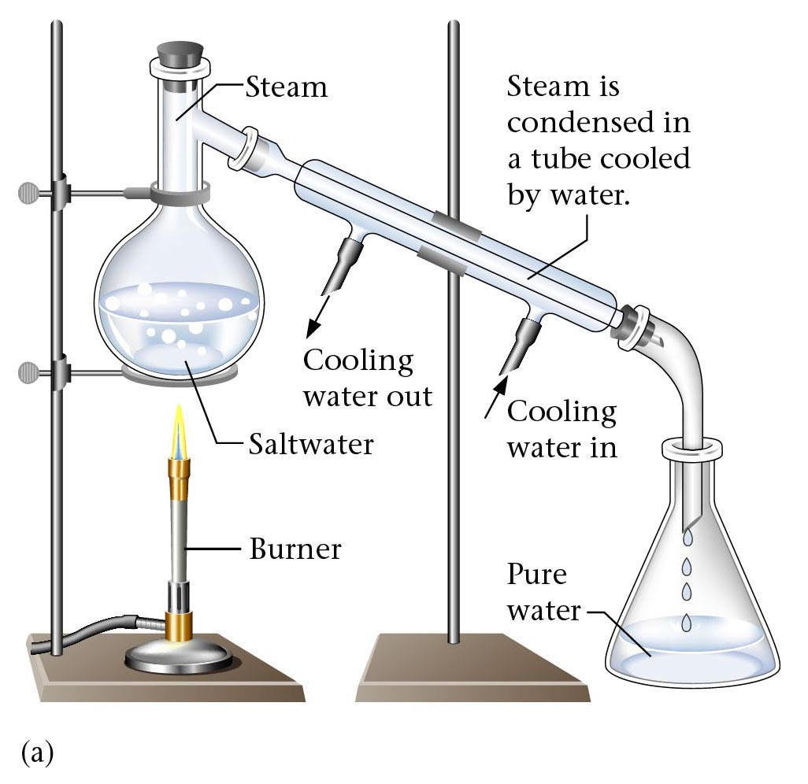
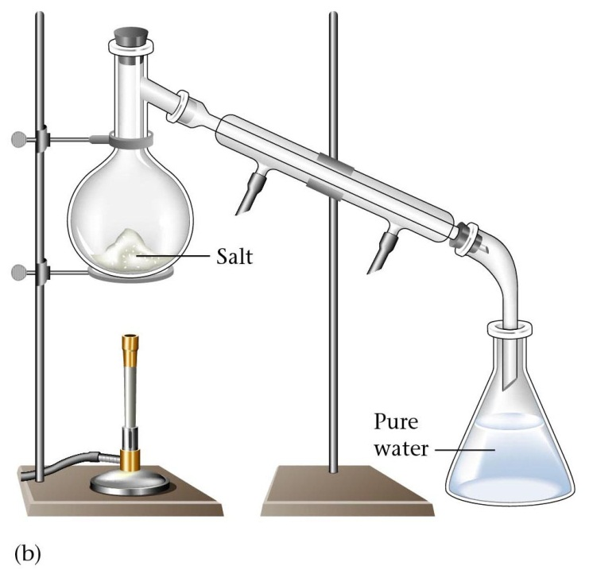
Distillation

Slide 97
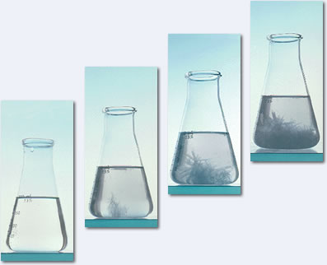
Crystallization

Slide 98
Basic Separation Techniques
Extraction – separation based on differences in solubility
  A material is mixed with a solvent that dissolves the soluble compound embedded in the insoluble material. A secondary solvent can be used to further separate and purify the compound.
Chromatography – separates the components of a mixture (mobile phase) on the basis of the tendency of each to travel or be drawn across the surface of another material (stationary phase)
  Separates the components based on differences in solubility.
  Mixture is dissolved in a gas or liquid called the mobile phase and the components are separated as this phase moves over a solid (or viscous liquid) surface called the stationary phase.
Notes:
Fourth is extraction. If you bake, you have probably used an extract before. Extraction is also based on solubility like crystallization. Let’s say you have some solid that is made up of more than one substance – maybe a plant leaf. Extraction uses a solvent, which is a special chemical that targets one of the mixed substances. The material is mixed with the solvent which dissolves a particular substance in the material that is soluble in the solvent. The remainder of the material which is insoluble in the solvent stays in solid form. Then the solvent can be separated from the remaining material and the solvent-extract mix can be separated further using other separation techniques of more solvents.
Finally, we get to chromatography. This separation technique splits components of a mixture based on their ability to travel across a surface of another material. This separation is also based on solubility. The mobile phase, which is a gas or liquid that contains the mixture, is drawn across a surface (often solid – called stationary phase). Different substances travel at different rates across the stationary phase. Look on page 29 of your textbook at an example of paper chromatography. The paper strip was dipped into the mixture of ink. The different colors in the ink travel up the paper strip. The greater the attraction the mixture has for the paper, the slower it travels because it is clinging to the material.

Slide 99
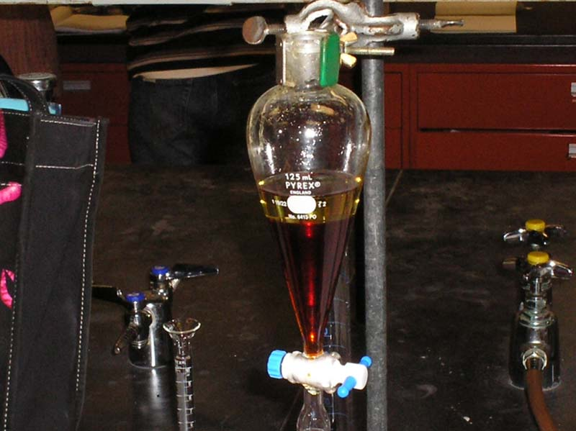
Extraction

Slide 100
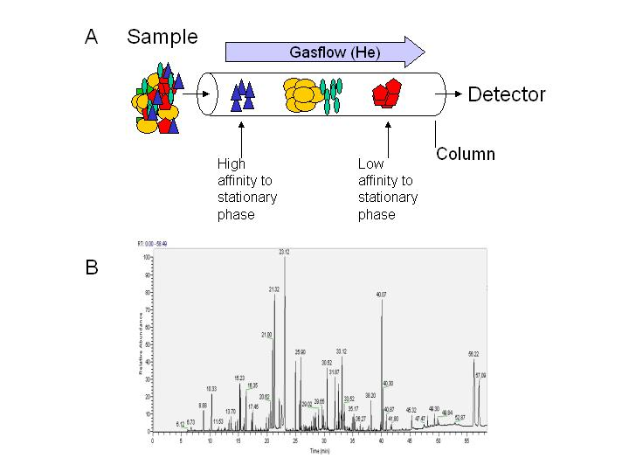
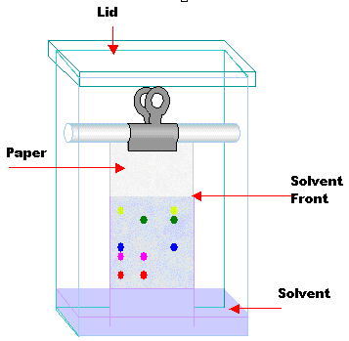
Chromatography
Gas Chromatography
Paper Chromatography

Slide 101
Videos
Fractional Distillation
Liquid-Liquid Extraction
Paper Chromatography
Crystallization

