Slide 1
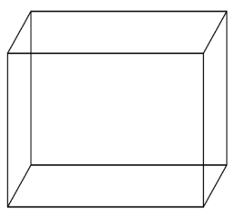
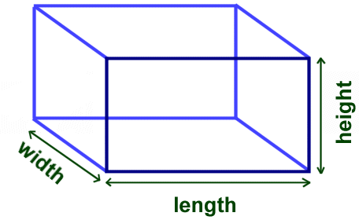
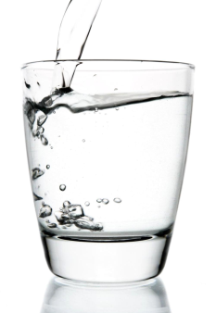
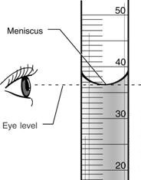
REFERENCE SHEET: How to Measure VOLUME
VOLUME is how much space an object takes up. We know THREE different ways to measure volume. How we measure an object’s volume depends on what kind of object it is!
If you want to find the VOLUME of a … | The TOOL you need is a … | With this tool, you should … | And the UNIT you should use is …
Rectangular Solid | Ruler | Find the length, width, and height, then multiply them! L x W x H | cubic centimeters cm³
Liquid | Graduated Cylinder | Read the BOTTOM of the meniscus. Don’t forget to bend down to eye level! | milliliters mL
Irregular Object | Graduated Cylinder | Water Displacement! 1) Pour in water. 2) Write V before. 3) Add your object. 4) Write V after. 5) Subtract! | cubic centimeters cm³
Turn to the back for more details on measuring volume!

Slide 2
To measure the volume of a rectangular solid:
Draw your object. Draw a sad unit cube in the corner.
Use a ruler to measure the length, width, and height of your object. Label your drawing with these measurements!
Round the length, width, and height to the nearest centimeter. Ask yourself, “Which centimeter is it closest to?”
Multiply the length, width, and height to find the volume! You may use a calculator. Do not forget the unit cubic centimeters (cm³)!
To measure the volume of a liquid:
If you’re pouring the liquid, do it slowly. No splashing!
Measure on a flat surface. Hold the cylinder still with two fingers.
Bend down so that you are at eye level with the meniscus – the upside-down bubble.
Read the BOTTOM of the meniscus.
Count up from the lower number. Each line = 1 milliliter (mL).
Don’t forget the right units!
WARNING: If you do not bend down to eye level with the meniscus, you will read the volume incorrectly!
To measure the volume of an irregular object, use water displacement! To do this:
Pour water in a graduated cylinder, just enough to cover your object. You should pour to a whole milliliter. Use the dropper to adjust.
Write down the starting volume. Use V_{B}, for Volume Before!
Carefully drop or slide your object into the cylinder. NO splash.
Measure the final volume within the cylinder. Use V_{A}, for Volume After! You may have to round to the closest milliliter.
Subtract the starting volume from the end volume.
Use the unit cubic centimeters (cm³), because the objects are solids, not liquids!

