Slide 1
Chapter 13
Gases

Slide 2
Why study gases?
An understanding of real world phenomena.
An understanding of how science “works.”

Slide 3
A Gas
Uniformly fills any container.
Mixes completely with any other gas.
Exerts pressure on its surroundings.

Slide 4
Pressure
SI units = Newton/meter² = 1 Pascal (Pa)
1 standard atmosphere = 101,325 Pa
1 standard atmosphere = 1 atm = 760 mm Hg = 760 torr

Slide 5
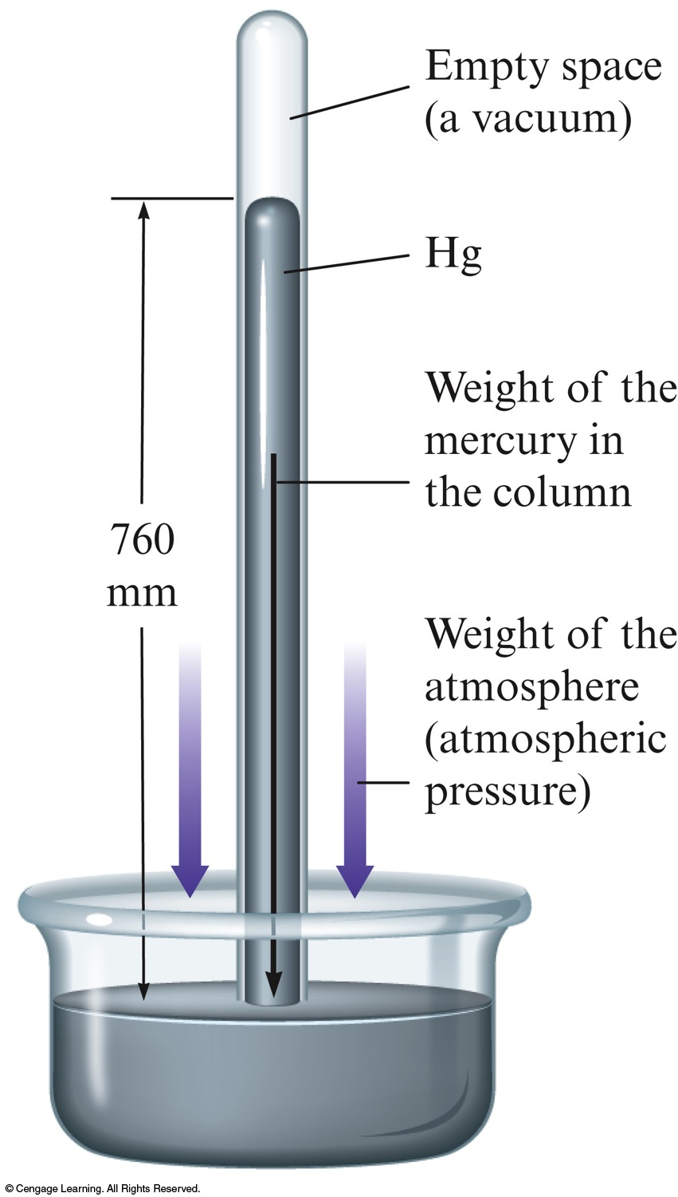
Barometer
Device used to measure atmospheric pressure.
Mercury flows out of the tube until the pressure of the column of mercury standing on the surface of the mercury in the dish is equal to the pressure of the air on the rest of the surface of the mercury in the dish.

Slide 6
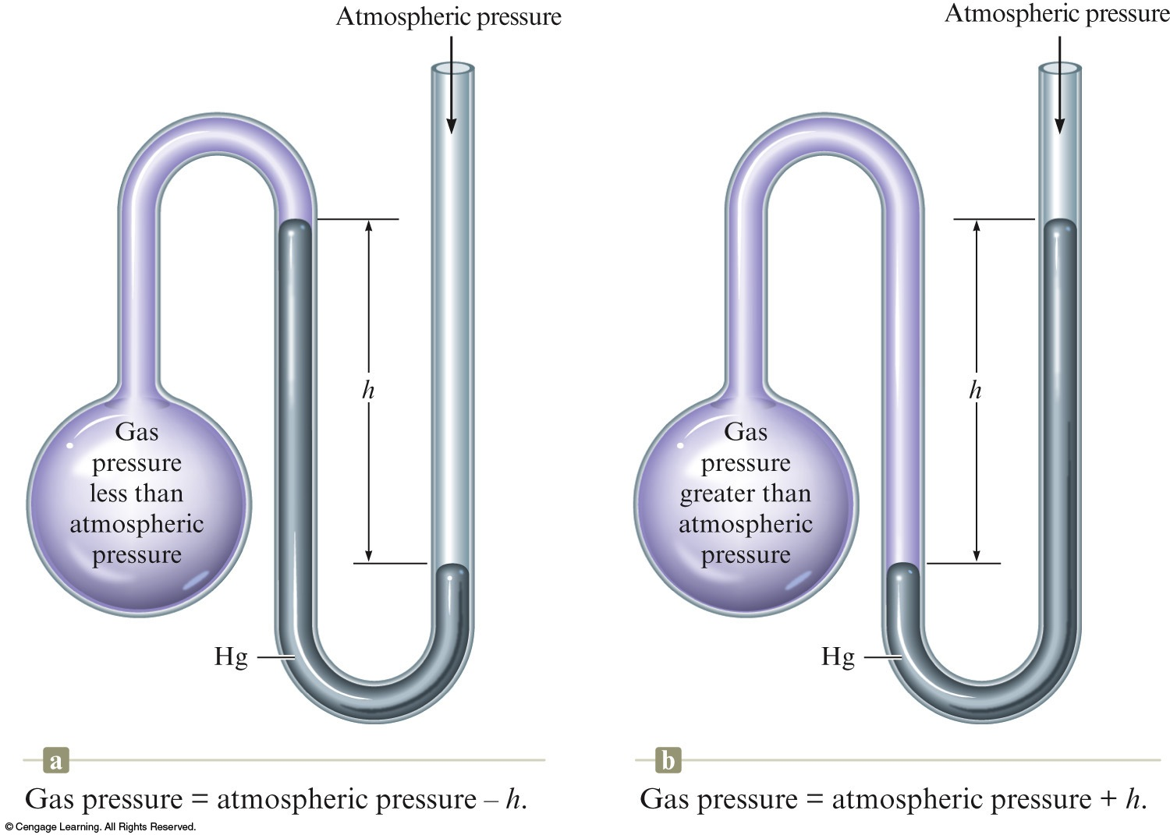
Manometer
Device used for measuring the pressure of a gas in a container.

Slide 7
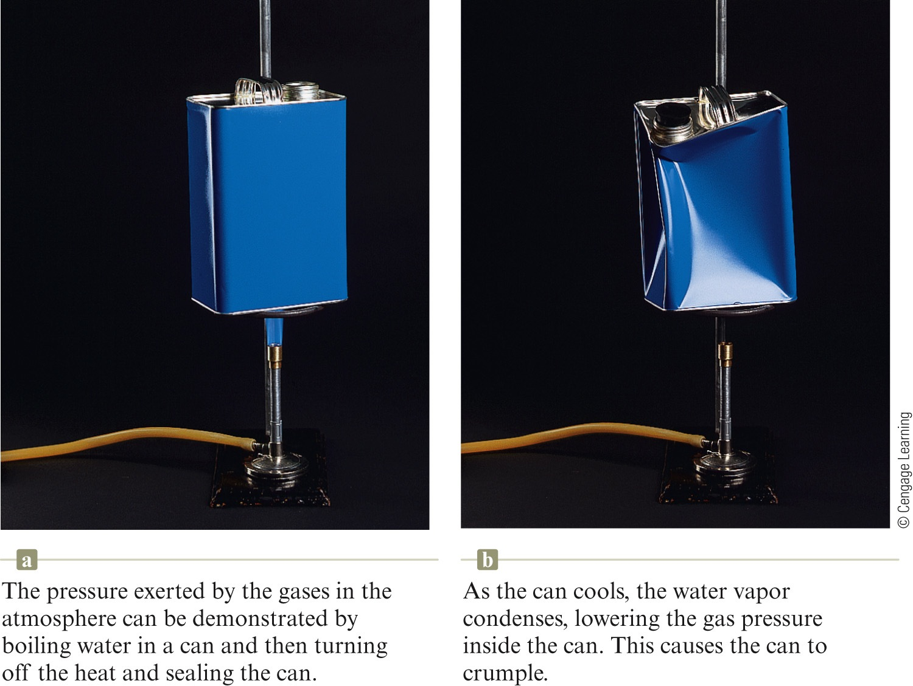
Collapsing Can

Slide 8
Pressure Conversions: An Example
The pressure of a gas is measured as 2.5 atm. Represent this pressure in both torr and pascals.
Where are we going?
We want to convert from units of atm to units of torr and units of pascals.
What do we know?
2.5 atm
What information do we need?
Equivalence statements for the units.

Slide 9
Pressure Conversions: An Example
The pressure of a gas is measured as 2.5 atm. Represent this pressure in both torr and pascals.
How do we get there?

Slide 10
Exercise
The vapor pressure over a beaker of hot water is measured as 656 torr. What is this pressure in atmospheres?
a) 1.16 atm
b) 0.863 atm
c) 0.756 atm
d) 0.500 atm
Notes:
The correct answer is b.
656 torr × (1 atm/760 torr) = 0.863 atm

Slide 11
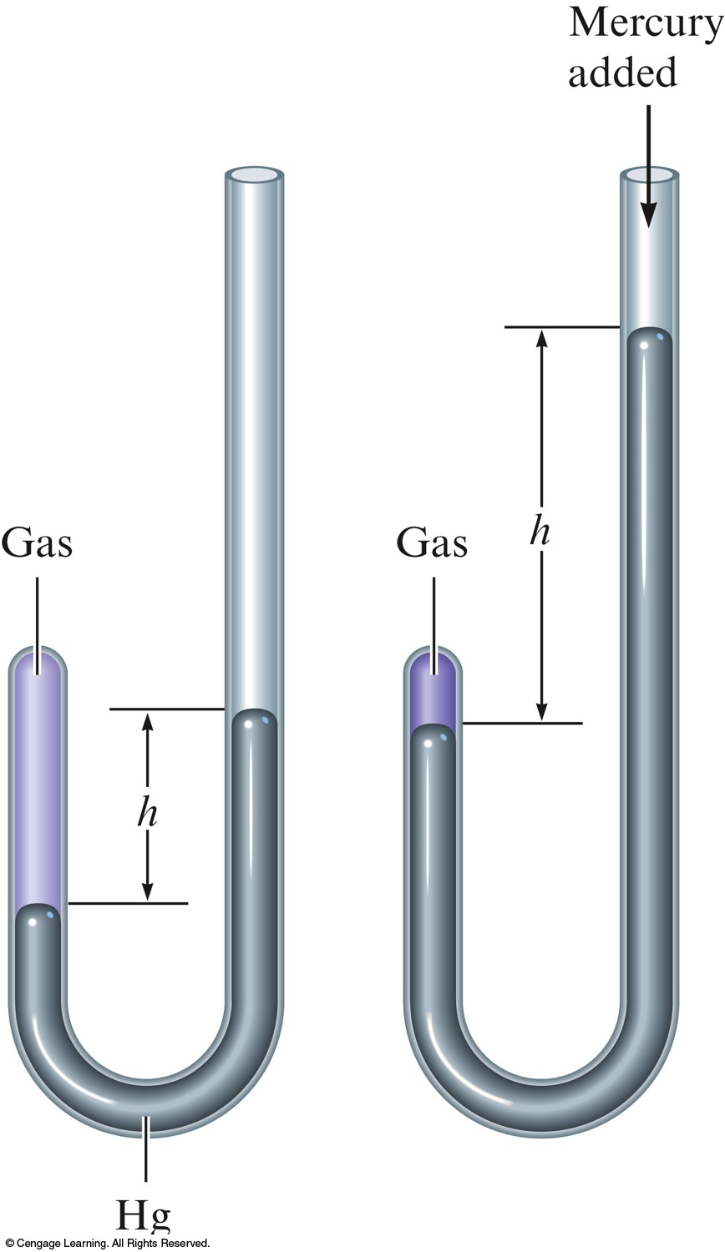
Robert Boyle’s Experiment

Slide 12
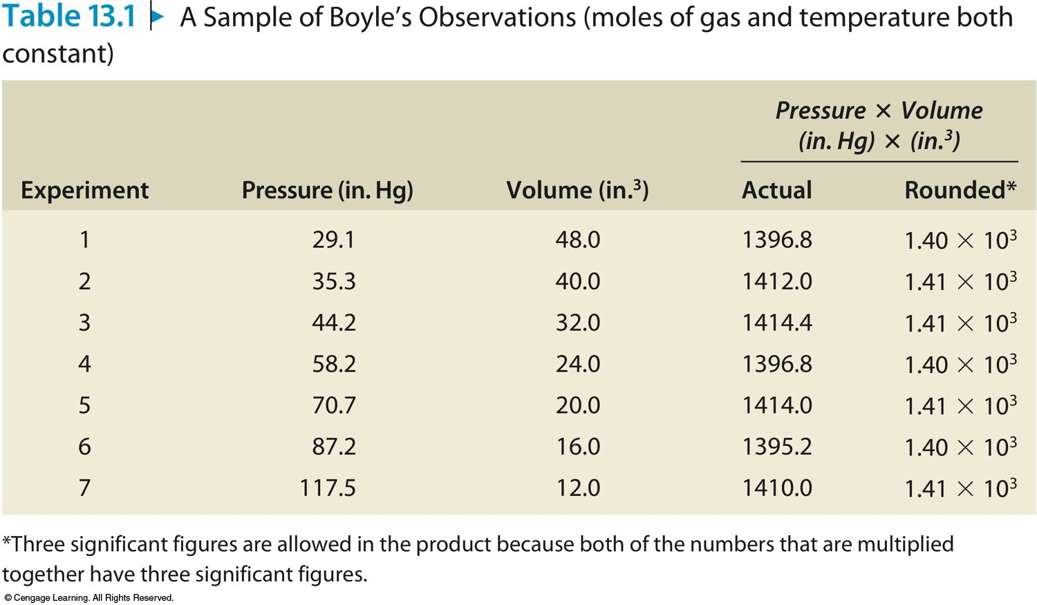
A Sample of Boyle’s Observations

Slide 13
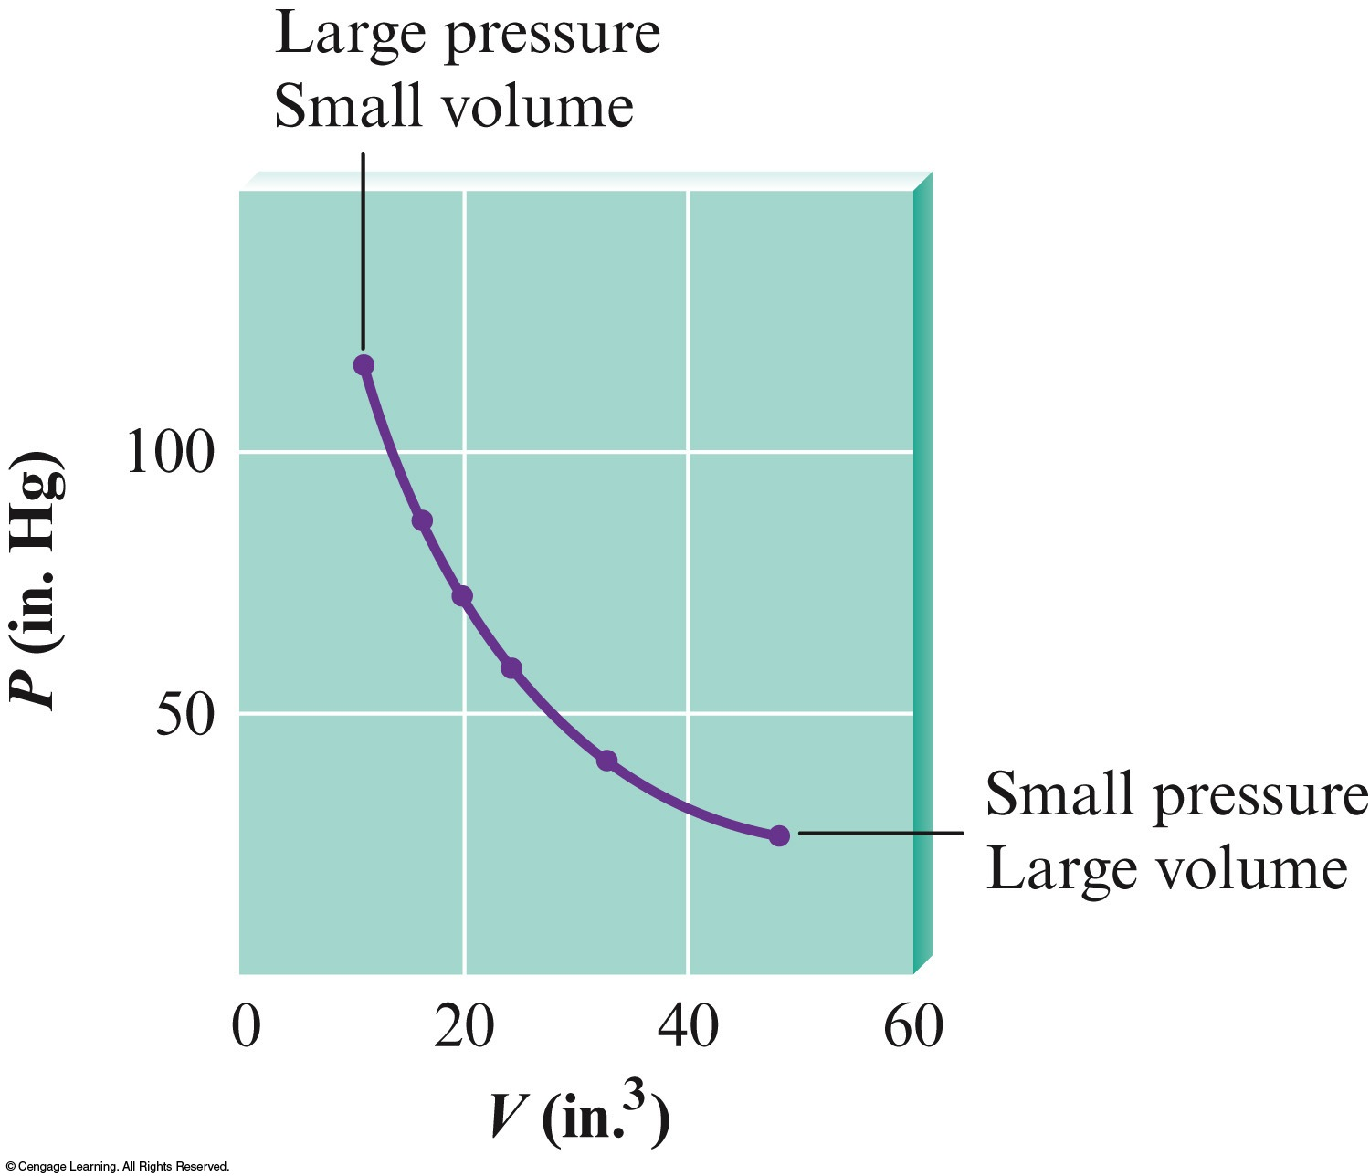
Graphing Boyle’s Results

Slide 14
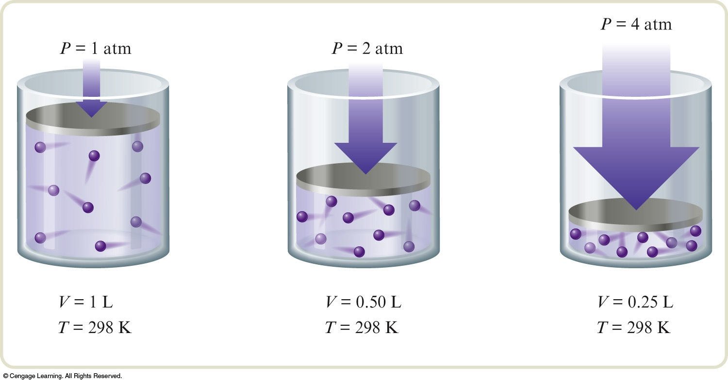
Boyle’s Law
Pressure and volume are inversely related (constant T, temperature, and n, # of moles of gas).
PV = k (k is a constant for a given sample of air at a specific temperature)

Slide 15
Exercise
A sample of helium gas occupies 12.4 L at 23°C and 0.956 atm. What volume will it occupy at 1.20 atm assuming that the temperature stays constant?
9.88 L
P₁V₁ = P₂V₂
(0.956 atm) (12.4 L) = (1.20 atm) (V₂)
V₂ = 9.88 L
Notes:
(0.956 atm)(12.4 L) = (1.20 atm)(V₂)
The new volume is 9.88 L.

Slide 16
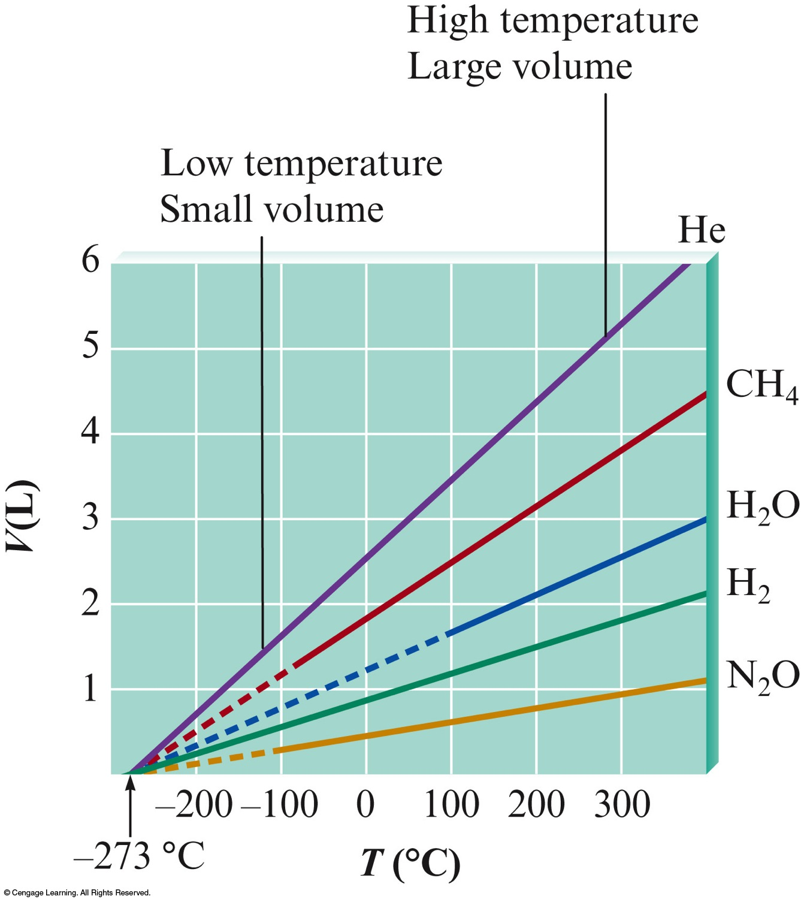
Graphing Data for Several Gases

Slide 17
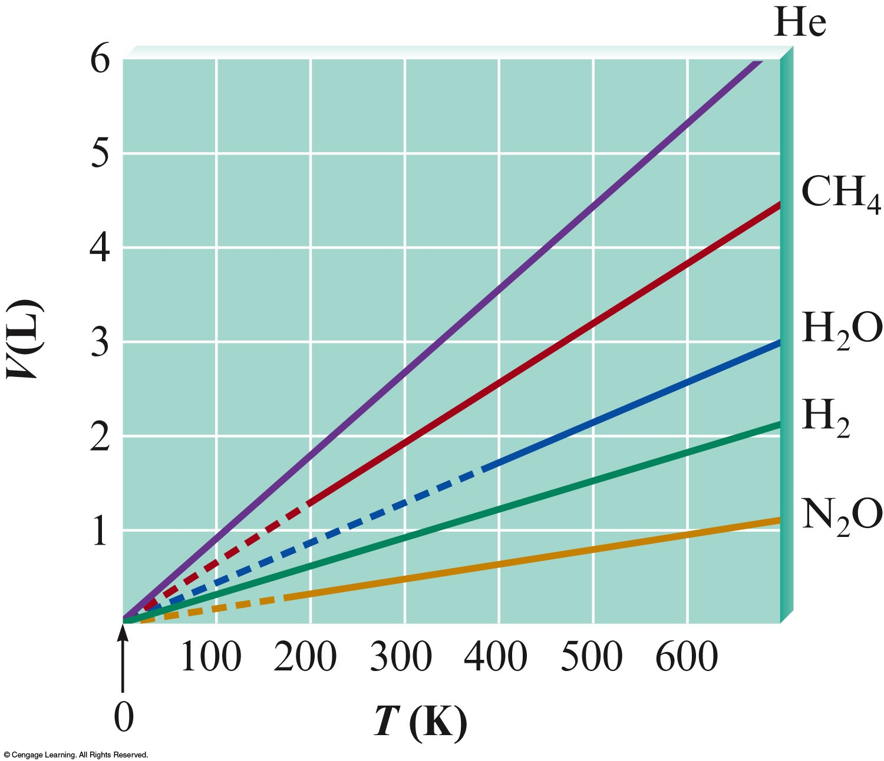
Graphing Data for Several Gases
It is easier to write an equation for the relationship if the lines intersect the origin of the graph.
Use absolute zero for the temperature.

Slide 18
Charles’s Law
Volume and Temperature (in Kelvin) are directly related (constant P and n).
V=bT (b is a proportionality constant)
K = °C + 273
0 K is called absolute zero.

Slide 19
Exercise
Suppose a balloon containing 1.30 L of air at 24.7°C is placed into a beaker containing liquid nitrogen at –78.5°C. What will the volume of the sample of air become (at constant pressure)?
0.849 L
Notes:
The new volume will become 0.849 L. Remember to convert the temperatures to Kelvin.
(1.30 L) / (24.7+273) = V₂ / (-78.5 + 273)

Slide 20
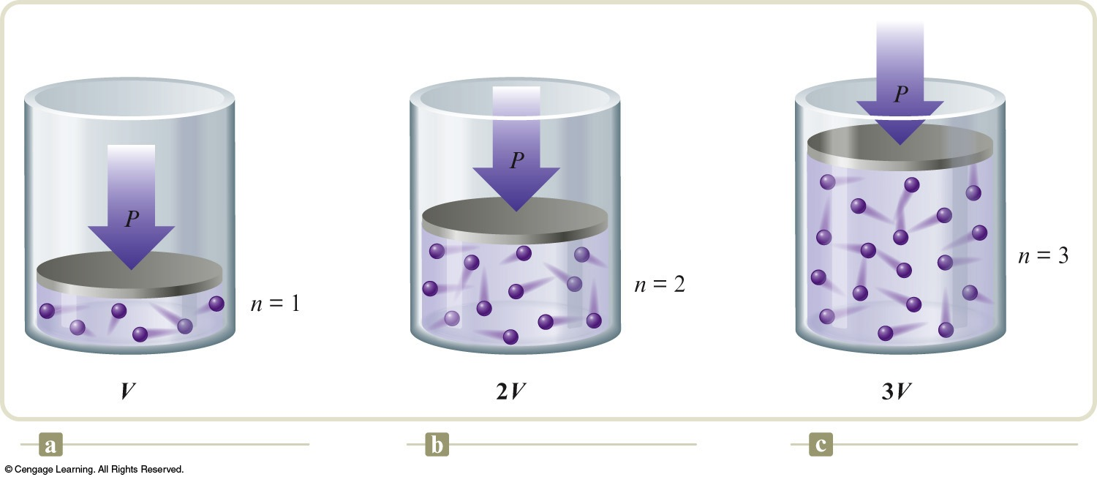
The Relationship Between Volume and Moles

Slide 21
Avogadro’s Law
Volume and number of moles are directly related (constant T and P).
V = an (a is a proportionality constant)

Slide 22
Exercise
If 2.45 mol of argon gas occupies a volume of 89.0 L, what volume will 2.10 mol of argon occupy under the same conditions of temperature and pressure?
76.3 L
Notes:
The new volume is 76.3 L.
(2.45 mol) / (89.0 L) = (2.10 mol) / (V₂)

Slide 23
We can bring all of these laws together into one comprehensive law:
V = bT (constant P and n)
V = an (constant T and P)
V = (constant T and n)
PV = nRT
(where R = 0.08206 L·atm/mol·K, the universal gas constant)

Slide 24
Exercise
An automobile tire at 23°C with an internal volume of 25.0 L is filled with air to a total pressure of 3.18 atm. Determine the number of moles of air in the tire.
3.27 mol
Notes:
The number of moles of air is 3.27 mol.
(3.18 atm)(25.0 L) = n(0.08206)(23+273)

Slide 25
Exercise
What is the pressure in a 304.0 L tank that contains 5.670 kg of helium at 25°C?
114 atm
Notes:
The pressure is 114 atm. Remember to convert kg of helium into moles of helium before using the ideal gas law.
(P)(304.0) = ([5.670×1000]/4.003)(0.0821)(25+273)

Slide 26
Exercise
At what temperature (in °C) does 121 mL of CO₂ at 27°C and 1.05 atm occupy a volume of 293 mL at a pressure of 1.40 atm?
696°C
Notes:
The new temperature is 696°C.
(1.05 atm)(121 mL) / (27+273) = (1.40 atm)(293 mL) / (T₂ + 273)

Slide 27
For a mixture of gases in a container,
P_{Total} = P₁ + P₂ + P₃ + . . .
The total pressure exerted is the sum of the pressures that each gas would exert if it were alone.

Slide 28
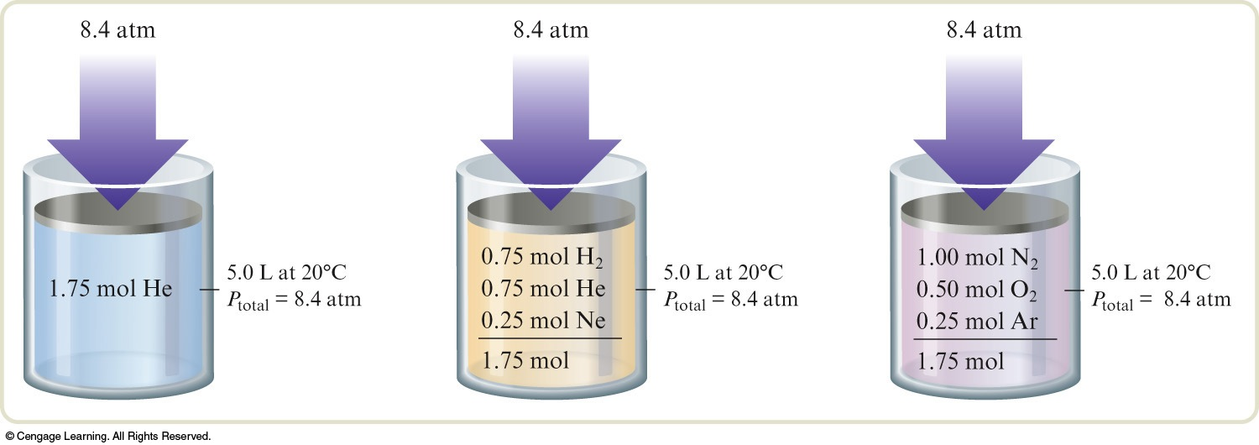
The pressure of the gas is affected by the number of moles of particles present.
The pressure is independent of the nature of the particles.

Slide 29
Two Crucial Things We Learn From This Are:
The volume of the individual particles is not very important.
The forces among the particles must not be very important.

Slide 30
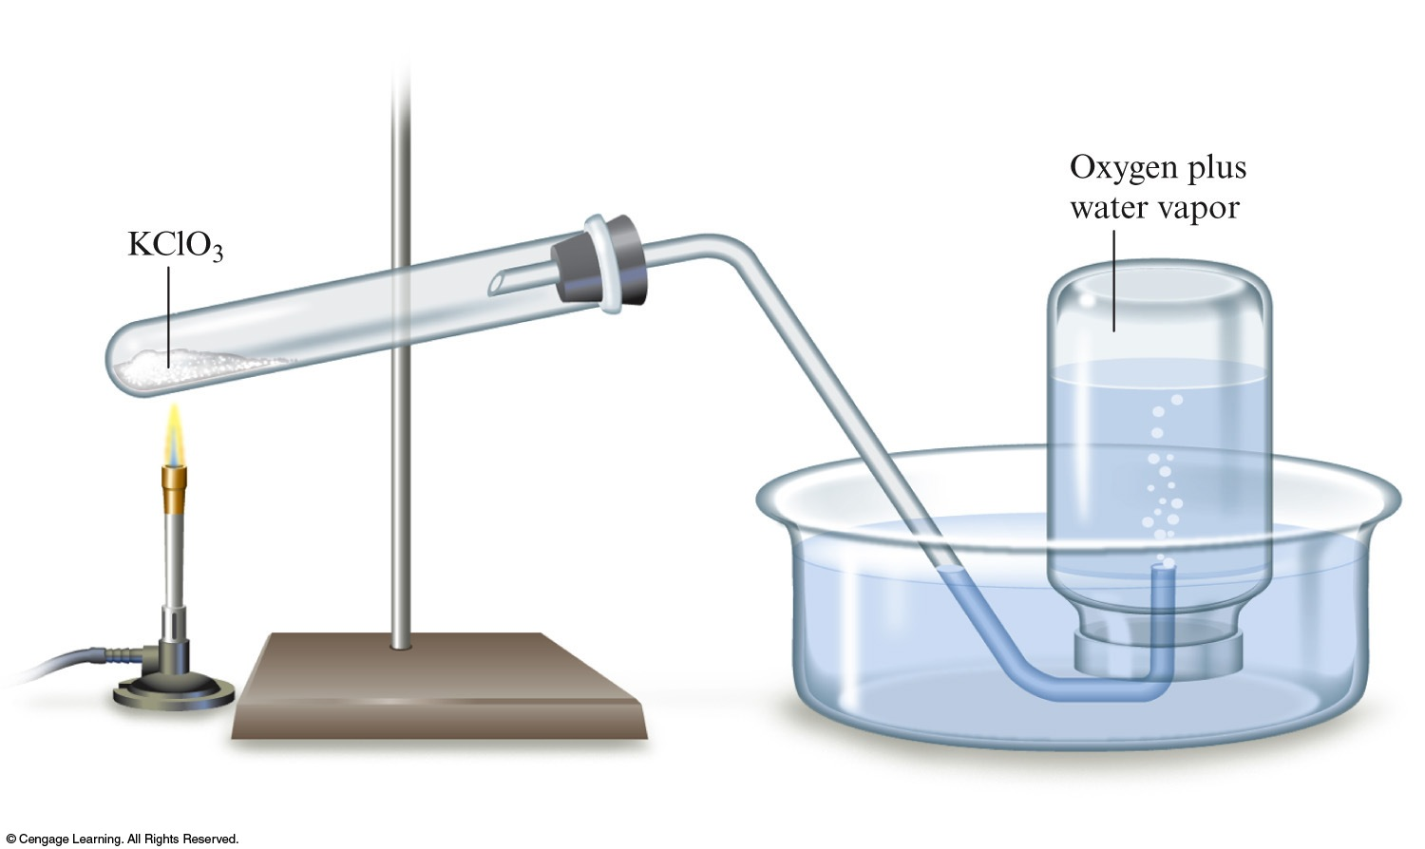
Collecting a Gas Over Water
Total pressure is the pressure of the gas + the vapor pressure of the water.

Slide 31
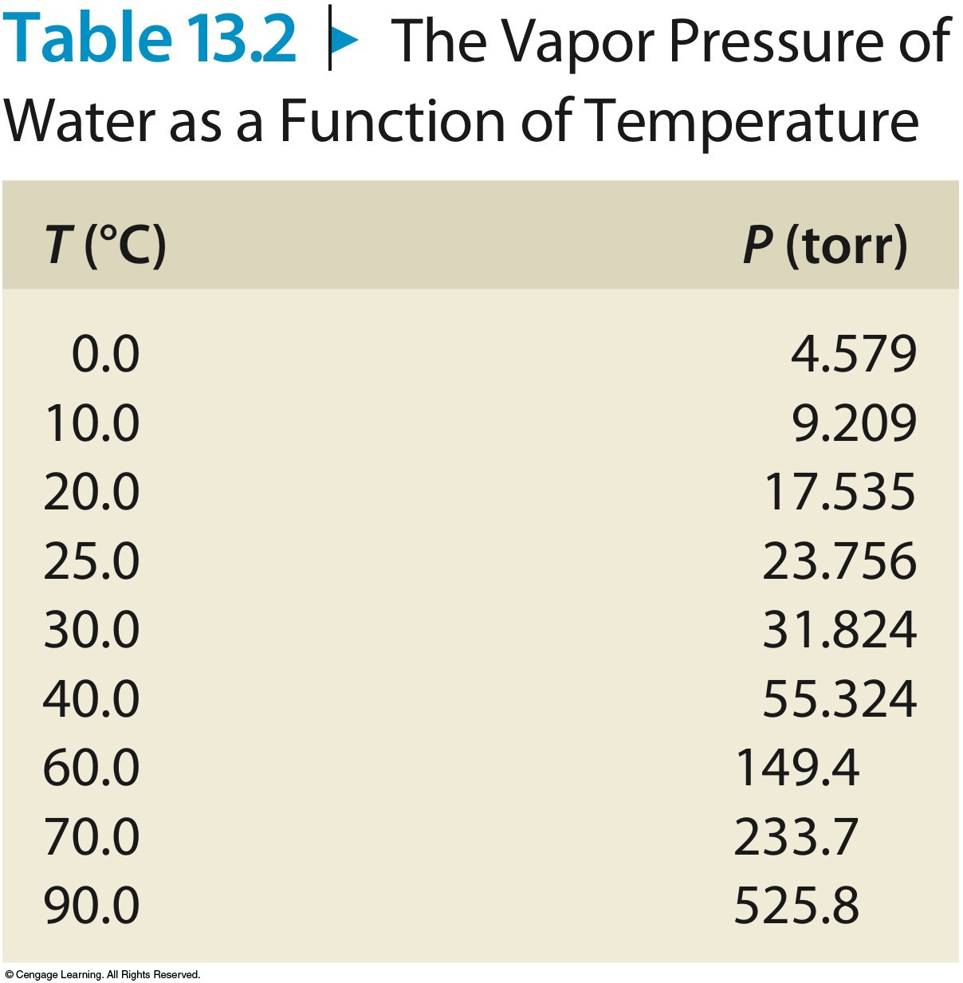
Collecting a Gas Over Water
How can we find the pressure of the gas collected alone?

Slide 32
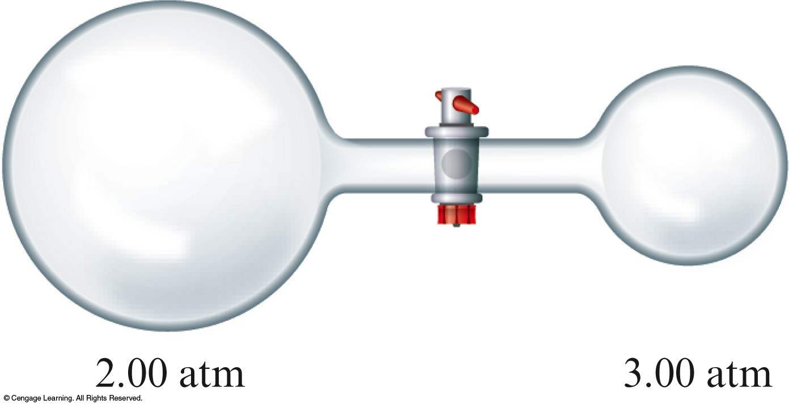
Exercise
Consider the following apparatus containing helium in both sides at 45°C. Initially the valve is closed.
After the valve is opened, what is the pressure of the helium gas?
P = 2.25 atm
Notes:
The pressure is 2.25 atm. There are two ways to solve the problem:
1) Find the new pressure of the gas on the left side after the valve is opened (P₁V₁=P₂V₂). The pressure becomes 1.50 atm.
(2.00 atm)(9.00 L) = (P₂)(9.00 L + 3.00 L)
P₂ = 1.50 atm
Find the new pressure of the gas on the right side after the valve is opened (P₁V₁=P₂V₂). The pressure becomes 0.75 atm.
(3.00 atm)(3.00 L) = (P₂)(9.00 L + 3.00 L)
P₂ = 0.75 atm
The total pressure is therefore 1.50 + 0.75 = 2.25 atm.
2) Find the number of moles in each chamber separately (using PV = nRT), add the number of moles and volumes on each side, then use PV = nRT to solve for the new pressure.

Slide 33
Exercise
27.4 L of oxygen gas at 25.0°C and 1.30 atm, and 8.50 L of helium gas at 25.0°C and 2.00 atm were pumped into a tank with a volume of 5.81 L at 25°C.
Calculate the new partial pressure of oxygen.
6.13 atm
Calculate the new partial pressure of helium.
2.93 atm
Calculate the new total pressure of both gases.
9.06 atm
Notes:
For oxygen:
P₁V₁=P₂V₂
(1.30 atm)(27.4 L) = (P₂)(5.81 L)
P₂ = 6.13 atm
For helium:
P₁V₁=P₂V₂
(2.00 atm)(8.50 L) = (P₂)(5.81 L)
P₂ = 2.93 atm
The total pressure is therefore 6.13 + 2.93 = 9.06 atm.

Slide 34
Scientific Method
A law is a generalization of observed behavior.
Laws are useful – We can predict behavior of similar systems.

Slide 35
A model can never be proved absolutely true.
A model is an approximation and is destined to be modified.

Slide 36
So far we have considered “what happens,” but not “why.”
In science, “what” always comes before “why.”

Slide 37
Postulates of the Kinetic Molecular Theory
1. Gases consist of tiny particles (atoms or molecules).

Slide 38
Postulates of the Kinetic Molecular Theory
2. The particles are so small, compared with the distances between them that the volume (size) of the individual particles can be assumed to be negligible (zero).

Slide 39
Postulates of the Kinetic Molecular Theory
3. The particles are in constant random motion, colliding with the walls of the container. These collisions with the walls cause the pressure exerted by the gas.

Slide 40
Postulates of the Kinetic Molecular Theory
4. The particles are assumed not to attract or to repel each other.

Slide 41
Postulates of the Kinetic Molecular Theory
5. The average kinetic energy of the gas particles is directly proportional to the Kelvin temperature of the gas.

Slide 42
Meaning of temperature
Kelvin temperature is directly proportional to the average kinetic energy of the gas particles.
Relationship between Pressure and Temperature
Gas pressure increases as the temperature increases because the particles speed up.
Relationship between Volume and Temperature
Volume of a gas increases with temperature because the particles speed up.

Slide 43
Concept Check
You are holding two balloons of the same volume. One contains helium, and one contains hydrogen. Complete each of the following statements with “different” or “the same” and be prepared to justify your answer.
He
H₂

Slide 44
Concept Check
Complete the following statement with “different” or “the same” and be prepared to justify your answer.
The pressures of the gas in the two balloons are __________.
He
H₂
the same
Notes:
the same

Slide 45
Concept Check
Complete the following statement with “different” or “the same” and be prepared to justify your answer.
The temperatures of the gas in the two balloons are __________.
He
H₂
the same
Notes:
the same

Slide 46
Concept Check
Complete the following statement with “different” or “the same” and be prepared to justify your answer.
The numbers of moles of the gas in the two balloons are __________.
He
H₂
the same
Notes:
the same

Slide 47
Concept Check
Complete the following statement with “different” or “the same” and be prepared to justify your answer.
The densities of the gas in the two balloons are __________.
He
H₂
different
Notes:
different

Slide 48
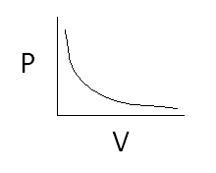
Concept Check
Sketch a graph of:
Pressure versus volume at constant temperature and moles.

Slide 49
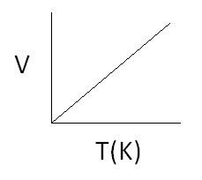
Concept Check
Sketch a graph of:
II. Volume vs. temperature (K) at constant pressure and moles.

Slide 50
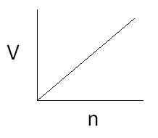
Concept Check
Sketch a graph of:
III. Volume vs. moles at constant temperature and pressure.

Slide 51
Concept Check
V_{Ne} = 2V_{Ar}
Ne
Which of the following best represents the mass ratio of Ne:Ar in the balloons?
a) 1:1
b) 1:2
c) 2:1
d) 1:3
e) 3:1
Ar
Notes:
1:1

Slide 52
Concept Check
You have a sample of nitrogen gas (N₂) in a container fitted with a piston that maintains a pressure of 6.00 atm. Initially, the gas is at 45°C in a volume of 6.00 L.
You then cool the gas sample.

Slide 53
Concept Check
Which best explains the final result that occurs once the gas sample has cooled?
The pressure of the gas increases.
The volume of the gas increases.
The pressure of the gas decreases.
The volume of the gas decreases.
Both volume and pressure change.
Notes:
The correct answer is d.

Slide 54
Concept Check
The gas sample is then cooled to a temperature of 15°C. Solve for the new condition. (Hint: A moveable piston keeps the pressure constant overall, so what condition will change?)
5.43 L
Notes:
The new volume is 5.43 L (use Charles’s law to solve for the new volume).
(6.00 L) / (45+273) = (V₂) / (15+273)

Slide 55
Molar Volume of an Ideal Gas
For 1 mole of an ideal gas at 0°C and 1 atm, the volume of the gas is 22.42 L.
STP = standard temperature and pressure
0°C and 1 atm
Therefore, the molar volume is 22.42 L at STP.

Slide 56
Exercise
A sample of oxygen gas has a volume of 2.50 L at STP. How many grams of O₂ are present?
3.57 g
Notes:
3.57 g of O₂ are present.
(1.00 atm)(2.50 L) = n(0.08206)(273)
n = 0.112 mol O₂ × 32.00 g/mol = 3.57 g O₂
OR
2.50 L O₂ × (1 mol O₂/22.4 L O₂) × (32.00 g O₂/mol) = 3.57 g O₂

Slide 57
Exercise
Consider the following reaction:
If 15.00 g of solid zinc reacts with 100.0 mL of 4.00 M hydrochloric acid, what volume of hydrogen gas is produced at 25°C and 1.00 atm?
a) 0.200 L
b) 4.89 L
c) 5.61 L
d) 9.78 L
Notes:
The correct answer is b. First determine the limiting reactant. There are 0.229 mol Zn and 0.400 mol HCl present. Since twice the amount of HCl is required, HCl is the limiting reactant. This determines how much H₂ gas is produced. Once the amount of H₂ is determined, use the Ideal Gas Law equation to determine the volume.

