Slide 1
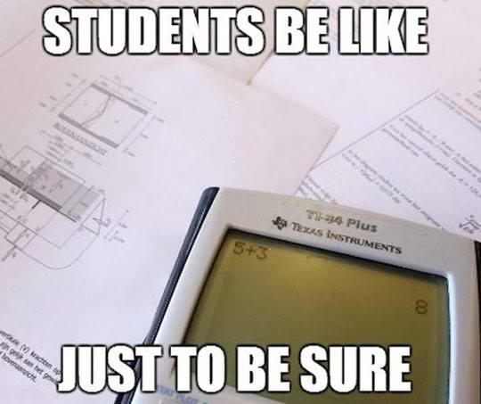
Mental Math and Units

Slide 2
AP Chemistry Exam
Multiple Choice Section
60 M/C questions over the 6 big ideas
Conceptual and calculations
NO CALCULATOR
Free Response
7 free response questions
Points for Set-up, calculation, significant figures and UNITS
This year your Unit Exams will have multiple choice and free response questions
Multiple Choice: NO Calculator
Free Response: No units=no credit

Slide 3
All values need units!!
Set-up each problem to determine units for final answer:
PV=NRT
(1.0atm)(1.0L) = (.25mol)(0.08206L atm mol⁻¹ K⁻¹) T?
T = (1.0atm)(1.0L) (.25mol)(0.08206L atm) mol K
T = 49K
Or use dimensional analysis for conversions:
The molar heat of fusion of water is 6.006kJ/mol. How much energy is needed to covert 60grams of ice at 0ºC to liquid water at 0ºC?
60g H₂O 1 mole H₂O 6.009kJ 18.0g H₂O 1 mol H₂O
= 20kJ
Convert to J = 20,000J

Slide 4
Multiplication (distribution)
Rearranging multiplication problems often simplifies the process when using “big” numbers.
15 x 75 = (10+5) x 75 = (10x75) + (5x75) = 750 + 375 = 1125
9 x 14 =
7 x 18 =

Slide 5
Rounding
32.2g/61.054L Calculate the density of the substance.
88.4mol/10.7L Calculate the concentration.

Slide 6
Bounding when your values are not “easily” round-able
2.256g/4.00g/mol. Calculate the number of moles.
3.47mol/12.0g/mol. Calculate the number of moles.

Slide 7
Scientific Notation
Multiplication
Add exponents
(10^{y})(10^{x}) = 10^{(y+z)}
Division
Subtract exponents
(10^{y})/(10^{x}) = 10^{(y-x)}
Exponents
(10^{y})³ = 10^{(3y)}
Distribution
(2x10^{y})³ = 2³ x 10^{3y}

Slide 8
Scientific Notation
0.0375L x 0.0000000060M. Calculate the number of moles
K_{eq} = 0.000000088 / (0.000002)³. Calculate the K_{eq}

Slide 9
Know your fractions!
1/8 = 0.125
¼ = 0.25
3/8 = 0.375
½ = 0.5
5/8 = 0.625
¾ = 0.75
7/8 = 0.875
1/3 = 0.333
2/3 = 0.667
1/9 = 0.111
2/9 = 0.222
3/9 = 0.333
4/9 = 0.444
5/9 = 0.555
6/9 = 0.666
7/9 = 0.777
8/9 = 0.888

Slide 10
Fractions
0.667 mol / 12.0 g/mol. Calculate the mass in grams
2.4 mol / 0.75L. Calculate the concentration in M
K_{eq} = 5.0x10⁵. What is the K_{eq} for the reverse reaction (inverse)

Slide 11
Factor
5.40g/ 12.0 g/mol. Calculate the number of moles
8.4g / 28g/mol. Calculate the number of moles

Slide 12
Logarithms
log 10^{x} = X
log (1x10^{x}) = X
log 1 + log 10^{x} = X
A solution with [H₃O⁺] = 0.0000125M. Calculate the pH

Slide 13
Logarithms
A solution with [H₃O⁺] = 0.0000000875M. Calculate the pH
[H₃O⁺] = (0.0000545)^{1/3} Calculate the pH

Slide 14
HINTS:
Eliminate very small or large numbers by using scientific notation
0.0075 = 7.5x10⁻³
Split problems into parts
0.0075mol x 110 g/mol
(75 x 110) x 10⁻⁴
((70x110) + (5x110)) x 10⁻⁴
(7700 + 550) x 10⁻⁴
8250 x 10⁻⁴ = 0.8250g

